Slide 1
NTMS Microwave Activity Day March 18, 2023
Stations heard on frequency
Al - W5LUA - 10, 24, 47 GHz
Scott – AA5AM – 10, 24, 47 GHz
Greg – AA5C – 10, 24, 47 GHz
Keith – WB5ZDP – 10 Ghz
Pat – W5VY/R – 10 GHz
Brad – WQ5S/R – 10, 24 GHz
Al – W5RLG – 10 Ghz
Paul – WA5WCP/R – 10 GHz
Jim – KM5PO/R – 10, 24, 47 GHz
Paul – KI5EMN/R – 10 GHz

Slide 2
Rover Grids
WQ5S – EM13gh - Decatur
W5VY – EM24tq, EM24qq – Queen Wilhelmina Lodge (Rich Mtn)
WA5WCP – EM12mq55 – Interstate 20/Hwy 408 split
KM5PO/KI5EMN – EM12hw, EM13nl, EM13th, EM12sv – Haslet, Tioga, Blue Ridge, Rockwall

Slide 3
Initial check out on 47 GHz
First contacts on new 47 GHz equipment
Date | Time | Stn 1 | Stn 1 grid | Stn 1 loc | Stn 2 | Stn 3 grid | Stn 2 loc | DX
3/17/2023 | 16:35 | W5LUA | EM13qc68il | Allen, TX | KM5PO/R | EM13td37cv | Farmersville, TX | 21.23 km
3/17/2023 | 19:00 | W5LUA | EM13qc68il | Allen, TX | KM5PO/R | EM13wh12nv | Celeste, TX | 47.54 km

Slide 4
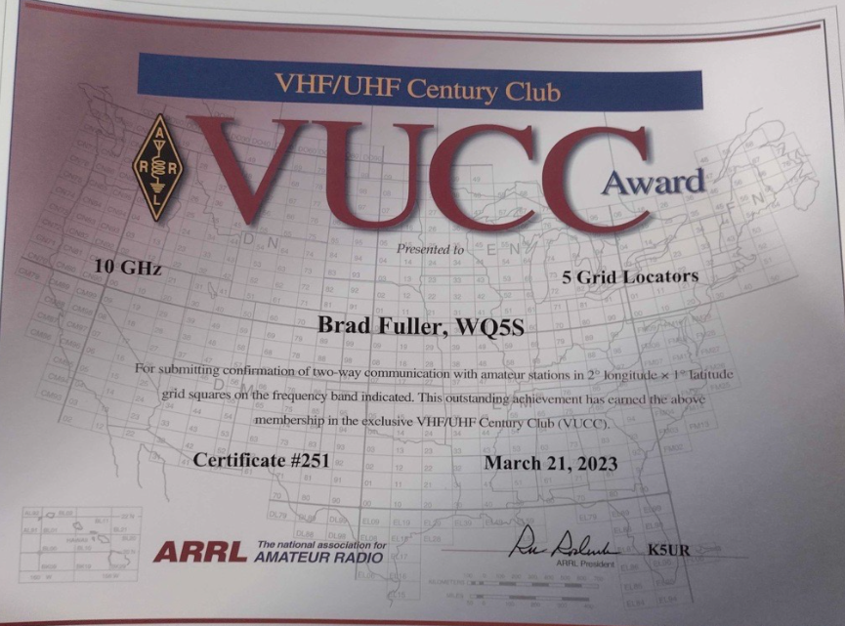
Accomplishments
WQ5S earned VUCC on 10 GHz by acquiring 5th grid

Slide 5
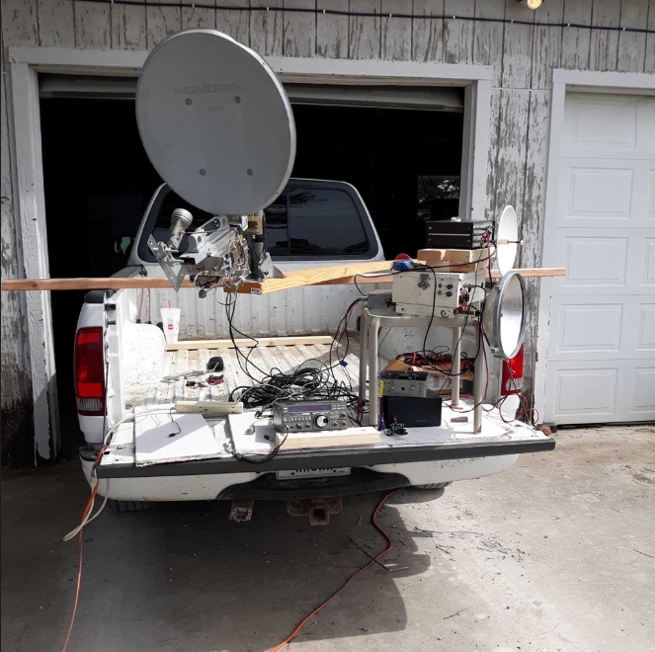
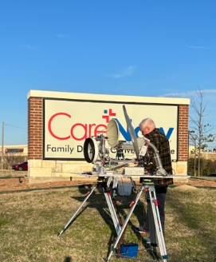
Accomplishments
AA5AM Blue Ridge ground level to KM5PO/R Rockwall – 24 GHz

Slide 6
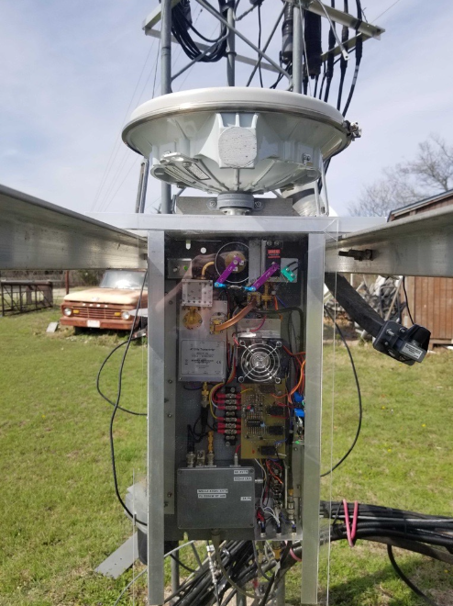
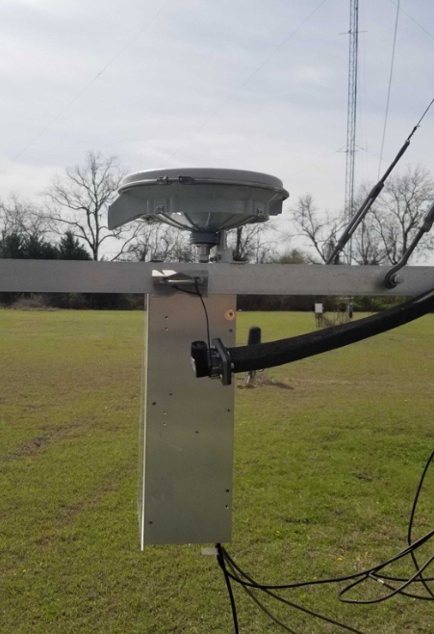
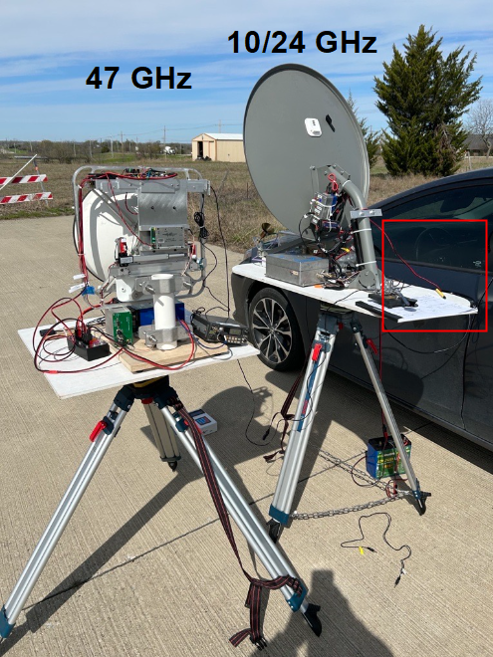
Accomplishments
W5LUA to KM5PO/R on 47GHz– 47 on 47
Al made 5 contacts total on 47 GHz

Slide 7
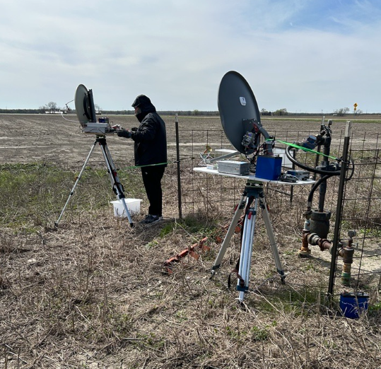
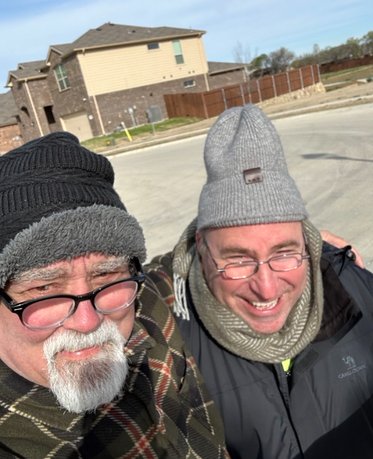
Challenges overcome
Cold – windy conditions
Gear tied to T-posts at Tioga TX

Slide 8
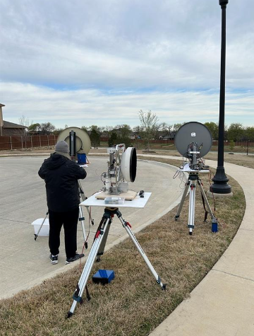
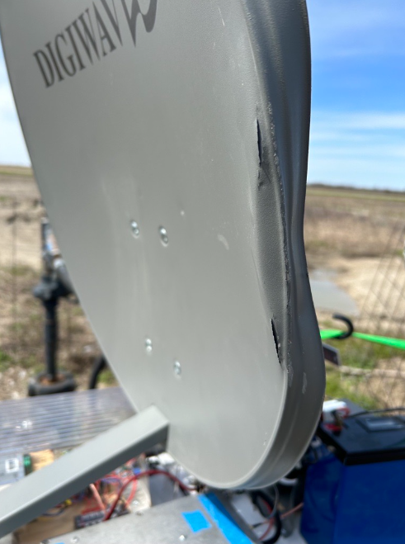
Challenges overcome
Tripod tip-over caused IF radio to lose TX ability

Slide 9
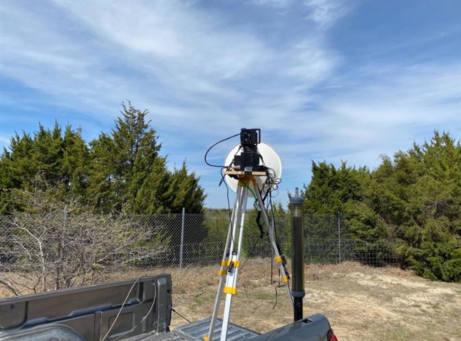
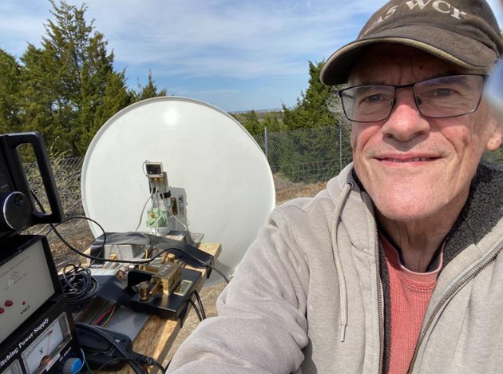
Winter MAD fun
Paul at EM12mq55 – Interstate 20 & Hwy 408

Slide 10
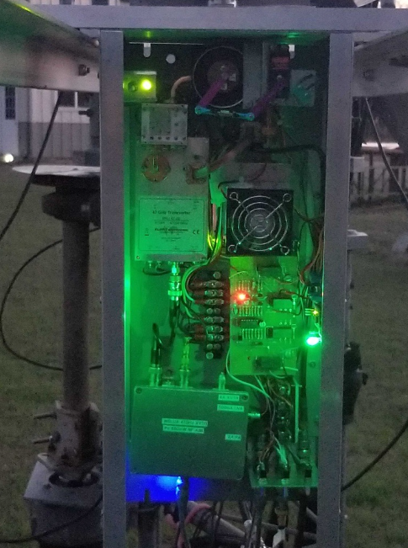
Winter MAD fun
Al’s (W5LUA) 47 GHz terrestrial rig glows in the dark!

Slide 11
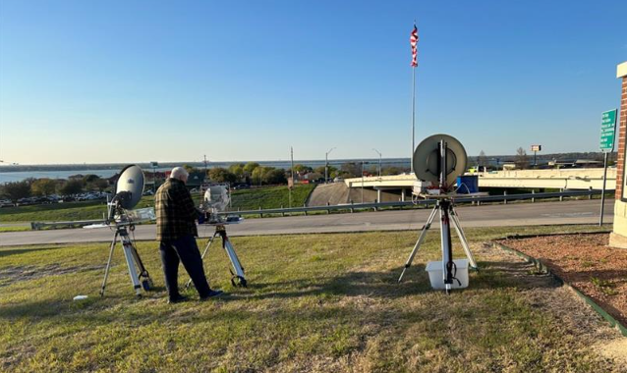
Winter MAD fun
Looking toward Greg AA5C from Rockwall Texas

Slide 12
Next NTMS MAD
May 27th
7 weeks away
Could be a rain-scatter weekend
KM5PO/R: EM11, EM01, EM02, EM03, EM04
Others?

Slide 13
Questions, Suggestions, Discussion?
WWW.NTMS.ORG
13

