Slide 1
24/47 GHz TWT Power Supplies
W5LUA
February 6, 2021

Slide 2
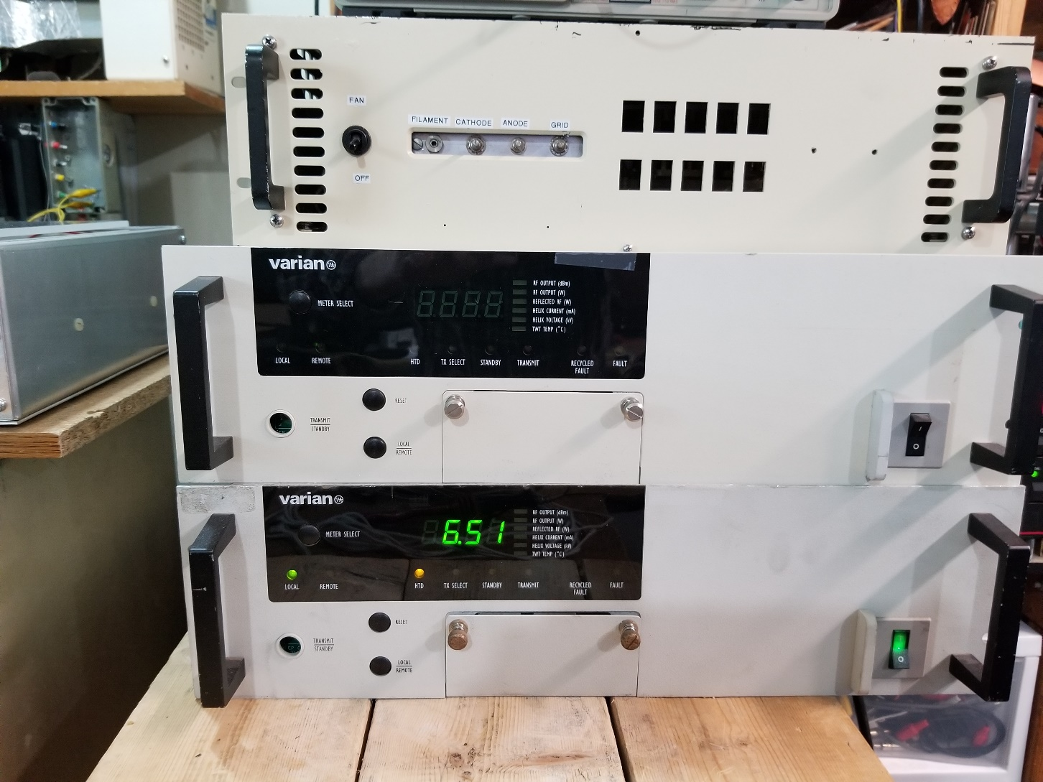
VPW2931 Power Supplies
Auxiliary power supply for lowering collector voltages for my tube
This power supply had been used for years to power my 30 watt 47 GHz tube but last November the PS developed a HV short that took out some logic circuitry
This one powers an Alelco 100 watt 24 GHz tube for terrestrial

Slide 3
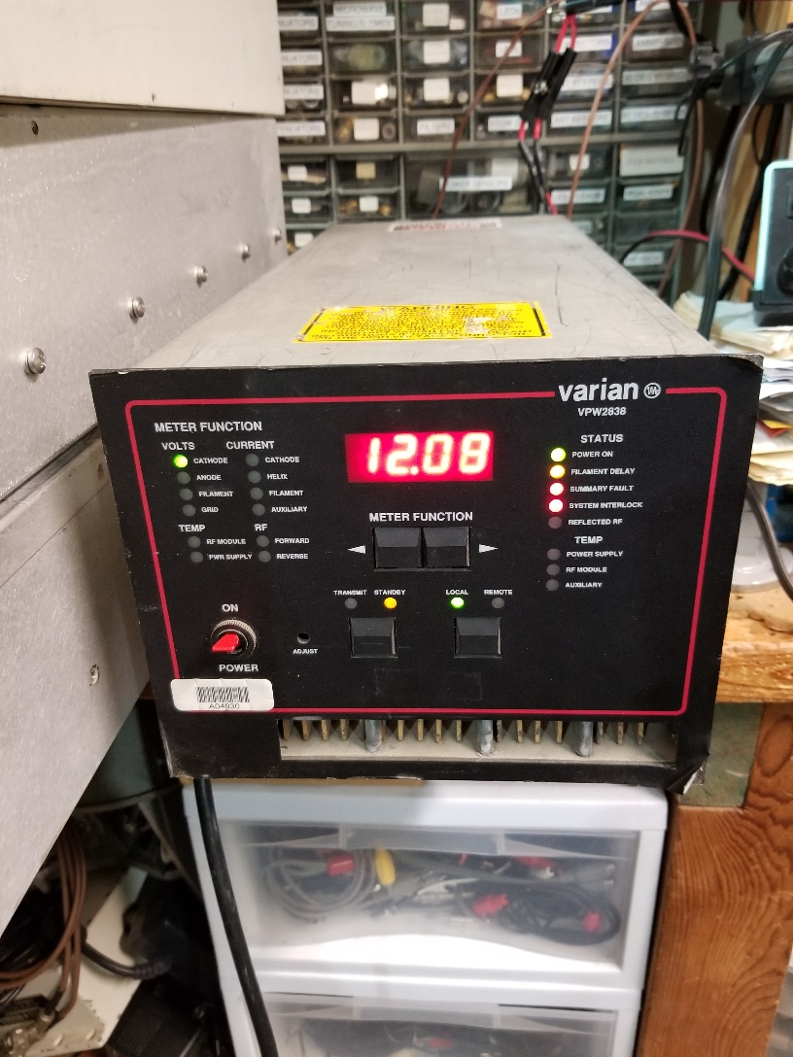
VPW2838 Power Supply
This power supply has potential but all I have done is an initial turn-on.
Until recently, we did not have a lot of information on this power supply

Slide 4
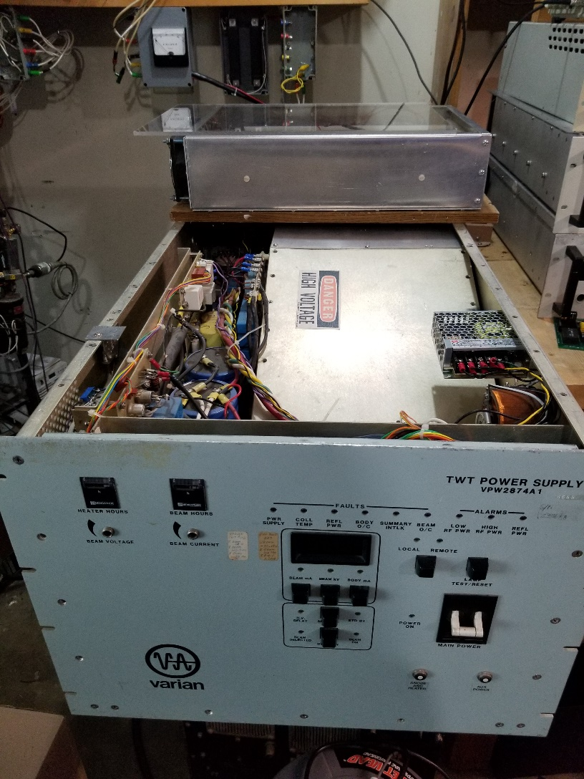
VPW2874 Power Supply
This power supply has the most potential and is the one I am modifying at present for my 47 GHz twt. This unit can supply 24 KV at 200 ma for 28 GHz applications
All 3 types of these supplies were designed for single depressed collector 100W 28 GHz tubes.
My 47 GHz tube is a dual depressed collector tube with different voltages
I built an external auxiliary collector power supply that allows me to optimize voltages for my 47 GHz tube.

Slide 5
Power Supply & TWT
Presently working rise time issues when switching off tube. Small spike in helix current due to defocusing of helix during transition.
The 90 ft of cable has a measured 4400 pF of capacitance from grid to cathode. The grid supply is a relatively high impedance source.

Slide 6
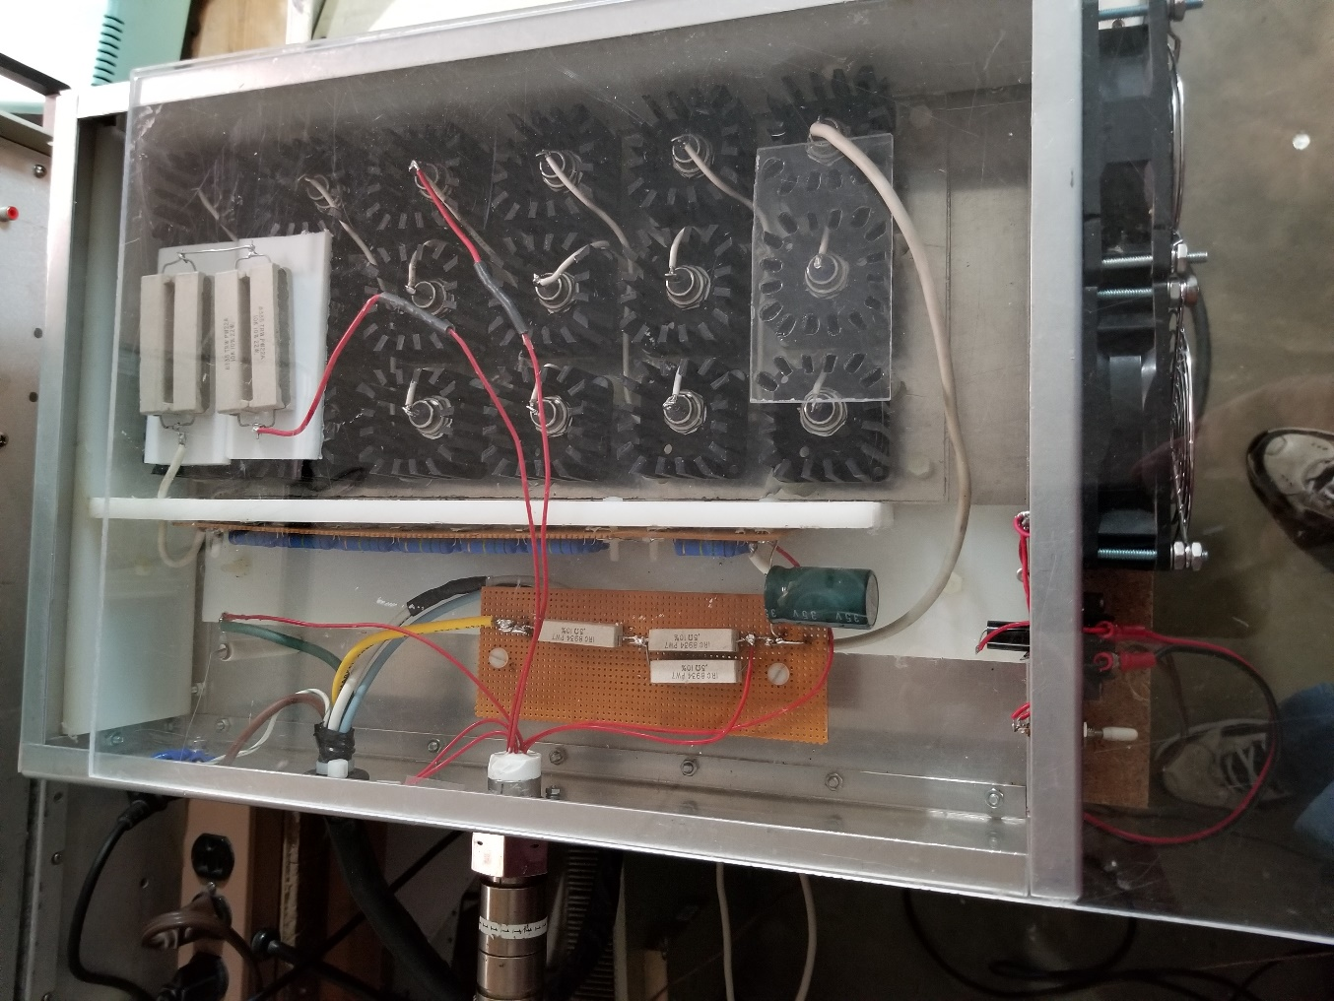
Auxiliary PS for VPW2874 PS
Rowe HV connector from 90 ft cable to twt out at feedpoint
Resistors to drop filament voltage at tube to 5.6V
18 X 200V 50 watt Zener diodes drop collector voltage from a nominal 7200V down to 5600V for collector #1 and 3600V for collector #2. Resistors are used to drop collector #2 voltage to 3500V. Collector #2 current ~ 44mA. All voltages are referenced to cathode which is sitting at -14200V w.r.t. ground

Slide 7
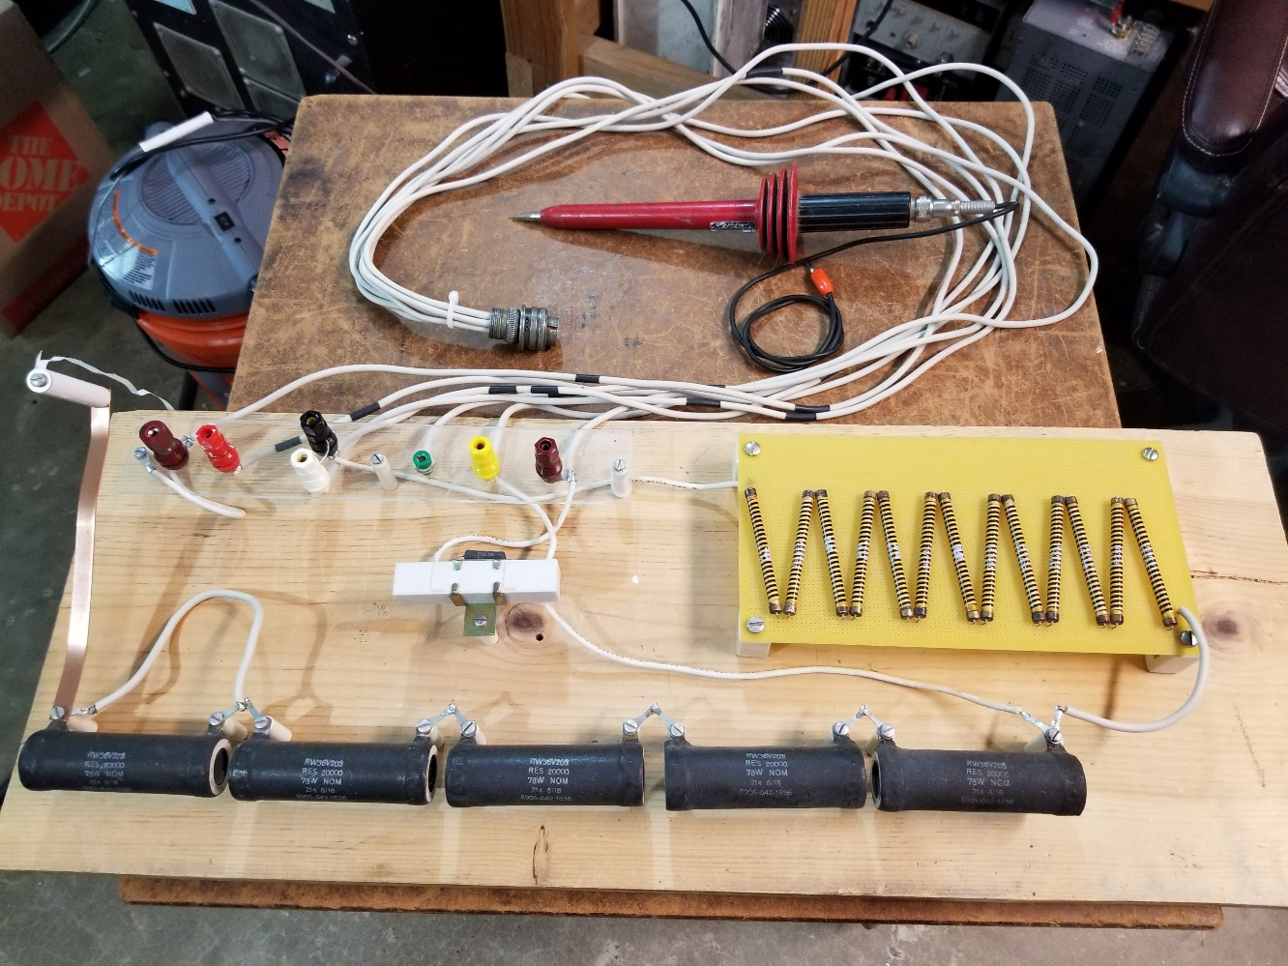
Power Supply Dummy Load
15kv Rowe HV connector
15kv Wire
100X HV Probe
High Voltage switch with tag line
Filament Load
Helix Load
Collector Load
1”X 12” Wood

Slide 8
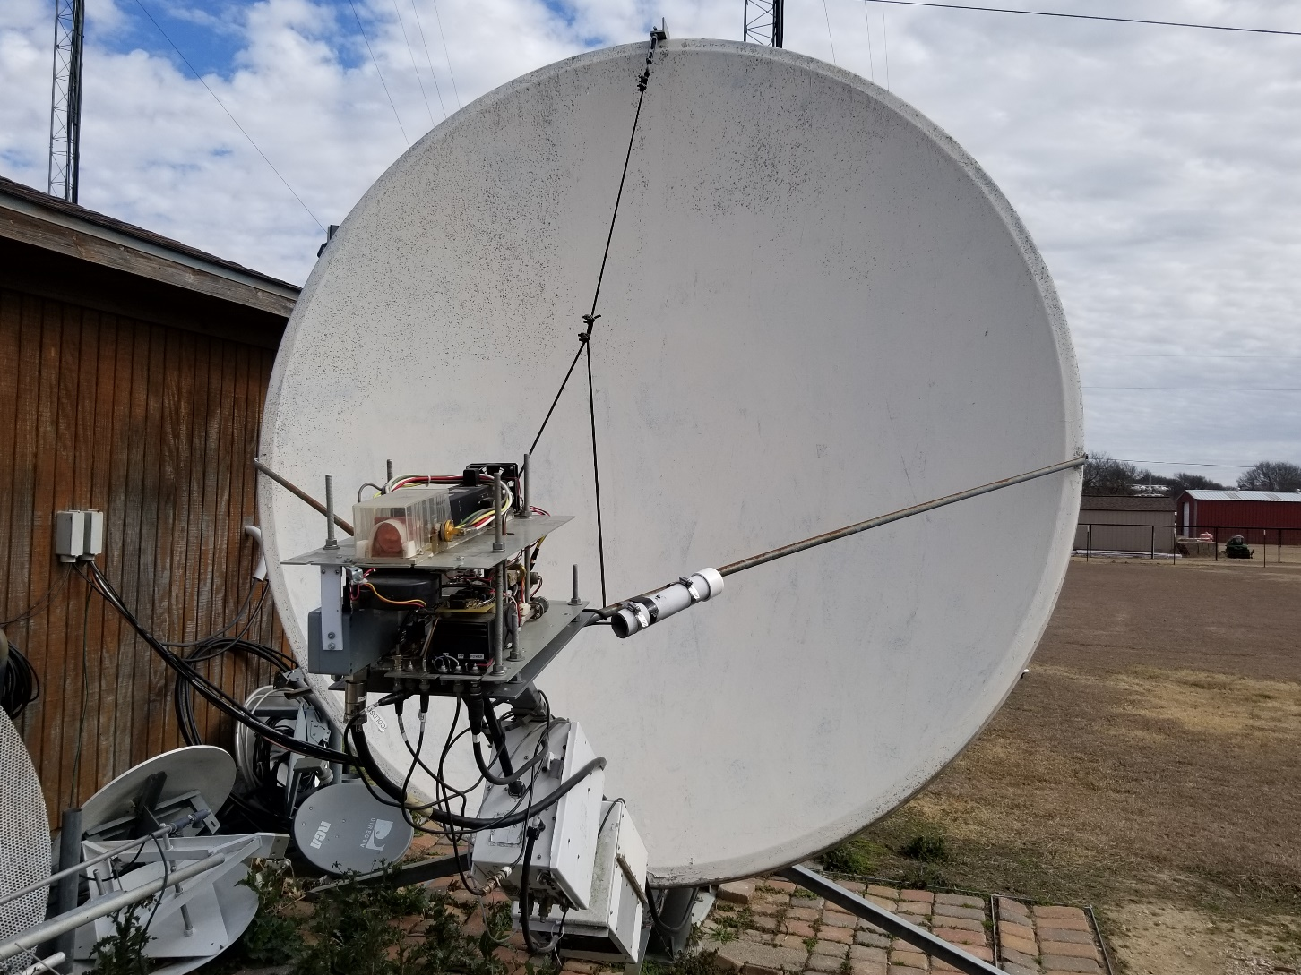
47 GHz EME
2.4 m Offset fed dish fed with W2IMU Feed
Dish also used on 24 & 76 GHz
47 GHz xvtr with 30 watt TWT
24 GHz XVTR
24 GHz 100W TWT

Slide 9
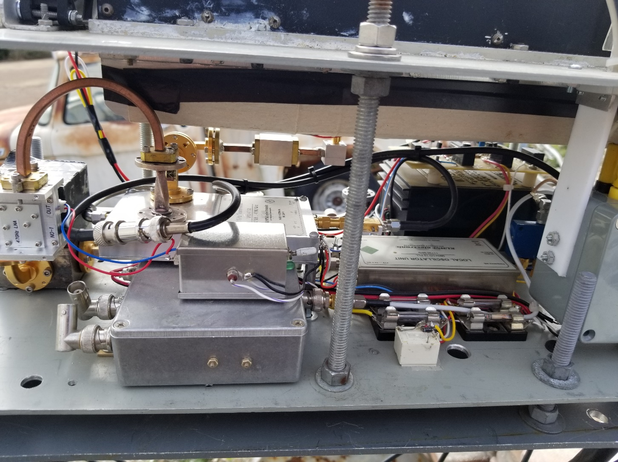
Closeup of 47 GHz XVTR
DB6NT XVTR
DB6NT LO
JA8CMY LNA
NF < 2 dB

Slide 10
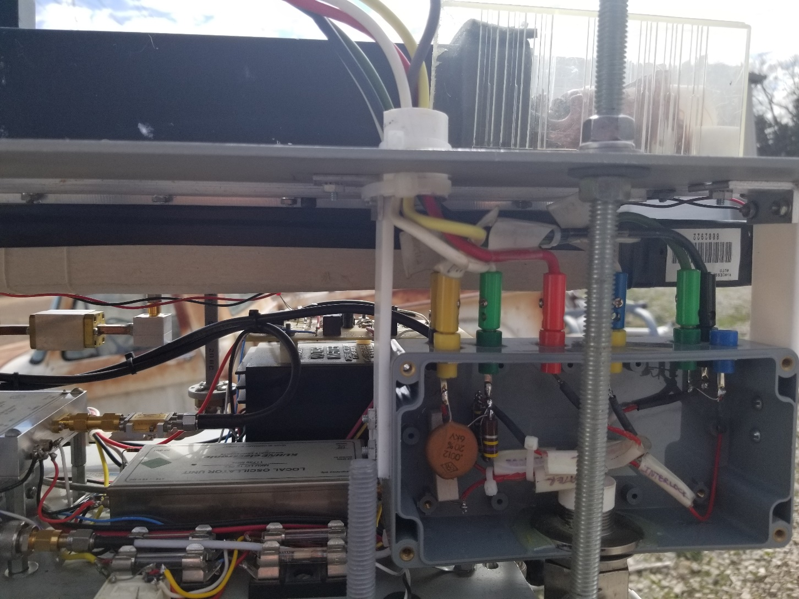
47 GHz TWT Breakout Box

Slide 11
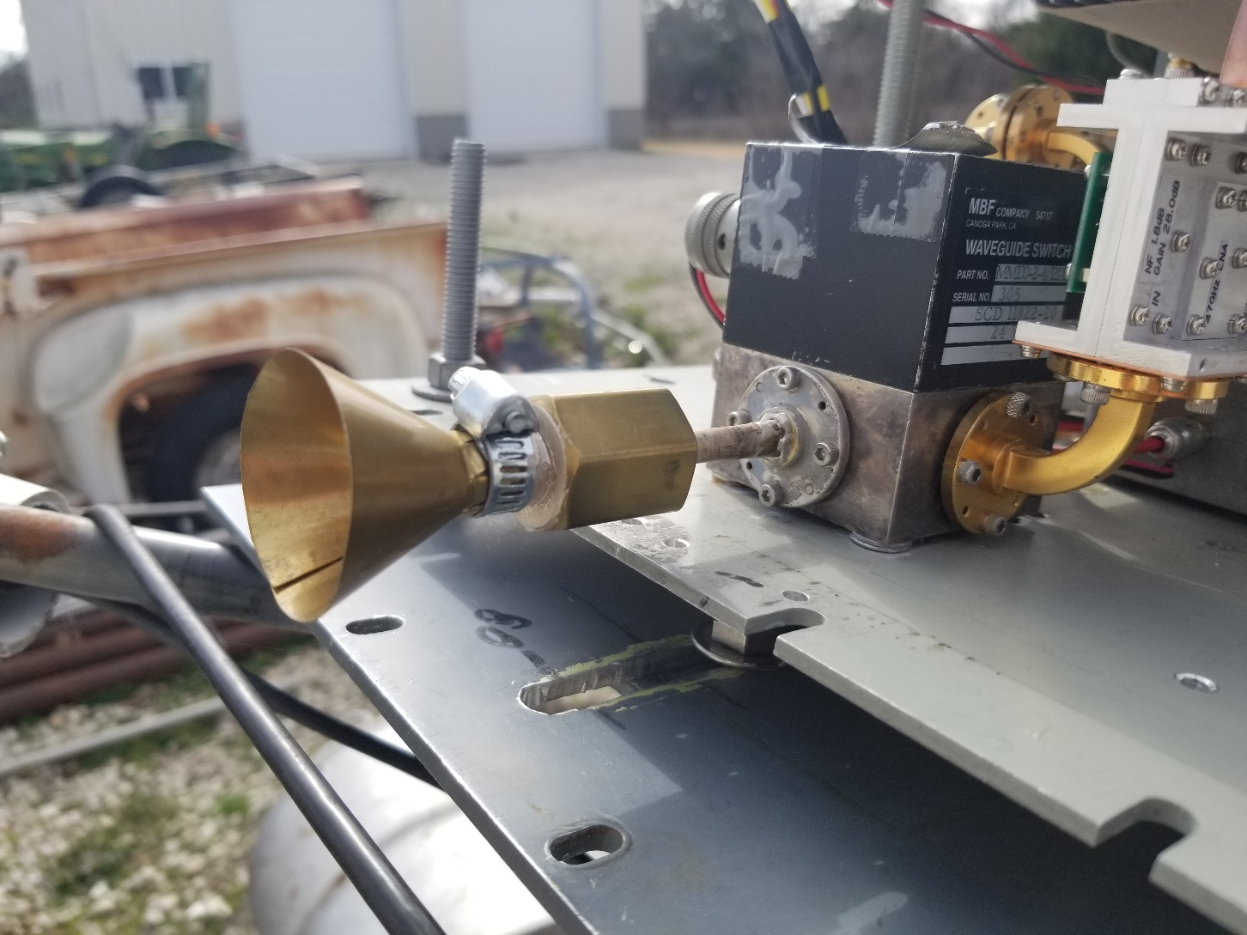
47 GHz W2IMU Feed with Flare

Slide 12
Next Steps
Building conditioning circuits for the cathode and grid lines out at the twt.
If anyone has any experience with any of these power supplies, I would like to hear from you w5lua@sbcglobal.net
Run further EME tests with JA1WQF.
See you off the moon.
73 Al

