Slide 1
Flyswatter Antenna on 5760 MHz
W5LUA
February 6, 2021

Slide 2
Introduction
I wanted to put up a dedicated antenna for 5760 MHz…..
My flyswatter has worked well on 47 and 76 GHz so why not 5760 MHz?
Next step was to check out the W1GHz Periscope Antenna Gain Calculator.
Then do I have enough coax/waveguide to get out to the base of the rotating tower?

Slide 3
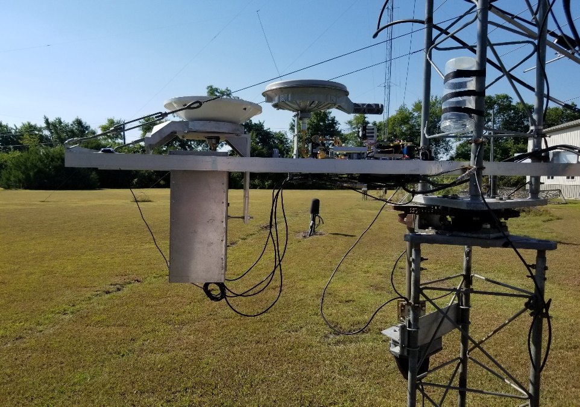
Periscope or Flyswatter Antenna

Slide 4
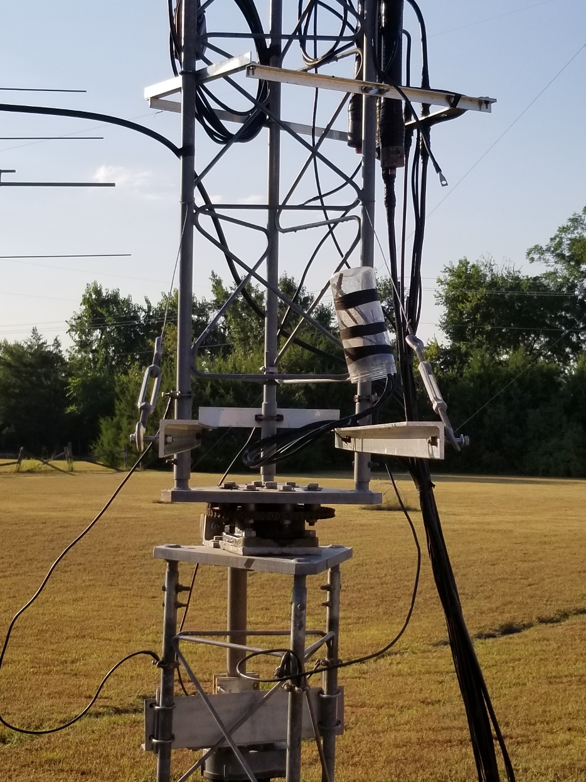
Lower Equipment Platform
Two 6 ft Pieces 2 inch angle , ¼ inch thickness
Two guy wires and turnbuckles used for support and alignment

Slide 5
Platform with 77 & 47 GHz Xvtrs
2 Transverters taking advantage of the larger than optimum reflector
I installed “Wings” on transverters so they can slide on the equipment platform
Sears Digital Torpedo Level and shims used to insure transverters are in good alignment with reflector
GPS Ant
77 GHz
47 GHz

Slide 6
Stop Sign Flyswatter Reflector
Built and originally used by KA5BOU
Small actuator used to optimize tilt from nominal 45 degree. Craig rotated the reflector since he used the reflector on a non-rotating tower. This also meant that he had to rotate the polarity of his source antenna to maintain horizontal polarity with respect to the horizon

Slide 7
W1GHZ Periscope Antenna Gain Calculator
Dish diameter = 30 inches
Reflector spacing ~ 45 ft
Reflector above ground ~ 51 ft
Flyswatter Aperture ~ 32 inches
Most Important

Slide 8
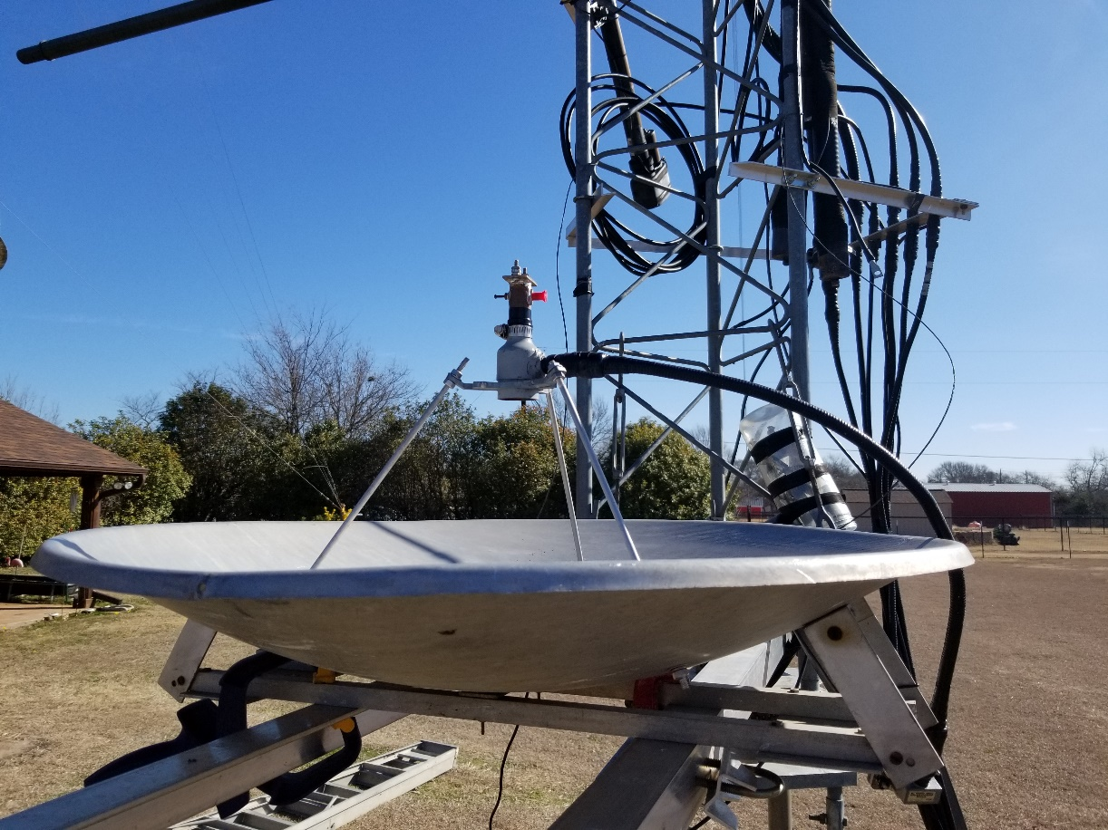
30 inch Dish for 5760 MHz
Feed is WB5LUA Dual Band 5/10 GHz Feed

Slide 9
Rotating Tower for 6m through 23 cm + Flyswatter

Slide 10
Radome
Radome purchased at Tractor Supply in Celina..
TSC 25 gal heavy duty round stock tank
SKU 222987099
$34.99
Loss at 5760 MHz measured at 2 to 3 dB
Has already proven to protect dish from hail on Jan 24th 2021

Slide 11
Pressurized WR-137 Rigid and Flex
31ft Rigid w/g 1 dB loss + 12ft Flex w/g .6 dB loss + 2 X 1/2” SF jumpers .9 dB loss for a total loss of 2.5 dB – Run with ½ in LDF and Superflex would be 3.5 dB loss….still not bad for 5760 MHz

Slide 12
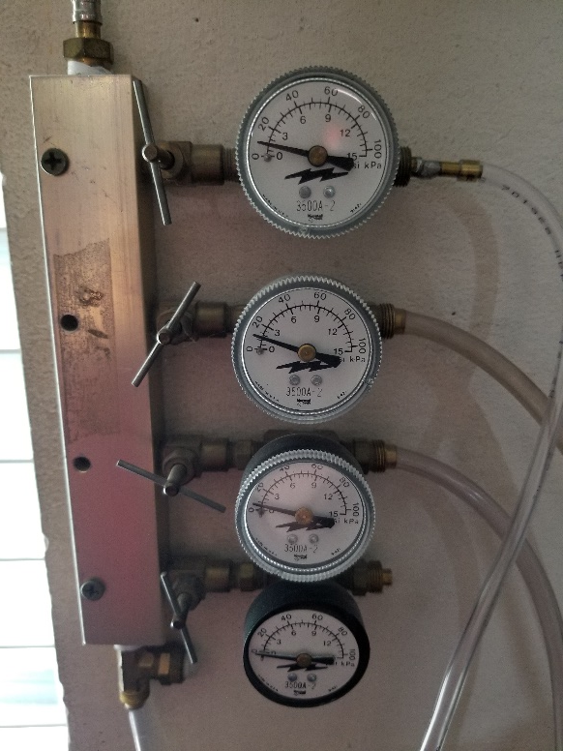
Waveguide Pressurization
Aquarium pumps
Air manifold with pressure gauges
I would like to find something better than aquarium pumps!
Desiccant Jar

Slide 13
W5HN 5760 MHz Beacon key down

Slide 14
W5AFY 5760 MHz QSL
170 mile DX

Slide 15
For further consideration to help others get a 10 GHz antenna up 20 ft…..

Slide 16
10 GHz Flyswatter at 20 ft.
Dish diameter = 18 inches
Reflector spacing ~ 20 ft
Flyswatter Aperture ~ 24 inches

Slide 17
Any Questions?

