Slide 1
Desert, TX Beacon Update
W5LUA & AA5AM
March 6, 2021

Slide 2
Scott plugging holes in shack
Location EM13sj
Lat 33.382185 N
Long 96.4206 W
8ft X 12ft air conditioned fiberglass building

Slide 3
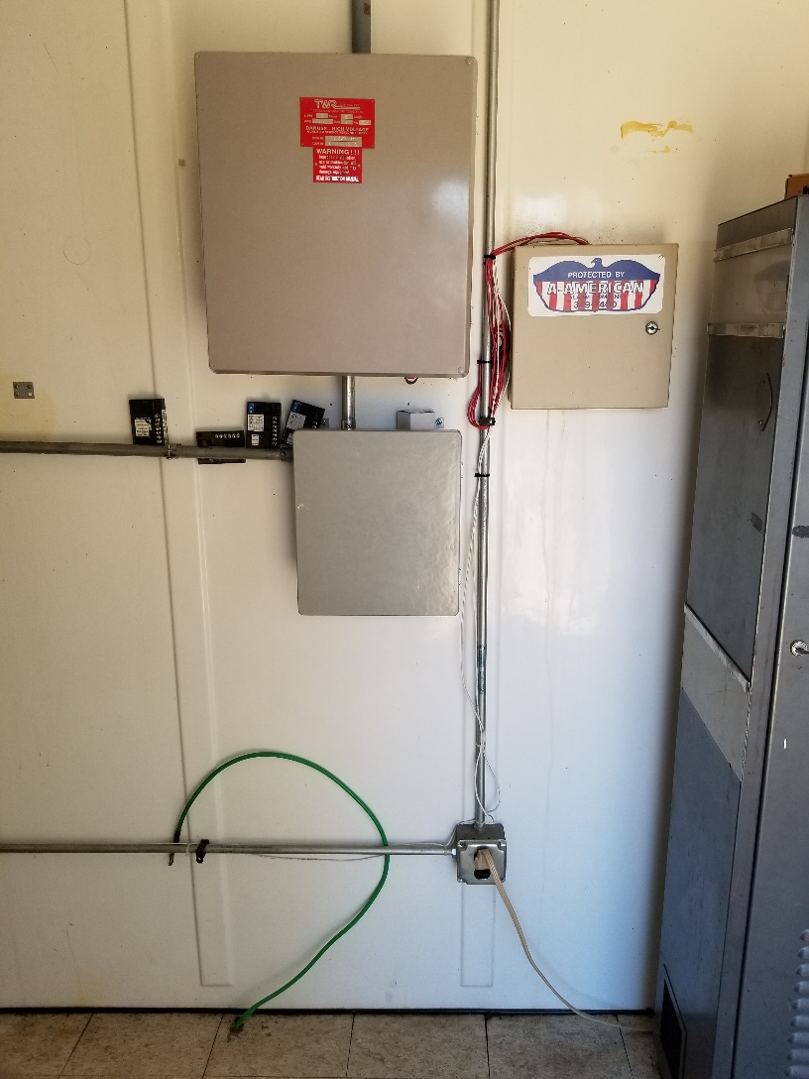
Lighting & W5HN Beacons

Slide 4
6 & 2 m W5HN Beacons
Hamtronics FM strips with on/off keying
2m 144.280.2 MHz 1.5 watts
6m 50.072.4 MHz 1 watt
WW2R/G4FRE beacon IDer

Slide 5
450 ft Tower
Our 6/2 m M2 halos are at 180 ft
My son Bryan N5QGH and I installed these about 20 plus years ago – I have no intention of climbing to this height ever again.
I plan to install a “temporary” new 6 m dipole antenna at about the 60 ft level and feed with about 70 ft of Belden 8214 with a measured 1 dB loss. Exact directional orientation TBD. We have been given the approval to put up the new antenna

Slide 6
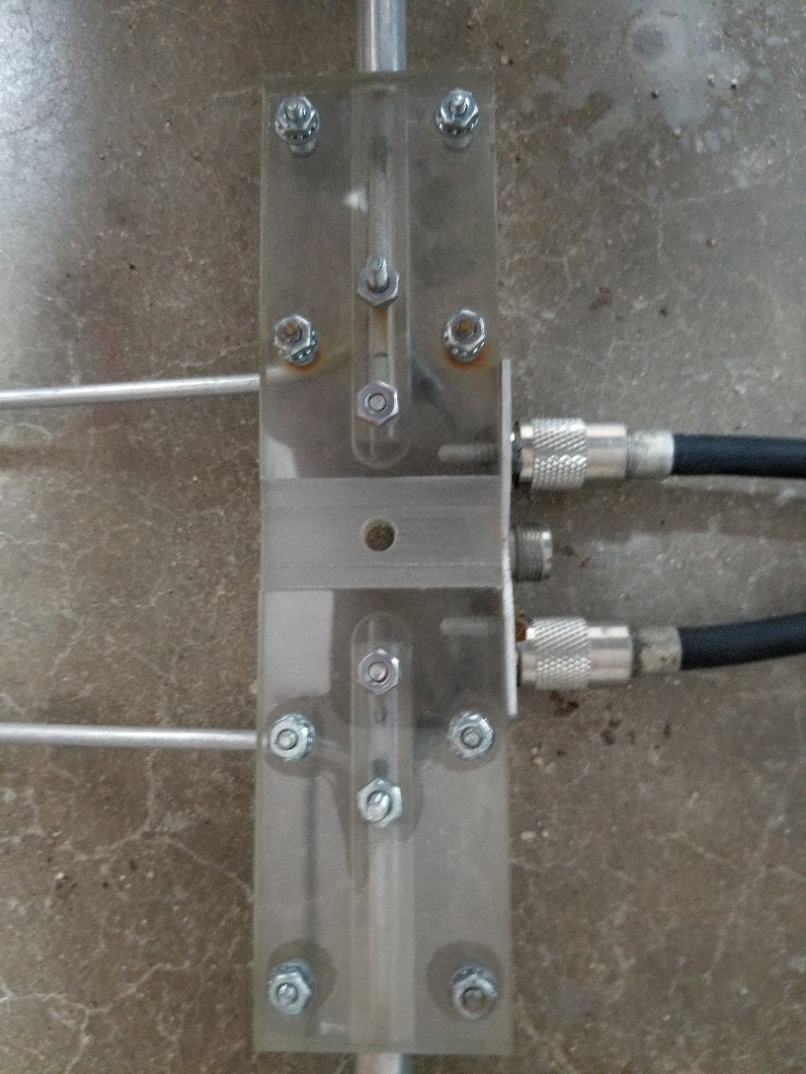
6m dipole built by Bob Gormley WA5YWC

Slide 7
Future Plans
Plan is to install WY6K’s CW/FT8 2m beacon soon. The existing 2m beacon will be back up.
Install 6m dipole next week.
Consider adding Internet capability to allow for changing power levels, antennas, etc.
and……

Slide 8
How about some additional microwave beacons?
Second 10 GHz beacon, could be DB6NT or a ZL PLL board with built in keyer and add a several hundred milliwatt PA. Install at 60 ft level. Would need an omni beacon antenna such as a slot antenna. GPS locked?
47 GHz beacon
76 GHz beacon
Other bands of interest to club members?

Slide 9
www.heywhatsthat.com
The following slides show panoramic views at the Desert tower at various elevations
Views provided by www.heywhatsthat.com

Slide 10
Desert tower view 6ft above ground
Tower is in a bit of a hole despite the higher areas on same property

Slide 11
Desert Tower View @ 450ft

Slide 12
Desert Tower View @ 180 ft
2 & 6 m antennas are at this height

Slide 13
Desert Tower View @ 60 ft
Proposed height for second 6 m antenna

Slide 14
Desert Tower View @ 15ft
Desert Tower
Lat 33.382185 N
Long 96.4206 W
Location of ISP tower that we propose using for internet – approximately 10 miles south of Desert tower
Lat 33.246254 N
Long 96.425726 W

Slide 15
Summary
Nice to have the 2m beacon operational again.
Signal has been reported from as far away as Dan W5AFY EM04id DX = 171 miles

