Slide 1
122 GHz DB6NT Mixer
W5LUA
May 2, 2020

Slide 2
Various DB6NT PCBs

Slide 3
Drilling Housing for WR-12 and WR-06 Waveguide Flanges
I had several pre-machined housings (left) that I decided to modify (right) for use with the 120 GHz DB6NT mixer boards
61 GHz LO input waveguide
122 GHz RF port
Fc = 115 GHz

Slide 4
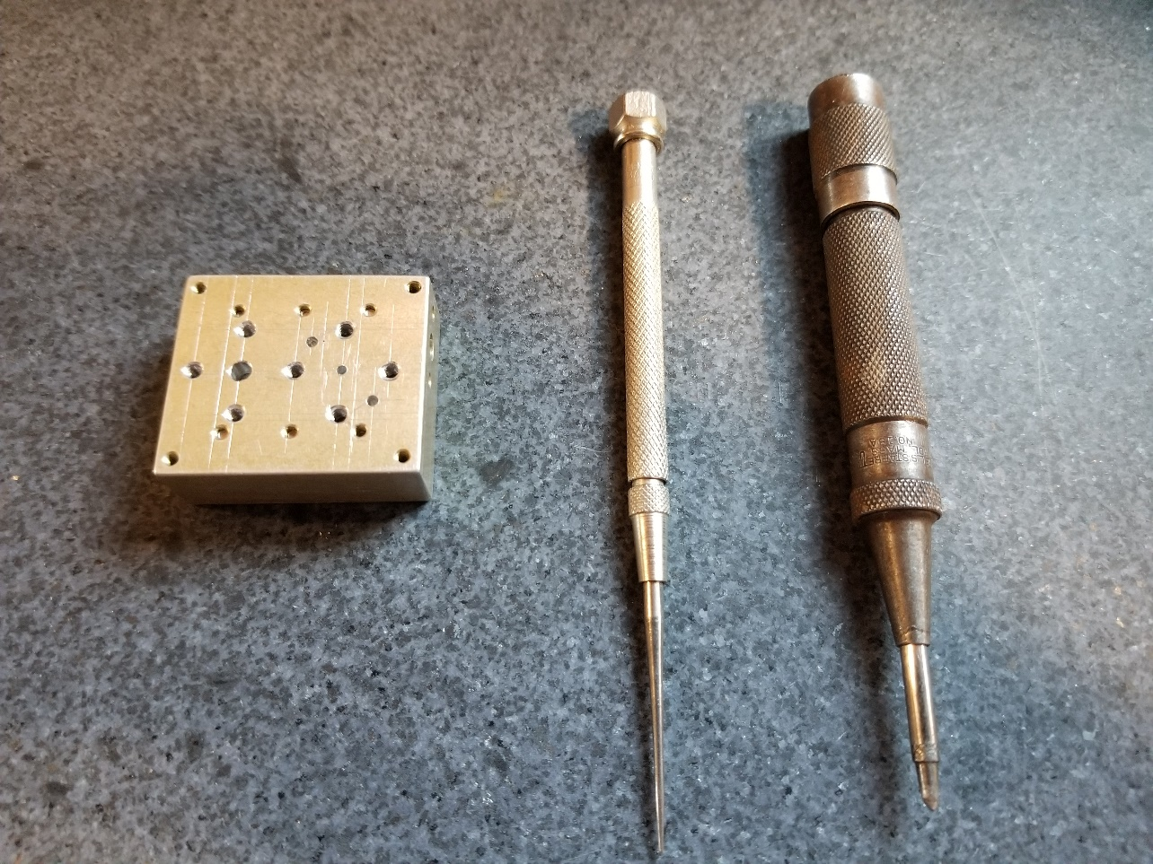
Using Granite Surface Plate and Digital Height Gage to scribe lines
https://www.grizzly.com

Slide 5
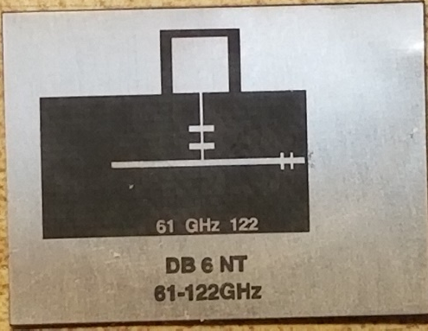
DB6NT 122 GHz Mixer PCB
Piece of acrylic plastic drilled to match holes in housing.
Provides a drilling template for pcb and
will be used to apply pressure on board when silver
epoxying board into place.
Shining a flashlight into the RF and LO ports gives a good indication of alignment with pcb.
Next step is to make back shorts for LO and RF ports
PCB #40

Slide 6
LO and RF Back Shorts
61 GHz LO Back short
122 GHz RF Back short
4-40 tuning screw
0-80 tuning screw

Slide 7
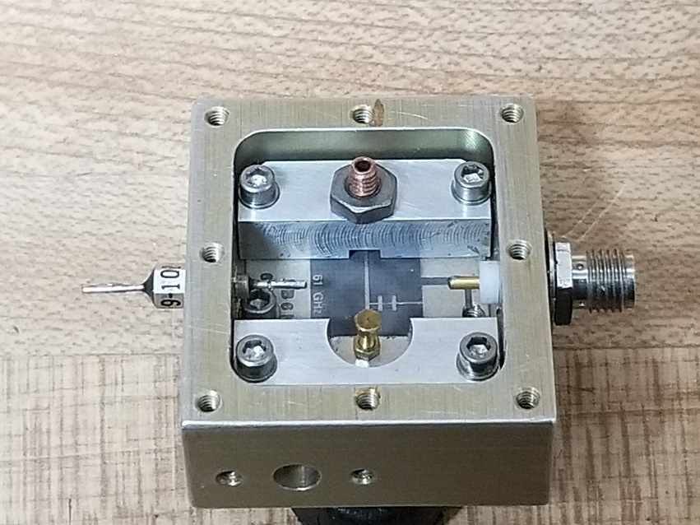
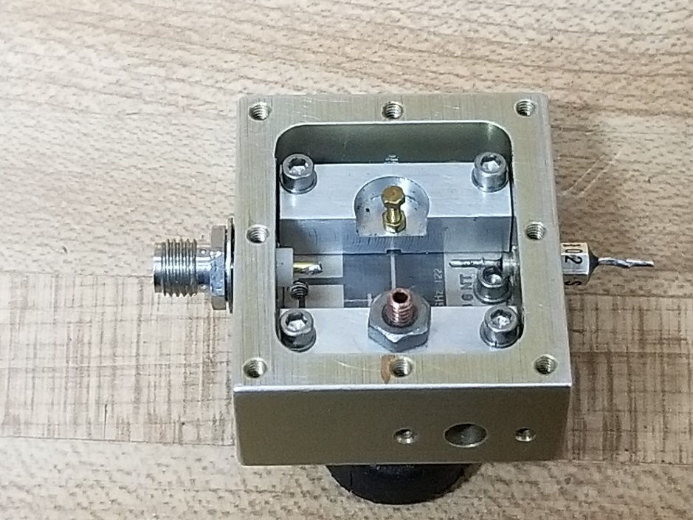
DB6NT 122 GHz Mixer
Completed mechanical assembly
IF
Looking down towards 61 GHz LO input
LO
RF
Looking down towards 122 GHz RF port
DC Bias

Slide 8
Next Step
Silver epoxy PCB into housing (or not)
Wire IF port and dc port
Install Diodes
Test

Slide 9
MA4E1318 Anti-Parallel Flip Chip Diode Pair
Cost per diode only $2.17 from Mouser but you must buy in 100 quantity

Slide 10
MG Chemicals 9400 Electrically Conductive Adhesive
One-part Epoxy
Recommended for semiconductor attachment.
Unlimited working life
Store in freezer
Heat Cure 70C (158F) for 2 hours.
Now for the fun……not

Slide 11
Installing the Diode
I decided NOT to epoxy the pcb in place.
I will rely on the LO and RF back shorts to keep the pcb in intimate contact with the housing.
I built a bracket to keep pcb in close contact with the housing when the RF back short is removed.
I had tremendous difficulty in keeping the epoxy away from the LPF.
I decided to use regular clear tape to mask off area where I did not want to have epoxy, then remove tape and put diode in place.

Slide 12
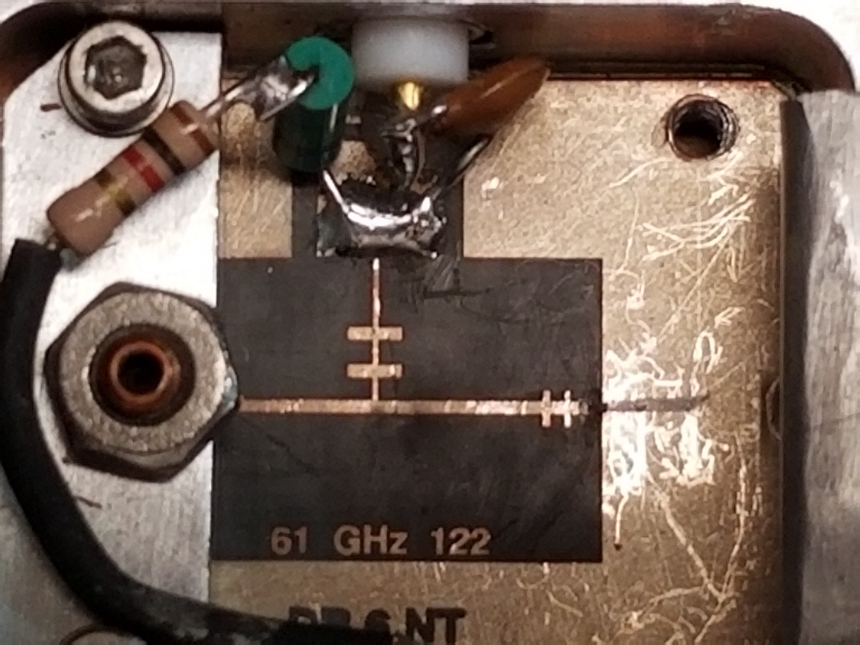
Diode Pair Installed
Diode installed
Only ruined or lost 5 diodes!

Slide 13
Toaster Oven for Curing Epoxy
July 7, 1973 Wedding Present
Heat Cure 70C (158F) for 2 hours.

Slide 14
Testing the Mixer
I have no test equipment for 122 GHz, so in the true ham spirit, I must improvise.
Most importantly, I need a signal source at 122 GHz.
Need to accurately measure receive dBs so I can tune for the last dB.. I use NaP3 Power SDR software with my K3 & DEMI 2m XVTR.
Now back to making a signal at 122 GHz..

Slide 15
Potential Weak Signal Sources for 122 GHz
Wiltron 13 to 20 GHz Amplifier & Spacek X3 (U-3X) with WR-22 output. Converted WR-22 to WR-15 & WR-15 Horn supplied by K9JHK, Thanks Karl!
60 GHz X4 Multiplier
CMA 382400 39 GHz X3 mult & 76 GHz SHM
ST Microwave Amplifier/Multiplier heard on 47/76 GHz
60 GHz WR-15
Amplifier

Slide 16
122 GHz LO & IF Sections
DEMI TC IF Interface with PGA-103 LNA (less than 1 dB NF)
Millitech X4 Multiplier Pout =10 dBm
Avago AMMP-6120 8-24 GHz X2 Multiplier
61056 MHz
15264 MHz
ZL2BKC 14 GHz PLL
7632 MHz

Slide 17
Front Panel of 122-134-241 GHz Transverter

Slide 18
Test Bench for tuning up mixer

Slide 19
122,256.1 MHz
Near-in spurs are -25dBc, still sounds T8+
Most phase noise is due to multiplying the HP8340A 15282.0125 MHz signal X8

Slide 20
Completed 122 GHz System

Slide 21
12” Cassegrain Fed Dish on 122 GHz
Mark N0IO used the W1GHZ Cassegrain Calculator to find the optimum feed and sub reflector for my 39 GHz dish. Mark machined both pieces. A big thank you Mark!

Slide 22
Closeup of mixer & transition to circular waveguide to dish feed

Slide 23
W2IMU Feed & Cassegrain Reflector

Slide 24
Summary
Hope to work you on 122256.1 MHz
Any questions?

