Slide 1
W5LUA/9 EN45wf September 2012
Al Ward
September 20, 2012

Slide 2
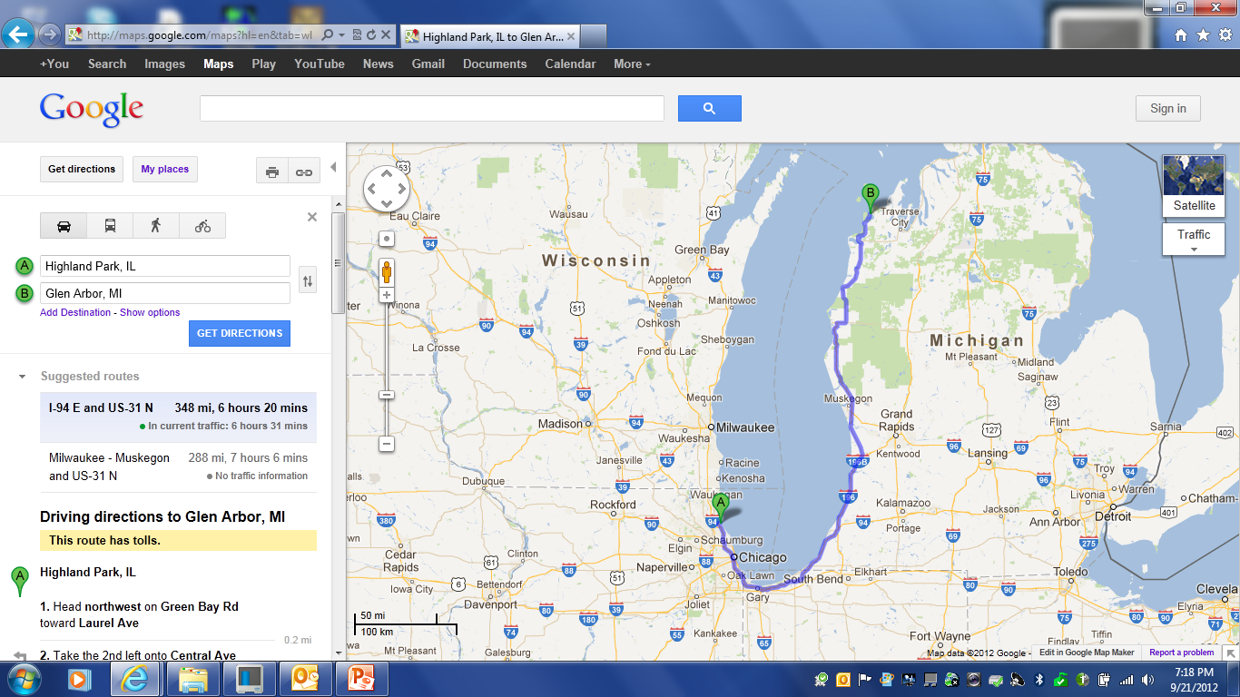
EN62ce to K2YAZ/8

Slide 3
Highland Park, Illinois EN62ce

Slide 4
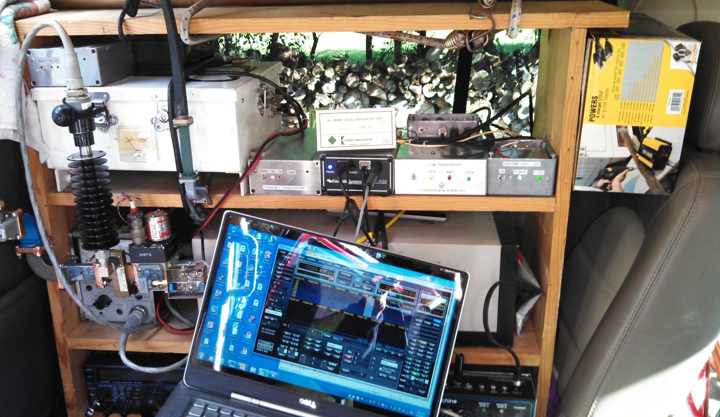
W5LUA Sept 2012 Rover

Slide 5
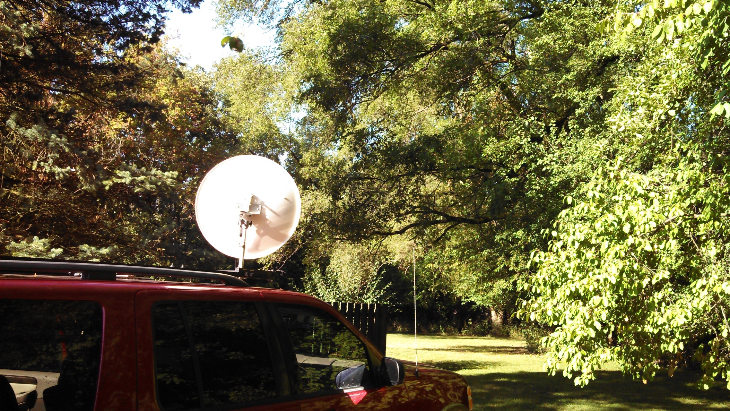
Worked W9ZIH in EN51nv at 45 miles on 10 GHz through these trees!

Slide 6
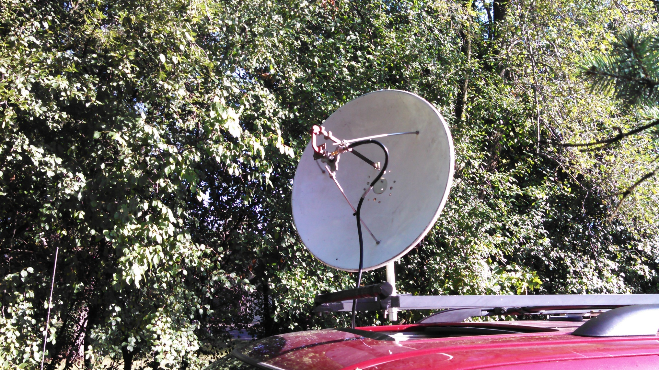
W5LUA Dual Band 10/24 GHz with elevation toward W9ZIH

Slide 7
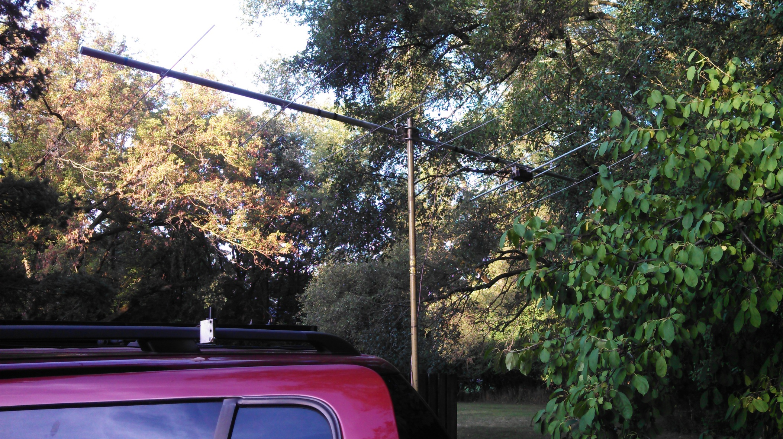
Worked WA8RJF at 350 miles from EN52wf in Illinois on 2M

Slide 8
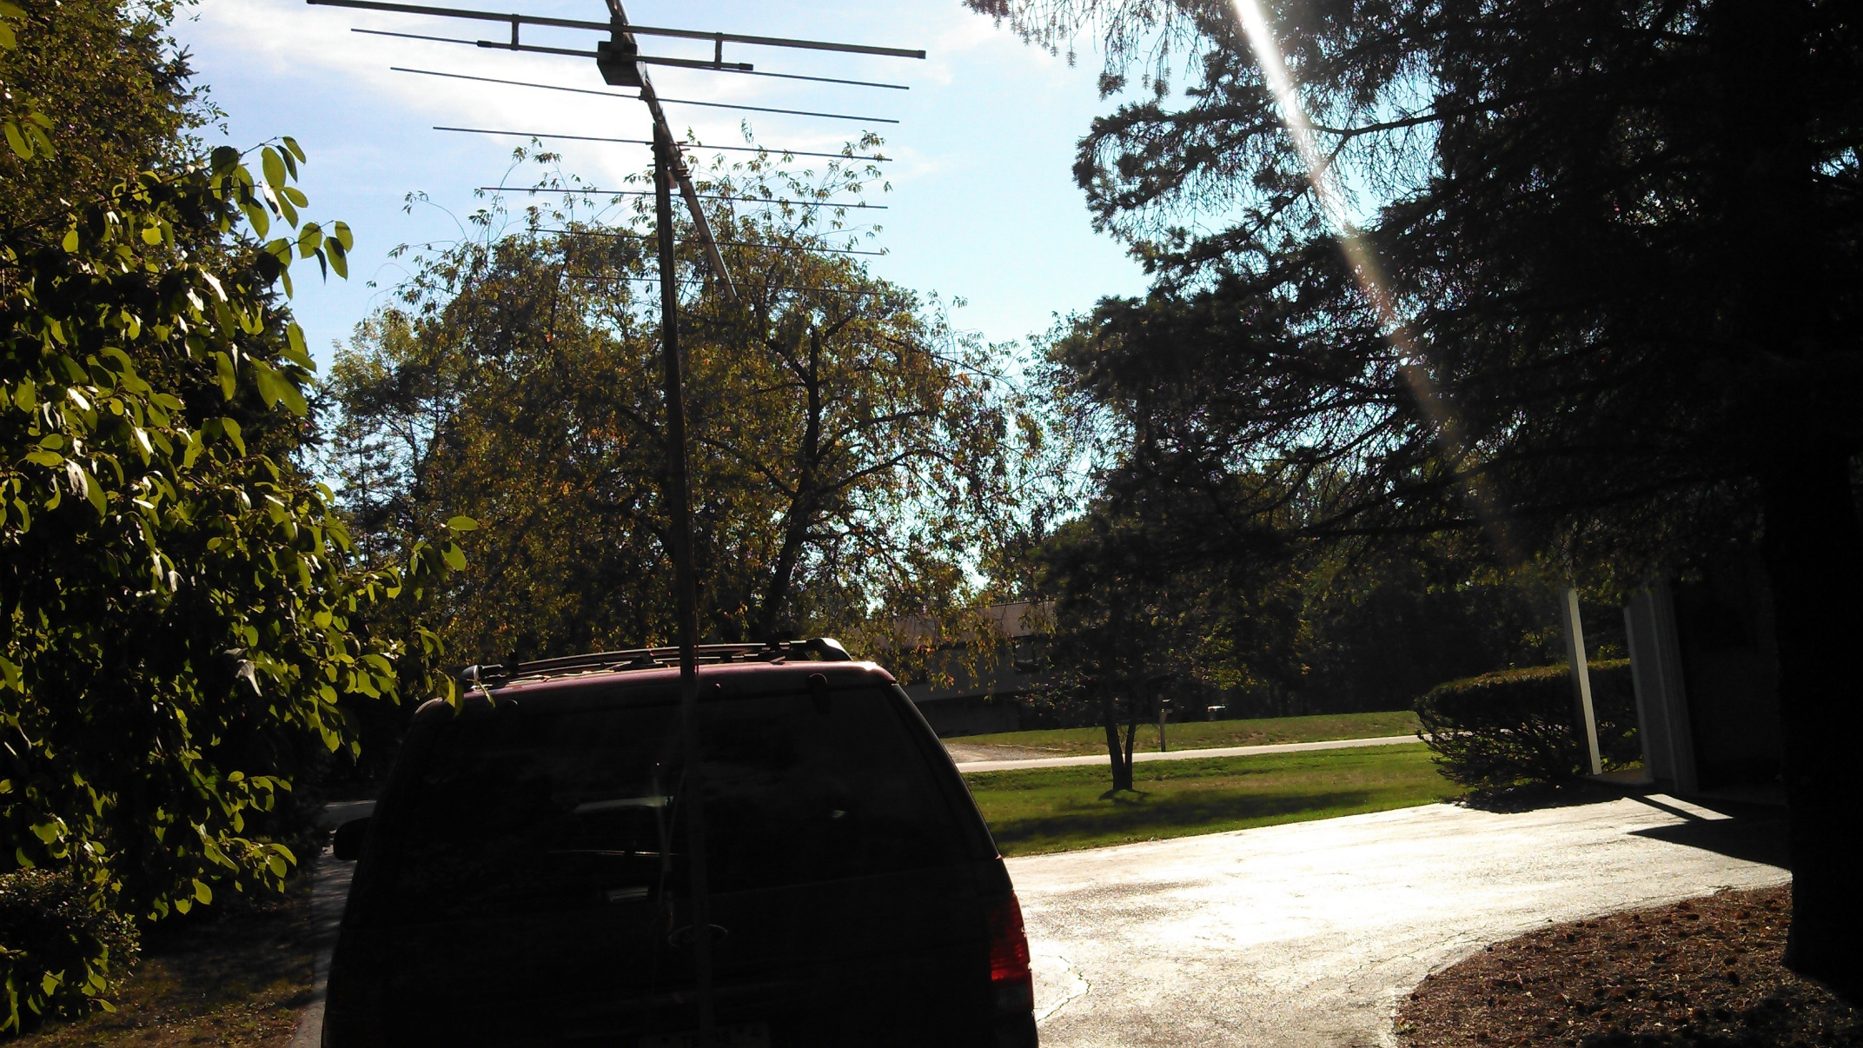
View toward WA8RJF

Slide 9
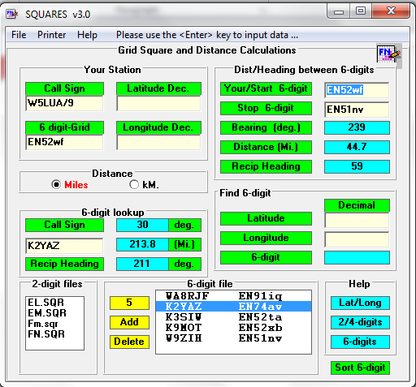
WA3JUF Software

Slide 10
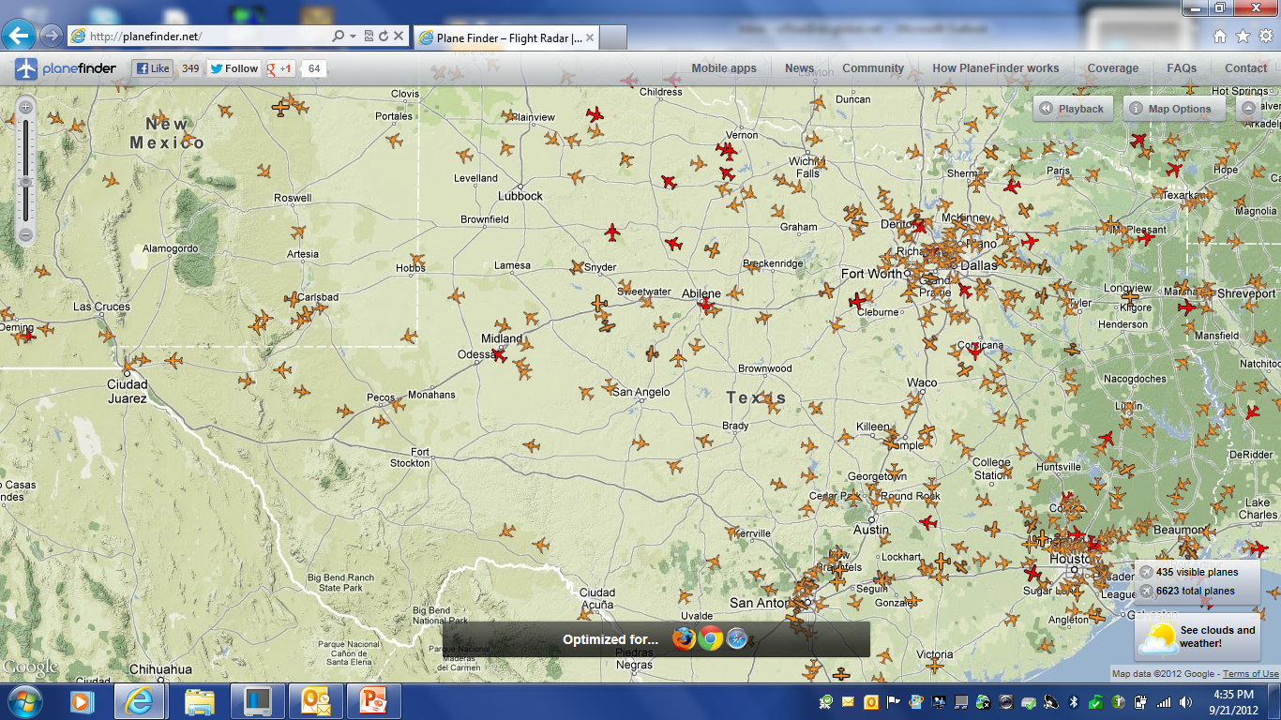
http://planefinder.net/

Slide 11
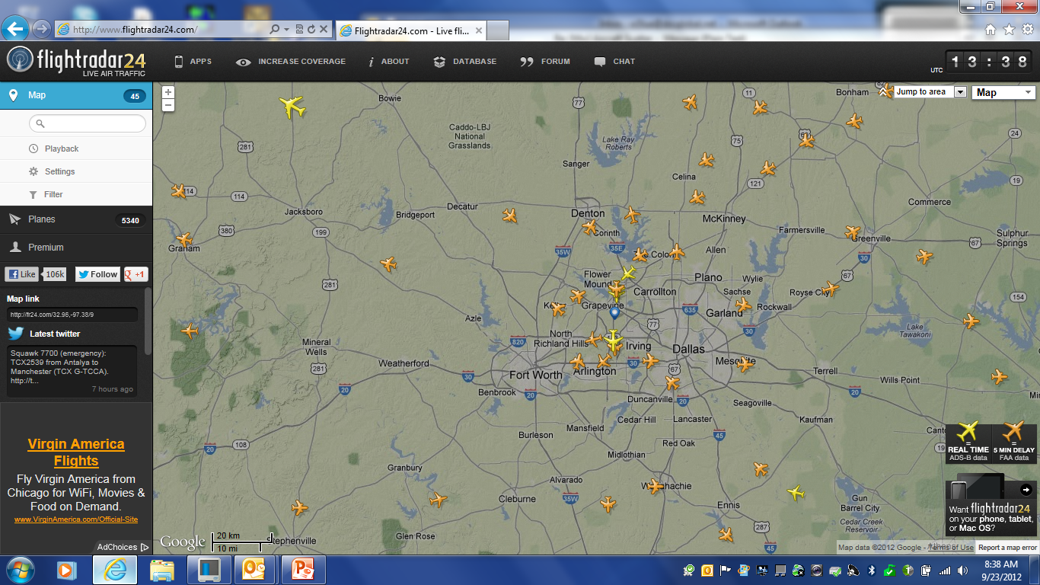
: http://www.flightradar24.com/

