Slide 1
VK7MO and W5LUA
3cm EME using JT-65C
Al Ward
W5LUA
October 25, 2012

Slide 2
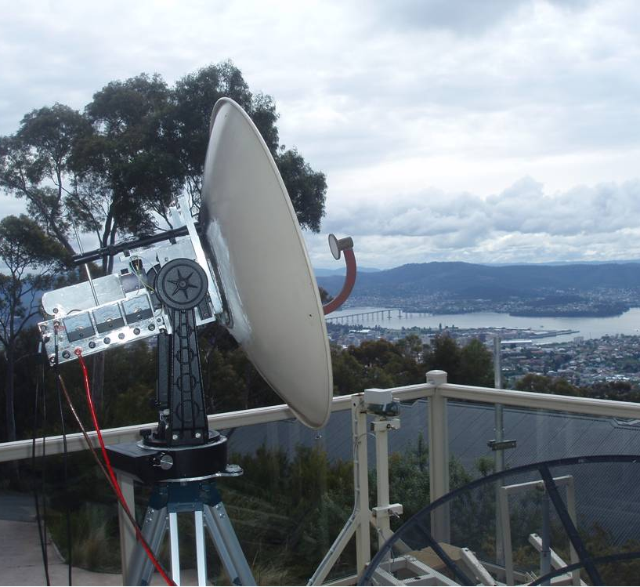
VK7MO .8M Dish for 10 GHz

Slide 3
VK7MO .8M Dish for 10 GHz

Slide 4
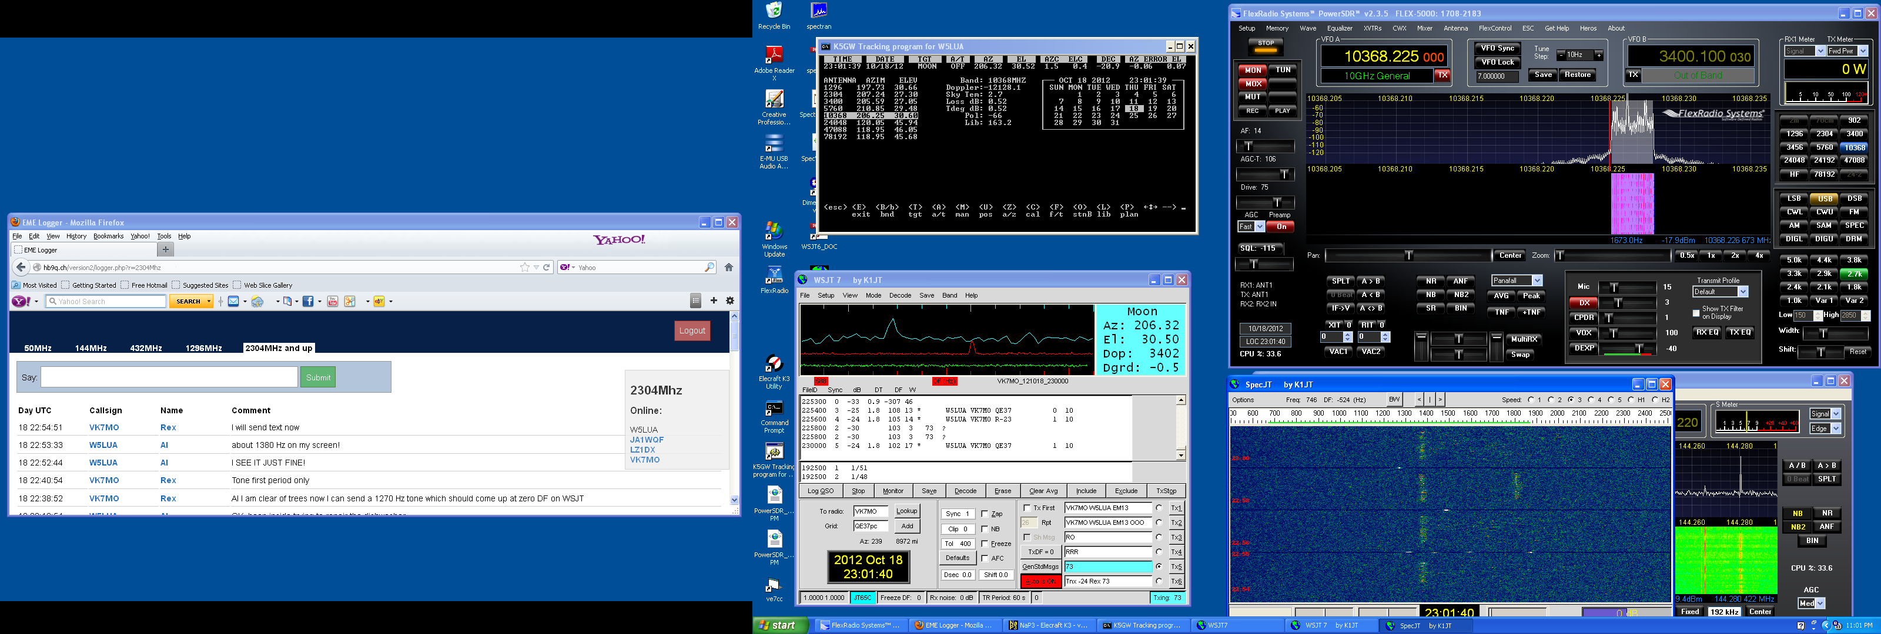
VK7MO-W5LUA OCT 18 23:01Z

Slide 5
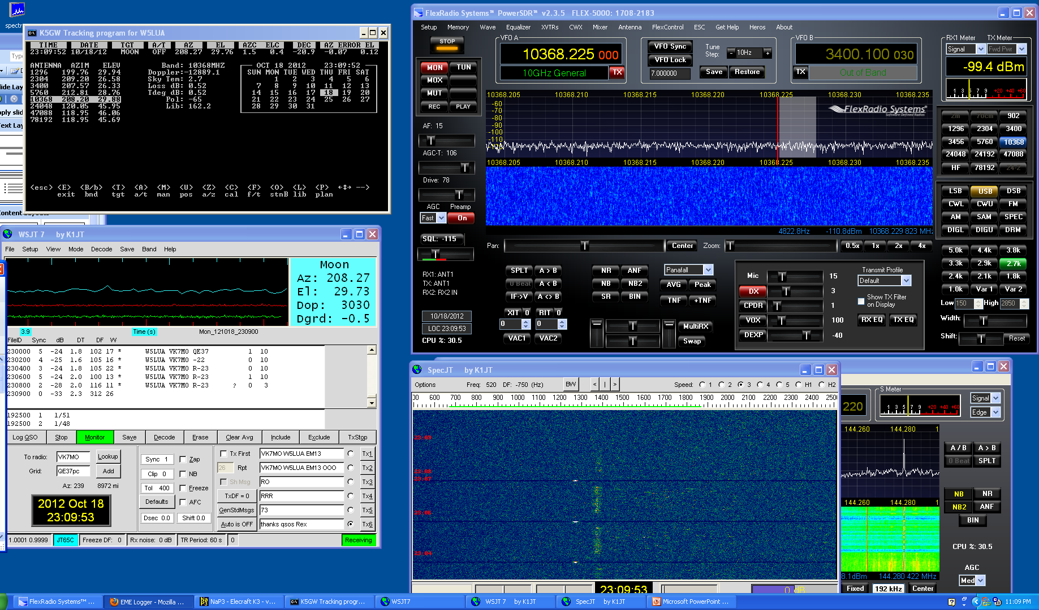
VK7MO-W5LUA OCT 18 23:09Z

Slide 6
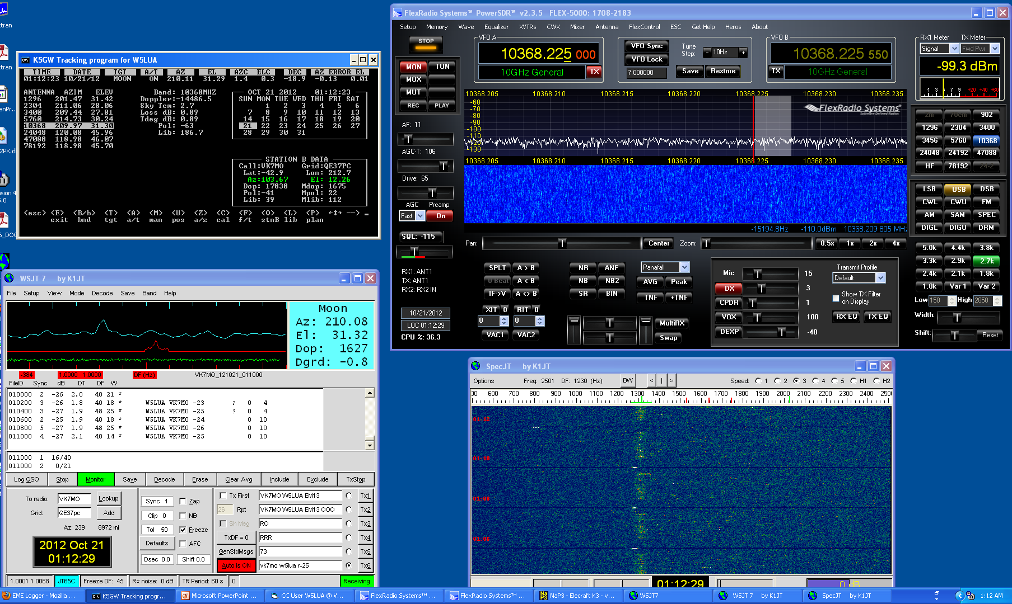
VK7MO-W5LUA OCT 21 01:12Z

Slide 7
Decodes Received at VK7MO

Slide 8
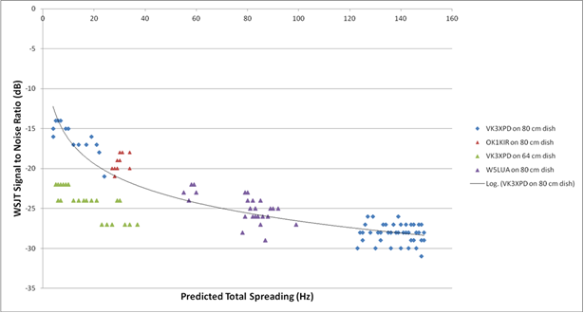
Signal Spreading vs WSJT decode level (dB)

