Slide 1
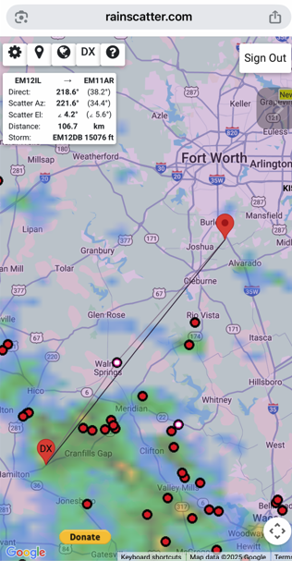
Welcome to
The North Texas Microwave Society
August 9th, 2025

Slide 2
NTMS Agenda
August 9, 2025
12:30 to 1:00– Setup & Bull Session
1:00 pm - Meeting Starts
Technical Program
  Sun Noise Measurement Review - Al Ward W5LUA
  Another One Way QSO Attempt! What’s Wrong? - Al Ward W5LUA
  Contest plans - ARRL 10 GHz and Up part 1 - August 16-18, 2025
  Using the RFzeroTM as a beacon driver at VHF, UHF and beyond - Jim McMasters KM5PO
  Show & Tell by members
Other items & Business Meeting

Slide 3
Phishing / scam emails
Be alert to bad guy schemes
Watch for
  Out of character requests – NTMS officers will not solicit through text or email
  Return email address or URL to click is suspicious
  Sense of urgency
Actions to take
  Contact the person directly
  Report the email as spam
WWW.NTMS.ORG
WWW.NTMS.ORG

Slide 4
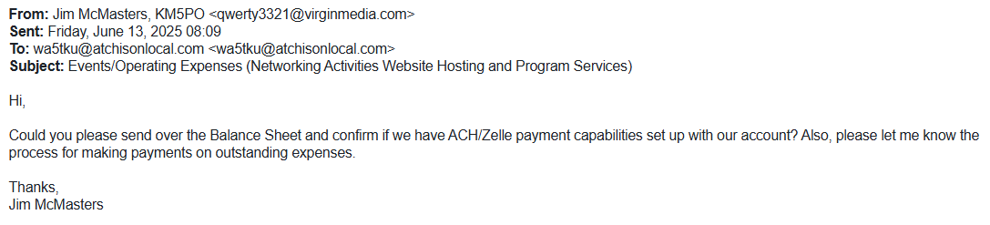
Phishing / scam emails
WWW.NTMS.ORG
WWW.NTMS.ORG

Slide 5
August 2025
12th Perseids meteor shower peak
16th to 18th – ARRL 10 GHz and Up contest (part 1)
16th & 17th – ARRL 2.3 GHz and up EME contest
WWW.NTMS.ORG
WWW.NTMS.ORG

Slide 6
September 2025
2nd (Saturday) NTMS MAD – Microwave Activity Day
  Note, last MAD testing day before part 2 of the contest
  Potential for an antenna tune-up? Sunday?
9th NTMS September Zoom meeting
  Machining WR-42 to SMA transitions – Mats KD5FZX
  RFzero library, Arduino IDE, example programs and modifying them,troubleshooting – Bo Hansen OZ2M
  Your presentation goes here
13th & 14th – ARRL 50 to 1296 MHz EME contest
20th to 22nd – ARRL 10 GHz and Up contest (part 2)
WWW.NTMS.ORG
WWW.NTMS.ORG

Slide 7
October 2025
3rd (Saturday) NTMS MAD – Microwave Activity Day
11th NTMS October Zoom meeting
  Your presentation goes here
17th to 18th International Microwave Update (M.U.D.)
  Tucson, Arizona
WWW.NTMS.ORG
WWW.NTMS.ORG

Slide 8
Perpetual
NTMS 2 meter net Every Sunday, 8:00 pm CST,144.260 MHz, called by Ross K5ZSJ
The 6 meter Hootowl net Every Saturday, Midnight, 50.125, called by Al W5RLG
NTMS Lunch
Every Tuesday, 11:30 am CST, Texas Smokehouse BBQ, Richardson TX (May change around holidays)
144 MHz Activity Night.
Every Monday 7:00-11:00 pm local
222 MHz Activity Night.
Every Tuesday 7:00-11:00 pm local
432 MHz Activity Night.
Every Wednesday 7:00-11:00 pm local
Midwest M.A.D. and NTMS M.A.D
First Saturday of every month.

Slide 9
Business Meeting
Old Business
New Business
Any other topics to be discussed?

Slide 10
NTMS Budget & Dues
Zoom Meeting $160/yr
Website Blue Host $86/yr
ARRL Liability Insurance $200/yr
PO Box $146/yr
501c3 non-profit filing with TX $25/yr
Total $617 / $20 dues > 31 members min
Does not include meeting room space and ARRL Spectrum Defense Fund donations
Please support the NTMS with your $20 annual dues. Information on paying dues at www.ntms.org (see Membership link on left side of home page)

Slide 11
NTMS Budget & Dues
Total $617 / $20 dues > 31 members min
Does not include meeting room space and ARRL Spectrum Defense Fund donations
ARRL SDF donation is approx. $300 so our total operating expenses are over $900 per year.
This takes 45 supporting club members to equal our operating expense just to stay flush.
Reality is: our account has averaged a $500 drop every year in the past 5 years.
The math seems to indicate that we have 20 supporting club members on annual average.

Slide 12
NTMS Budget & Dues
Like all things there is a finite amount of time we can operate at the current drift down before activities of the club will be affected.
  Zoom Meeting $160/yr
  Website Blue Host $86/yr
  ARRL Liability Insurance $200/yr
  PO Box $146/yr
  501c3 non-profit filing with TX $25/yr
  ARRL Spectrum Fund donation $300/yr

Slide 13
NTMS website usage
A key resource in use by many is the NTMS website.
Number of unique visitors is about 1600-1900 per month
Number of hits can reach 20000 per month.
Referrals are from Google (#1) and then other search engines such as Bing and DuckDuckGo.
Presentations from NTMS meetings are being downloaded daily.

Slide 14
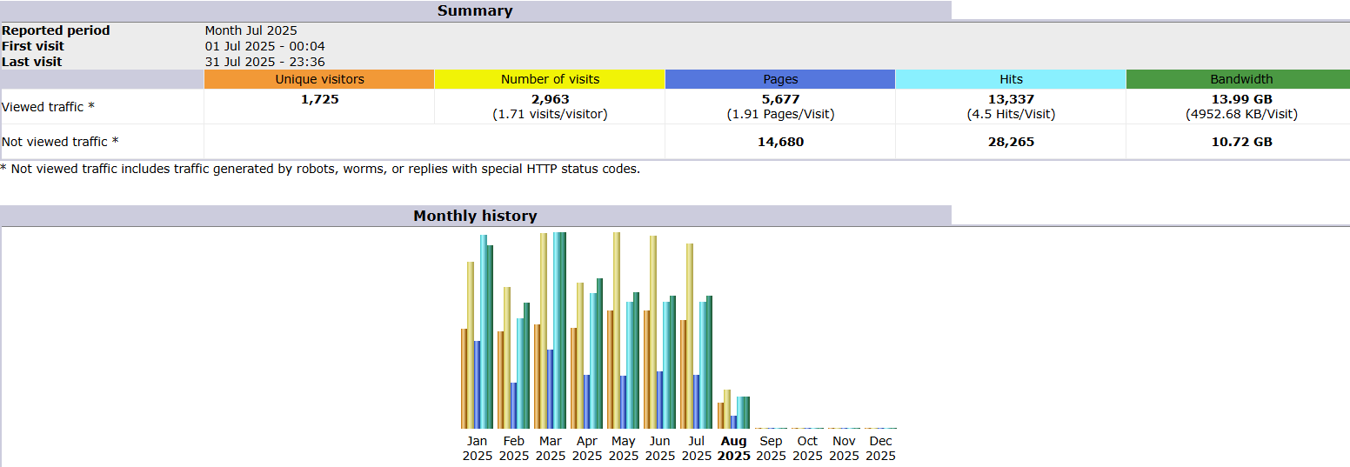
July 2025 website usage

Slide 15
NTMS website usage
What is being downloaded
  Navigation>Downloads>Full List
How did users find NTMS
  Referrers>Origin>Referring Search Engine
  Referrers>Origin>Referring Sites
Where are users located
  Who>Locales>Full List
What time and day of week are users active
  When>Days of week

Slide 16
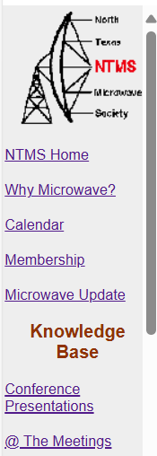
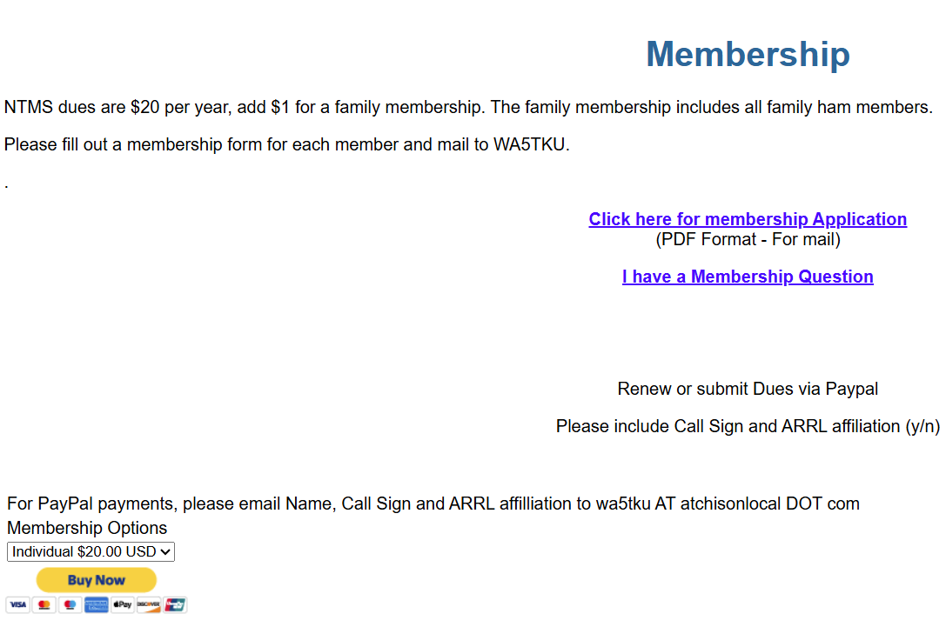
NTMS Budget & Dues
As we approach the end of the year, please pay your dues and take part in supporting NTMS.
You may pay dues using the PayPal link on the website or send a check/M.O. to Wes Atchison.

Slide 17
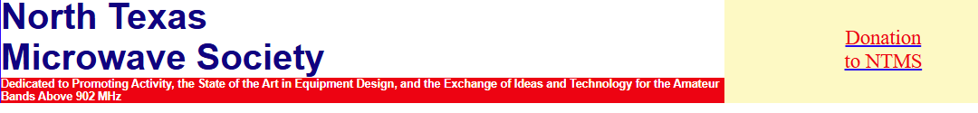
NTMS Donations
For donations by check please mail your check to:
NTMS
P. O. Box 26
Sanger, TX. 76266-0026
Note Donation and call sign on check.

Slide 18
Free information?
Is accurate and reliable information ever really free?
No, some price was paid to obtain, maintain and archive the information. NTMS information is ad-free but came at a cost.
  Combined experience of IEEE members and RF Engineers
  Operational skills gained over decades of time
The next gen of microwave operators are among us today. For our mission to succeed will depend on them and the persistence of NTMS resources.
We will be socializing the need for member support through email and other messaging.

Slide 19
Adjourn?
Motion to adjourn?

