Slide 1
Using Sun Noise Measurements to Evaluate System Performance
Al Ward
W5LUA
March 3, 2012
Updated Feb 3, 2024
Presented again August 9, 2025

Slide 2
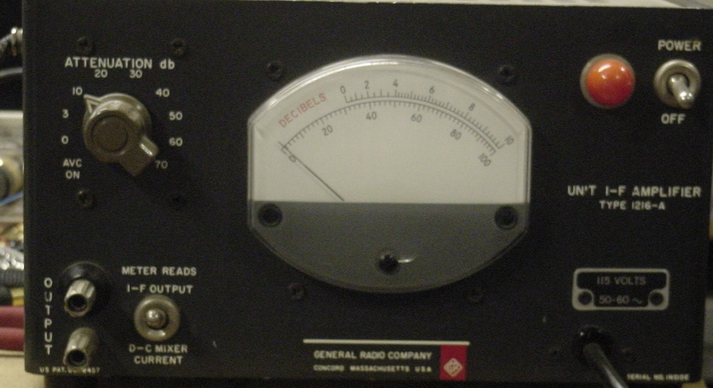
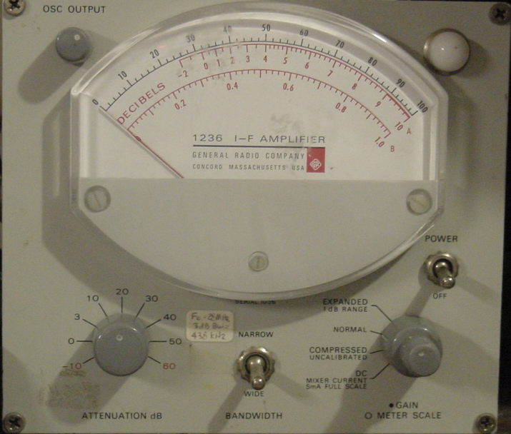
GR-1216 & GR-1236 IF Amplifiers
These meters provide a 30 MHz IF amplifier with up to several MHz of bandwidth which makes it easy to measure sun and moon noise – they can be easily retuned for 28 MHz

Slide 3
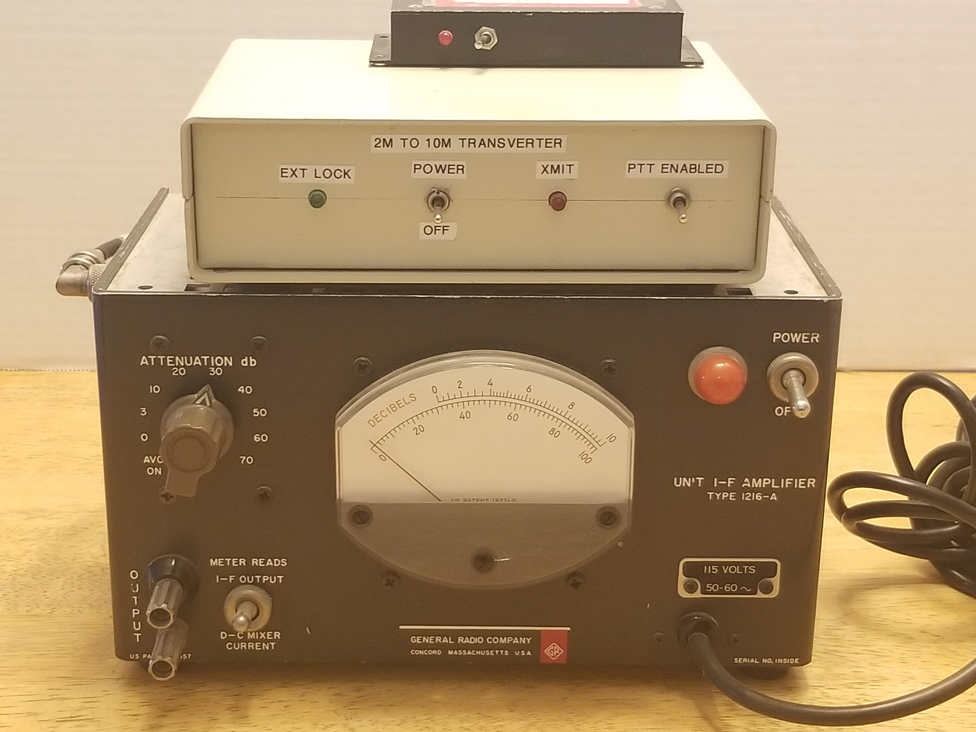
Setup for measuring sun/moon noise on portable systems
HB 144 to 28 MHz downconverter
Optional 144 MHz ( 2m) preamplifier – comes in handy for use with low gain converters

Slide 4
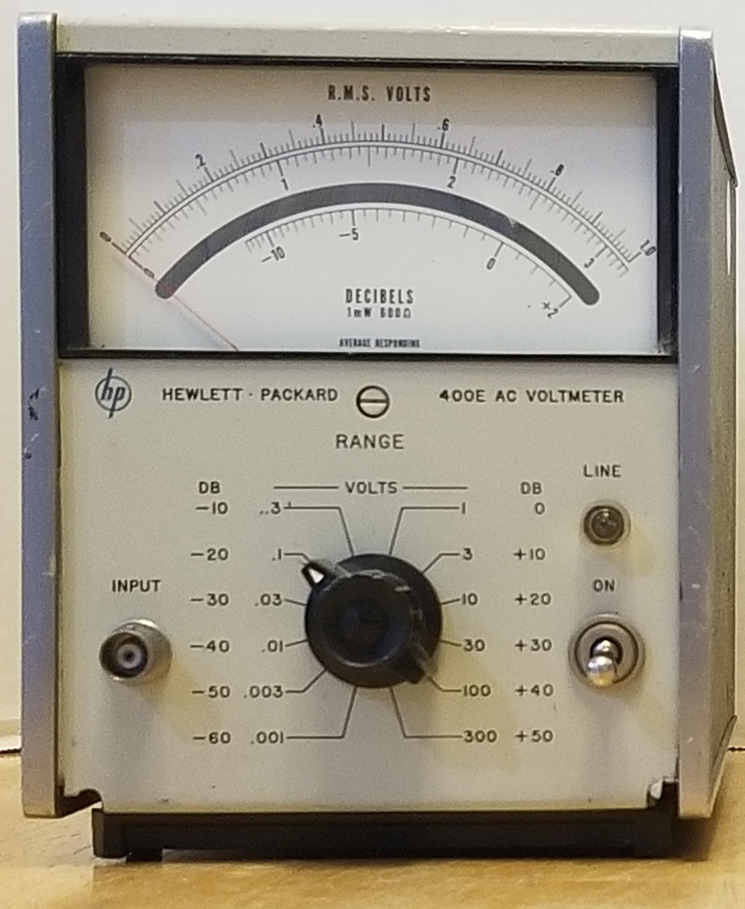
Using an Audio Meter
An option that has worked well over the years
Options include the HP 400 or 3400 AC voltmeter or even your old Triplett or Simpson VOM measuring AC voltage – the meter include a convenient dB scale which is simply 20 log (V2/V1)
The ac voltmeter is connected to the radio’s speaker or headphone jack. On the radio, turn AGC off, turn audio gain up and reduce RF gain to set the radio in a linear range and not in compression.
Since the bandwidth of the “audio meter” approach is only several kHz, the readings maybe “jumpy”, therefore a capacitor across the input terminals may be needed to help obtain an average reading

Slide 5
How do we compare sun noise readings?
Converting (S+N)/N to S/N
Since we have very low sky noise on the microwave bands, we measure our sun noise and moon noise over cold sky. When comparing sun noise readings among amateurs with different systems in order to determine one’s performance versus someone else, it is common place to compare these readings. At low S meter readings the measured level is actually signal plus noise and when we compare it to the noise level we must first convert (S+N)/N to S/N before making relative dB comparisons
S + N
S
=
+
1
N
N
S
S + N
_
Therefore
=
1
N
N
Convert dBs to ratios, then substitute in equations

Slide 6
Converting (S+N)/N to S/N Ratio

Slide 7
Example #1 & #2
Converting (S+N)/N to S/N
If station A is measuring 20 dB of sun noise and station B is measuring only 10 dB of sun noise then the difference is 19.96 - 9.54 = 10.42 dB or a change in sensitivity of 10.42 dB.
Now comparing station C who is receiving 10 dB of sun noise to station D who is receiving only 3 dB of sun noise then the difference is 9.54 - -.02 = 9.56 dB or a change in sensitivity of still nearly 10 dB for a 7 dB drop in sun noise.
S + N
S
=
+
1
N
N
S
S + N
_
Therefore
=
1
N
N
Convert dBs to ratios, then substitute in equations

Slide 8
Converting (S+N)/N to S/N Ratio Expanded Scale
W5LUA
Sept 26, 2000

Slide 9
Example #3
Example
Ant 1 Sun Noise = 2 dB
Ant 2 Sun Noise = 4 dB
Is the gain difference 2 dB
or something else?
Ant 1
Convert each sun noise reading
from (S+N)/N to S/N in dB
Ant 2
(S+N)/N = S/N + N/N
= S/N + 1
or S/N = (S+N)/N - 1
Gain Difference in dB

Slide 10
Sun Noise Measurements at 24 GHz – May 2001
Receiver Noise Figure = 2.4 dB, Solar Flux 175

Slide 11
March 3, 2012 10 GHz Sun Noise Results
 |  |  | Sun noise |  | relative
 |  |  | S+N/N | S/N | gain
W5LUA | 24 inch | Prime focus | 1.5 dB | -3.84 dB | 0 dB | 36 dBi
W5LUA | 30 inch | Prime focus | 1.3 dB | -4.57 dB | -.73 dB | 35.3 dBi
W5RLG | 24 inch | Prime focus | 1.1 dB | -5.4 dB | -1.56 dB | 34.4 dBi
WA5YWC | 18 inch | Offset fed | 1 dB | -5.87 dB | -2.03 dB | 34 dBi
W5LUA | 7.75 inch | Offset fed | .22 dB | -12.84 dB | -9 dB | 27 dBi
Same 10 GHz transverter and cable used for all measurements

Slide 12
Moving Forward
The preceding results were based on using the same downconverter on 10 and 24 GHz to make relative gain comparisons of antennas
The plan in moving forward is to test 10/24/47 GHz as individual systems which includes the antenna, cabling and transverter…..this is the bottom line as we continue to improve our systems…..
Stand by for additional test parties and results.

