Slide 1
Surplus LDMOS 902 Power Amplifier Module
Greg McIntire, AA5C
1 February 2020

Slide 2
85Y84 Modules
Class A Bias
  10K pot controls drain current and power out
  Could use input to control TX/RX
Connections
  Cut and Peel technique using 0.062 inch FR4 board works
  Etched board would be neater
Mounting
  Needs good heatsink
    ~60 Watts dissipated at full power
  Doesn’t have base plate extension tabs
    Used #8 screws with flat washers to mount to heatsink
    Use heatsink grease
    May be possible to solder directly to a copper spreader
Two built – both showed 38 dB gain and saturate at +43 dBm output
It is an LDMOS devices – excessive input power will damage them
Kent, WA5VJB has a good supply of these parts

Slide 3
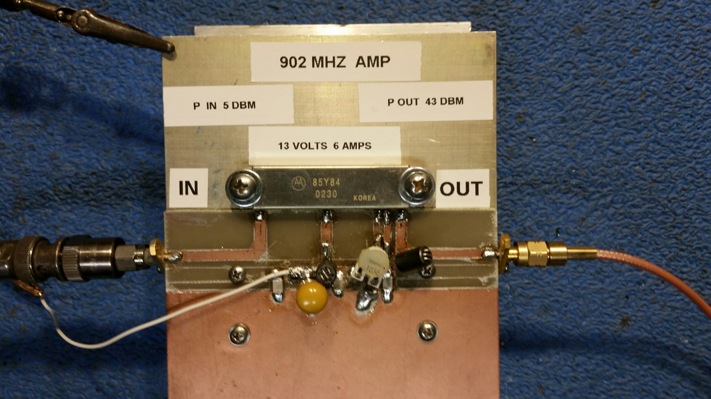
20 Watt Amplifier

Slide 4
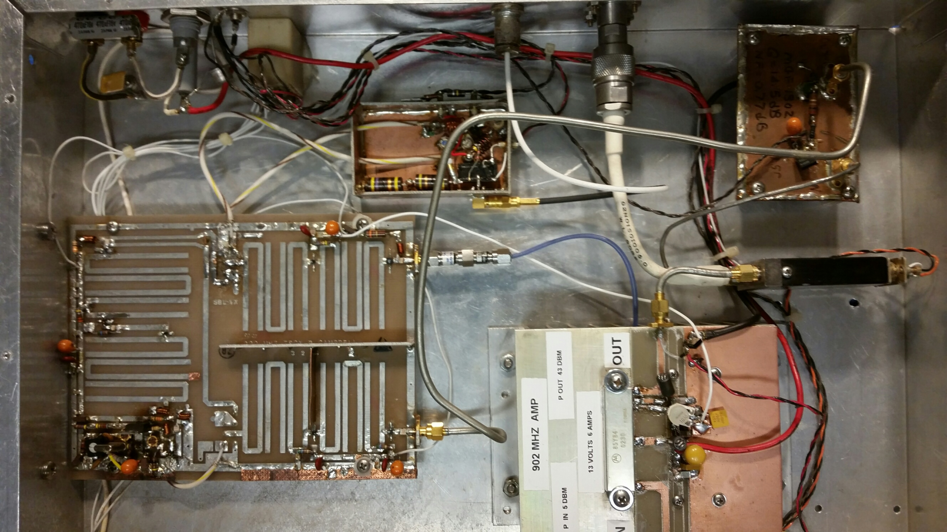
Power Amp Installed in 902 MHz Portable XVTR

