Slide 1
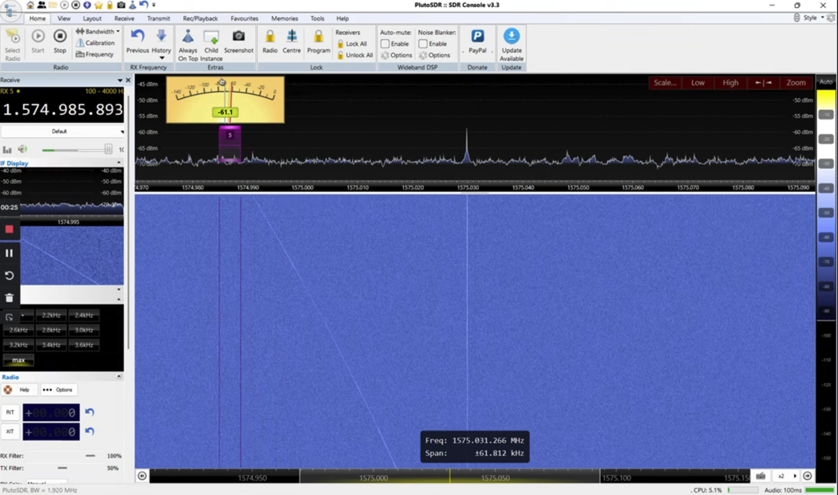
Welcome to NTMS February 8 2025 meeting
Chasing Starlink satellite leakage

Slide 2
NTMS Agenda
February 8, 2025
12:00 to 12:30– Setup & Bull Session
12:30 pm - Meeting Starts
  New Opportunities in 24 GHz Rain Scatter - Andy Flowers K0SM/2
  Current Electronic Warfare (as presented at DEFCON32) - Kent Britian WA5VJB
  NTMS Survey results - Matt Kube W5ZCA
  NTMS 2024 recap and 2025 Activity Plan
Show & Tell by members
Other items & Business Meeting

Slide 3
March 2025
^{1st} NTMS MAD – Microwave Activity Day
8th NTMS Zoom meeting
WWW.NTMS.ORG
WWW.NTMS.ORG
3
3

Slide 4
Perpetual
NTMS 2 meter net Every Sunday, 8:00 pm CST,144.260 MHz, called by Ross K5ZSJ
The 6 meter Hootowl net Every Saturday, Midnight, 50.125, called by Al W5RLG
NTMS Lunch
Every Tuesday, 11:30 am CST, Texas Smokehouse BBQ, Richardson TX (May change around holidays)
144 MHz Activity Night.
Every Monday 7:00-11:00 pm local
222 MHz Activity Night.
Every Tuesday 7:00-11:00 pm local
432 MHz Activity Night.
Every Wednesday 7:00-11:00 pm local
Midwest M.A.D. and NTMS M.A.D
First Saturday of every month.

Slide 5
NTMS Budget & Dues
Zoom Meeting $160/yr
Website Blue Host $86/yr
ARRL Liability Insurance $200/yr
PO Box $146/yr
501c3 non profit filing with TX $25/yr
Total $617 / $20 dues > 31 members min
Does not include meeting room space and ARRL Spectrum Defense Fund donations
Please support the NTMS with your $20 annual dues. Information on paying dues at www.ntms.org (see Membership link on left side of home page)

Slide 6
Business Meeting
Old Business
New Business
Any other topics to be discussed?

Slide 7
Adjourn?
Motion to adjourn?

