Slide 1
NTMS 2024 Recap and 2025 Activity Plan
Feb. 8 2025

Slide 2
NTMS 2024 Recap
6 club meetings
  23 technical presentations
Representation by NTMS members at other venues
  Central States VHF Society – multiple papers/presentations
  Microwave Update Vancouver – multiple papers/presentations
  Defcon32 – Kent Britain representing
  Other
    Cowtown Hamfest – multiple presentations
    Field Day (Jim & Matt at Cowtown, Brad at Bridgeport)
    Huntsville & Gigaparts convention

Slide 3
NTMS 2025 Activity Plan
Please volunteer where you can help. Raise your hand!
Meeting venue change – Zoom meetings likely
Meeting presentations needed
  EZNEC antenna design
  KiCad how-to build a circuit & PCB board
  Technical presentations from basic to advanced
  Building microwave equipment
Beacon projects
  24 GHz prototype is ready for packaging (unit test March 1st)
  47 GHz prototype is ready for packaging (unit test March 1st)
  Field test 24/47 GHz starting in May 2025
  Implement permanent 24/47 beacons by year end
SDR clinics
  Cowtown Hamfest we presented 3 times on SDR – well attended
  Interest list indicated 13 ops want more
  Zoom SDR schedule is posted on NTMS website – First session 2/22.

Slide 4
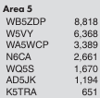

NTMS 2024 Recap
10 GHz and up contest
M.A.D.
  10 Microwave Activity Days in 2024
  Aligned with other parts of the country to hold MAD on first Saturday of the month starting April 2024

Slide 5
NTMS 2025 Activity Plan
SDR clinics
  Cowtown Hamfest (January) we presented 3 times on SDR – well attended
  Interest list indicated 13 ops want more
  Zoom SDR schedule is posted on NTMS website – First session 2/22.
  Zoom meetings will be every 2 weeks. We need instructors.
Cowtown club Field Day
  6 meter digital station, 5 Element yagi at 50’, 300 watts. (need volunteers and approval by Cowtown club) more to come

Slide 6
NTMS 2025 Activity Plan
10 GHz and up contest
Next week Matt will send out a “help needed” survey
  If warranted we will hold build out sessions from March to May
  Maybe you have most or all of the parts and need help in final build/test?
  We have 24 GHz Wavelab boards, 6 extra XP modules, 7 - 12” PF dishes
  We purchased 4 horns for 47 GHz DB6NT transverters

Slide 7
NTMS 2025 Activity Plan
M.A.D. – we’ve already had Jan and Feb MADs
  Focus is on 10 GHz and up but other bands are available
  We have a 10/24 GHz rover rig loaner (Matt currently using)
  As you finish your 10/24/47 rigs then put them on the air!
  As a rover I will be adding 5 GHz & crank up height
  Strategy group to plan 24 GHz dx records attempts
  Strategy group to plan 122/134 GHz dx records attempts
Microwave Update Tucson
Central States VHF Society – Lincoln – July 24-27

Slide 8
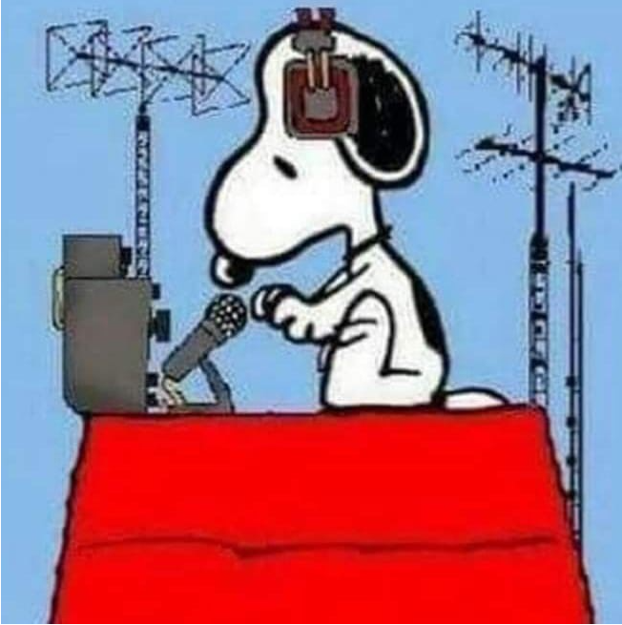
Questions?

