Slide 1
Cheap is good
If we can reduce the price of admission…
We will expand the uWave community
Many hams (good engineers) stay away from uWaves
Don’t like to guess or shoot in the dark
Test equipment is expensive
Reduce the cost of test equipment → more folks
Reduce the cost of the rigs → more folks

Slide 2
Dispel Faulty Notions
Chinese stuff is NOT crap
eBay is NOT a shoddy marketplace
eBay + Paypal is the safest way to buy
If you stay away – you are missing out on some good stuff

Slide 3
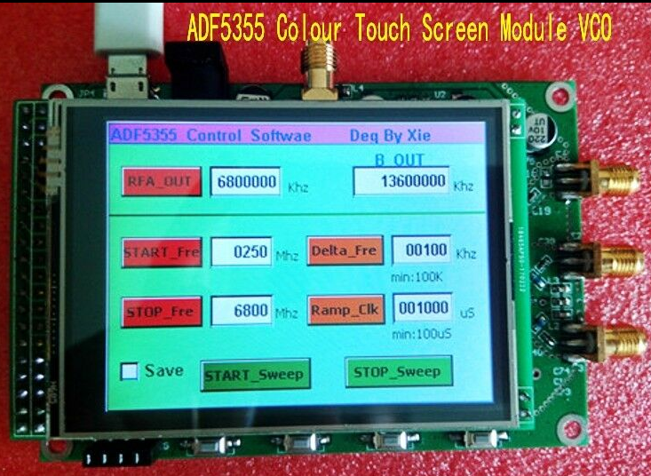
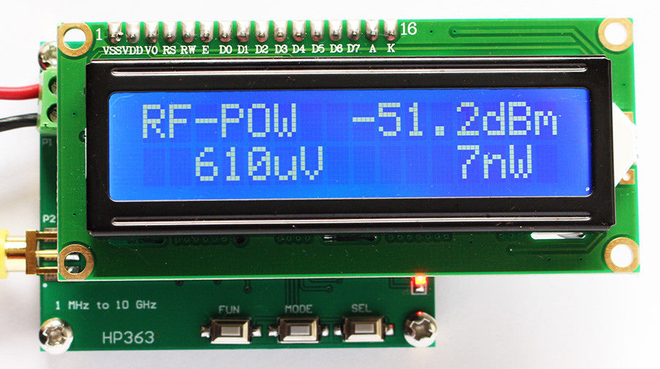
Interesting Function Modules
From China (mostly)
Via eBay – Amazon, Aliexpress, Taobao
Free shipping – no min order
Started simple → increasing complexity

Slide 4
Recurring Theme
Semiconductor Cos doing the heavy lifting
Makes an interesting analog chip
Mostly AD, LTC and Quervo (RFMD & Triquint)
Somebody puts that chip on a board
Add uController and display
Assembled, tested, delivered
Price < ones twosy price for the chip

Slide 5
Application Engineers
Basically acting as App Engineers
Designs are frequently the exact application circuit recommended by chip maker – sometimes even layout
Reference designs

Slide 6
Pay attention to the chip
Reputable chips → modules meet specs
Approach chips from Chinese companies with some caution
Some Chinese chips are ok
Some don’t meet their own specs
RF designs have been spot on
Power supplies: some specsmanship

Slide 7
28 volts for relays for $.75 (switching)

Slide 8
300 Watts 20 A Buck for $10 (switching)

Slide 9
30 Watts Buck for $5 with DVM (switching)

Slide 10
I prefer China – others are no better, just more expensive

Slide 11
I prefer China – others are no better, just more expensive

Slide 12
Actually, it’s better

Slide 13
Even comes with Characterization

Slide 14
By the dozen

Slide 15
LDO also

Slide 16
Not just DC/DC

Slide 17
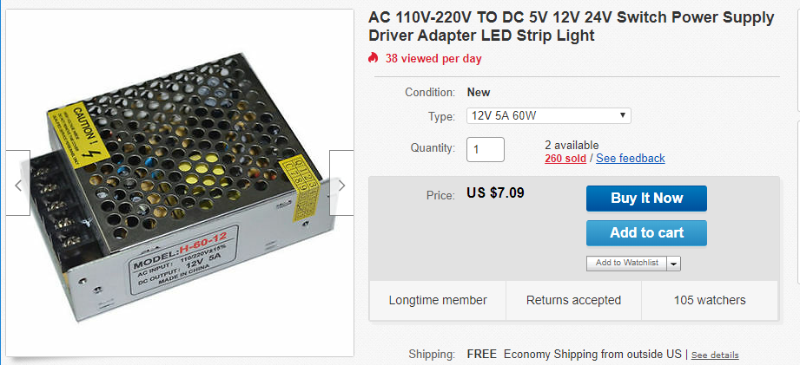
Buy it when you find it

Slide 18
Noise Floor? (ON)

Slide 19
Noise Floor? (OFF)

Slide 20
Audio Power Amps

Slide 21
Audio Power Amps

Slide 22
Audio Power Amps

Slide 23
Many sellers – many prices

Slide 24
LNAs Up to 4 Gig NF < 0.6 @ 1 GHz, NF <1.0 @ 2.2 GHz

Slide 25
Shielded

Slide 26
Enclosed

Slide 27
Digital Voltmeter

Slide 28
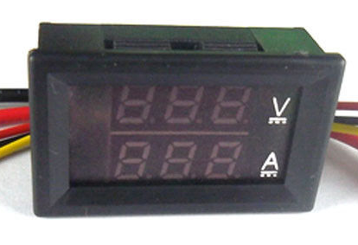
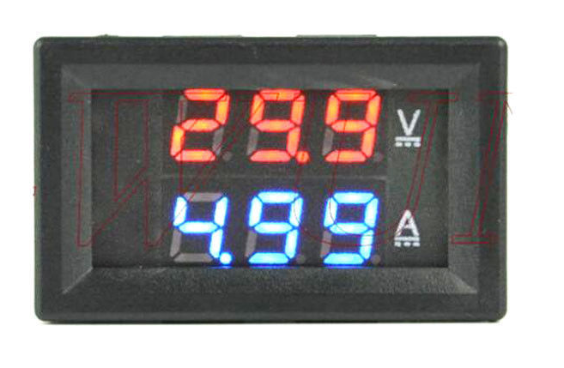
Digital Voltmeter – panel mount

Slide 29
Precision Voltage Reference 2.5, 5, 7.5, 10 volts AD584: 0.1% & 15ppm

Slide 30
Noise Source Up to 6 GHz – others to 10GHz +

Slide 31
Noise Source Spectrum to 150 MHz (w/ atten)

Slide 32
Noise Source Spectrum to 2.5 GHz (33 db atten)

Slide 33
Signal Source Antenna Range…

Slide 34
Characterize Filters Before the filter

Slide 35
After 2.6 MHz High Pass filter

Slide 36
Bandpass filter: 118 – 136 MHz

Slide 37
RTL-SDR V3 dongle Pretty good spectrum Analyzer
500 kHz to 1.76 GHz
Only 2.4 MHz instantaneously displayed
$20
Can characterize filters up to 1.76 GHz with:
$15 noise source
$20 RTL-SDR

Slide 38
Power Meter 1 MHz – 10 GHz: $33

Slide 39
How Good?

Slide 40
With coax loss on HP435

Slide 41
Damn Good – 2 meters

Slide 42
Damn Good – 2 meters

Slide 43
How about 10 GHz?

Slide 44
How about 10 GHz?

Slide 45
Damn good at 10 GHz

Slide 46
Enter an offset

Slide 47
Enter an offset

Slide 48
50 MHz Counter: $4.30

Slide 49
Be careful about shipping

Slide 50
Same unit – reasonable shipping

Slide 51
Even Cheaper
Shop a bit – check it out – pick your vendor

Slide 52
65 MHz Counter: $8

Slide 53
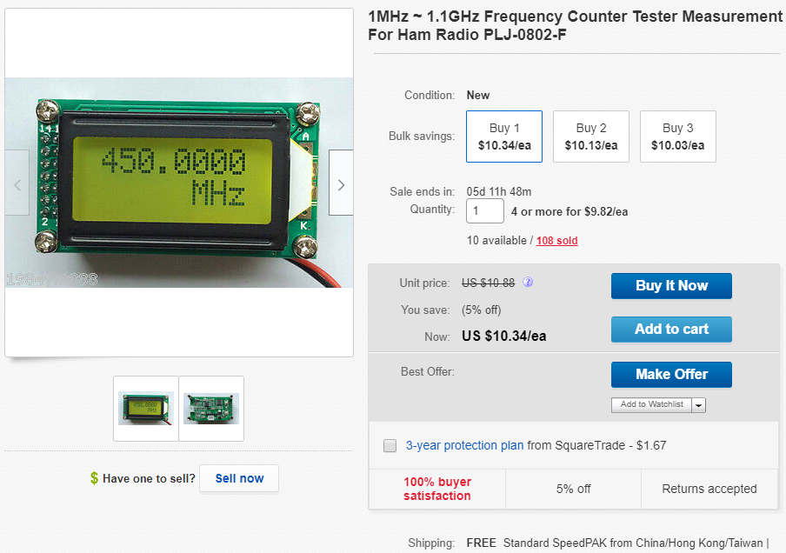
1.1 GHz Counter: $10

Slide 54
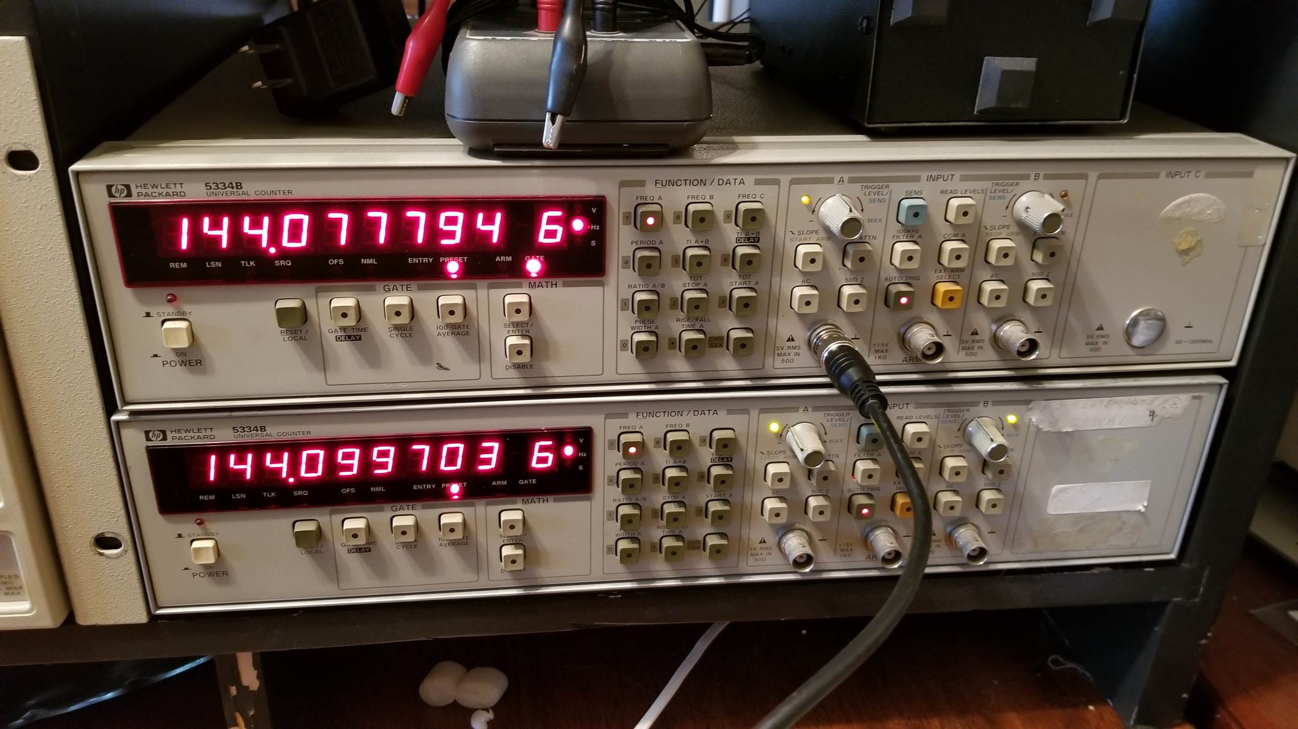
Difference in size…

Slide 55
Up to 2.4 GHz: $9.59

Slide 56
Go crazy for $82

Slide 57
3 watt RF Amp - 2 to 700 MHz: $15

Slide 58
1W 6GHz Variable Attenuator: $24

Slide 59
CW Keyer

Slide 60
GPS Reference Freq. Std – 10 MHz

Slide 61
NanoVNA – 50 kHz to 900 Mhz

Slide 62
NanoVNA
Be careful about choice of vendor – US is preferred
Must include:
Battery
Shielding
Cal standards
Coax jumper
Pay $45 to $50 delivered – more is NOT better
There are scams at $20
Higher priced units are not any better

Slide 63
NanoVNA
Very good device – not a toy
Recognize it as an inspired design
I’d invest – but no
Well supported – routine firmware upgrades
User guides suck – ZL1SCI is best
Developers are available online
Cal standards are good enough
Except – must add SMA female – female adapters
Be careful of the included SMA f-f adapter
Early ones have 1 db loss at 900 MHz (delrin)
Edd555 now shipping PTFE units (<0.1 db)
3D printed plastic enclosures available, but may not fit

Slide 64
NanoVNA
Immediately join the Nanovna group on groups.io
Direct communications with hardware and firmware developers
Lots of tips
Wiki
Files
Join the Facebook group “MiniVNA Tiny & NanoVNA”
Good YouTube videos – “look for IMSAI guy” and “Joe Smith”

Slide 65
NanoVNA-H history
Been coming since 2006
Derived from earlier designs including the VNWA from Professor Thomas Baier DG8SAQ
A kit designed by edy555 only available in Japan
Commercialized by hugen (Chinese) Nanovna-H
Open source HW and FW
Several vendors
Many sellers: eBay, Amazon, Aliexpress, Taobao
Prices and completeness vary

Slide 66
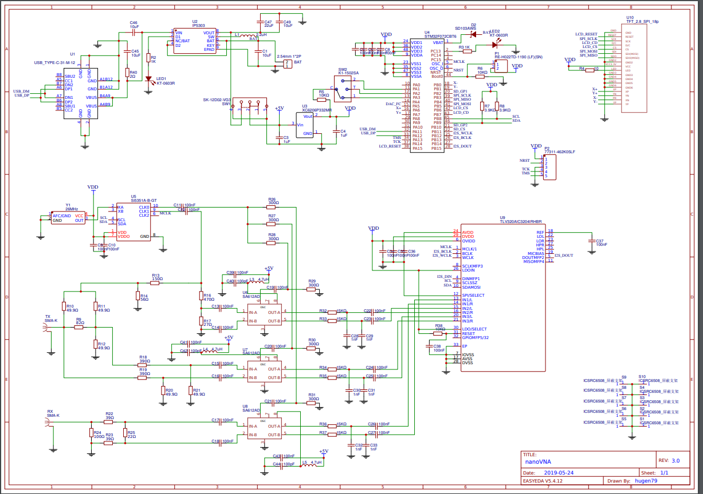
Schematic

Slide 67
NanoVNA Fits the model
Interesting chip is the SI5351
+ uController (STM32F072CBT6)
+ Display
Small number of support circuitry

Slide 68
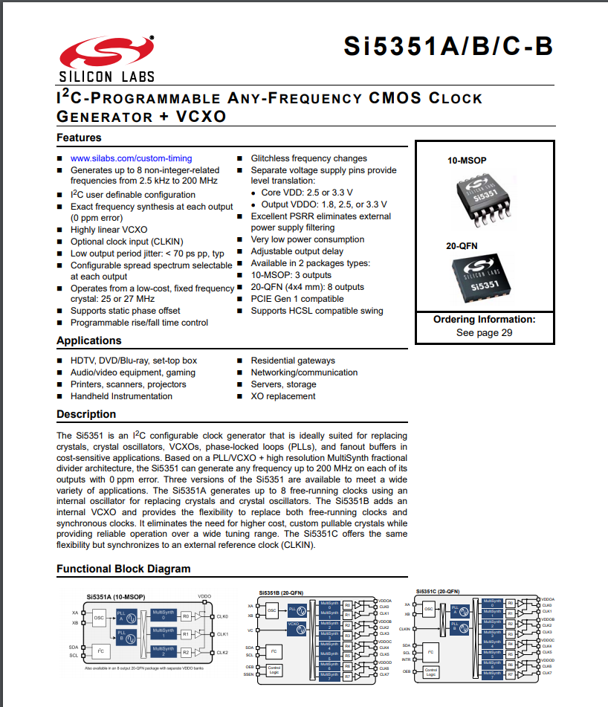

Slide 69
NanoVNA – F

Slide 70
NanoVNA – F
4.3” screen, Al case
$123
Designed and produced by BH5HNU
Not so clearly open source
Different Firmware, uses an RTOS
Great support from designer plus its own groups.io
Serious attempt to remain compatible – PC software
Customers like it

Slide 71
NanoVNA–H: V2
In board layout
Available in a couple more months
Same price point, same screen size
Up to at least 3.5GHz, more dynamic range
Uses the ADF4350
One mixer + switch vs. 3 mixers
Drops the codec – 12 bit uController A/Ds
Expect it will be a big deal
May begin to set the world on fire

Slide 72
NanoVNA-saver PC Software
Use Nanovna-saver
Rune Broberg 5Q5R
GREAT support and VERY responsive
HW does 101 point
SW strings segments together
Average measurements, discards
TDR

Slide 73
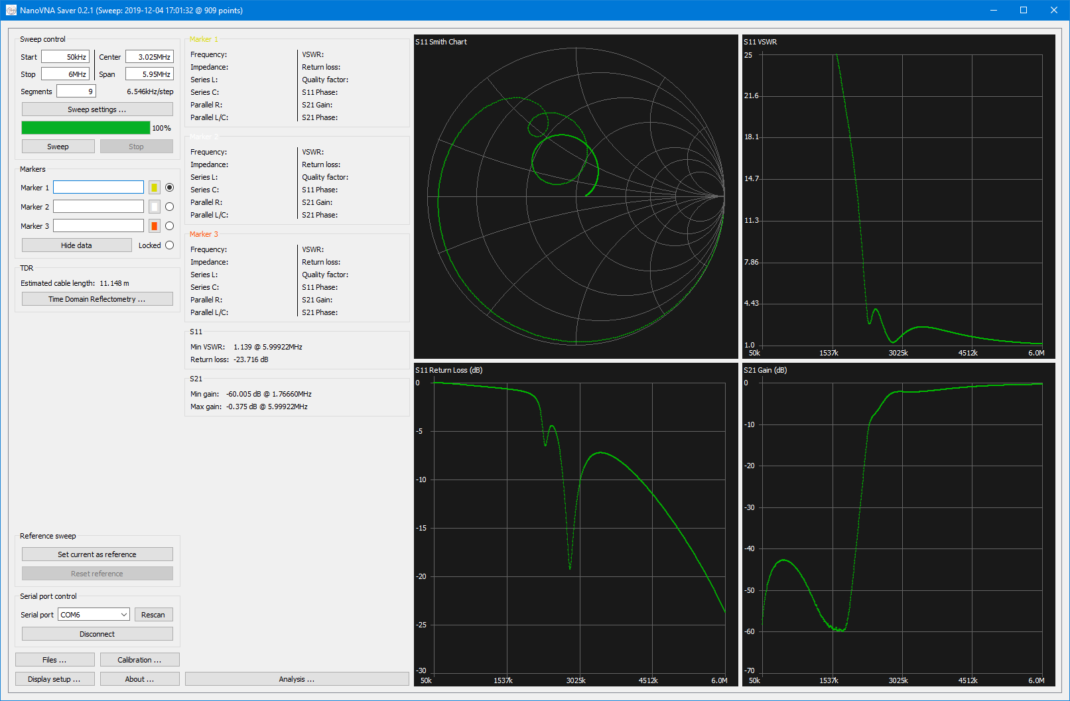
2.6 MHz High Pass (RTL-SDR)

Slide 74
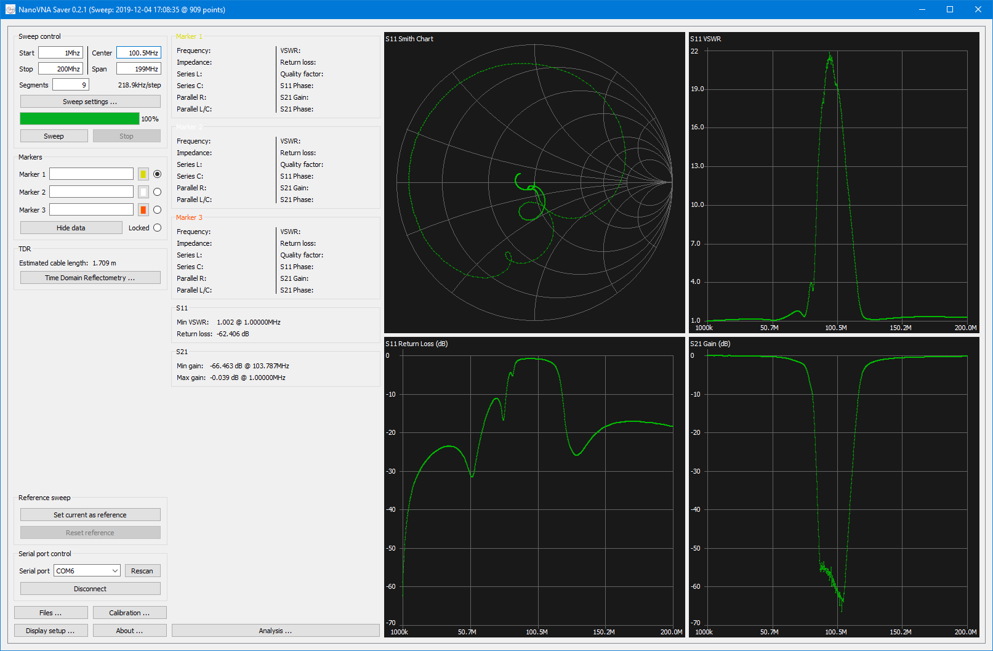
FM BC Notch

Slide 75
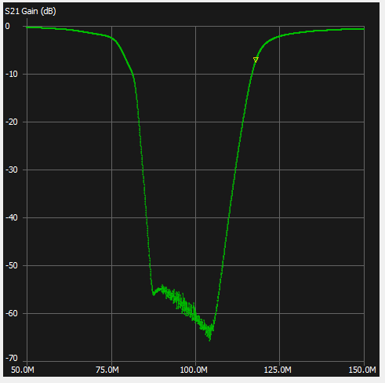
NanoVNA-saver

Slide 76
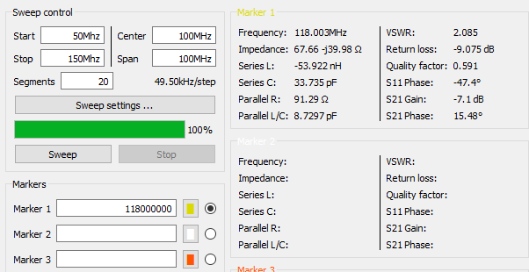
NanoVNA-saver

Slide 77
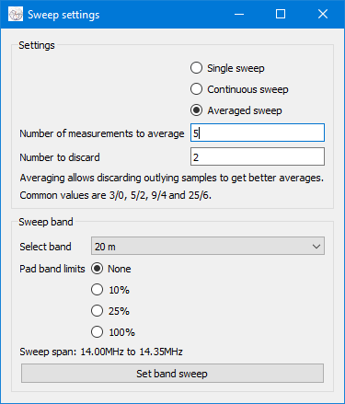
NanoVNA-saver Sweep Settings
TERRIFIC

Slide 78
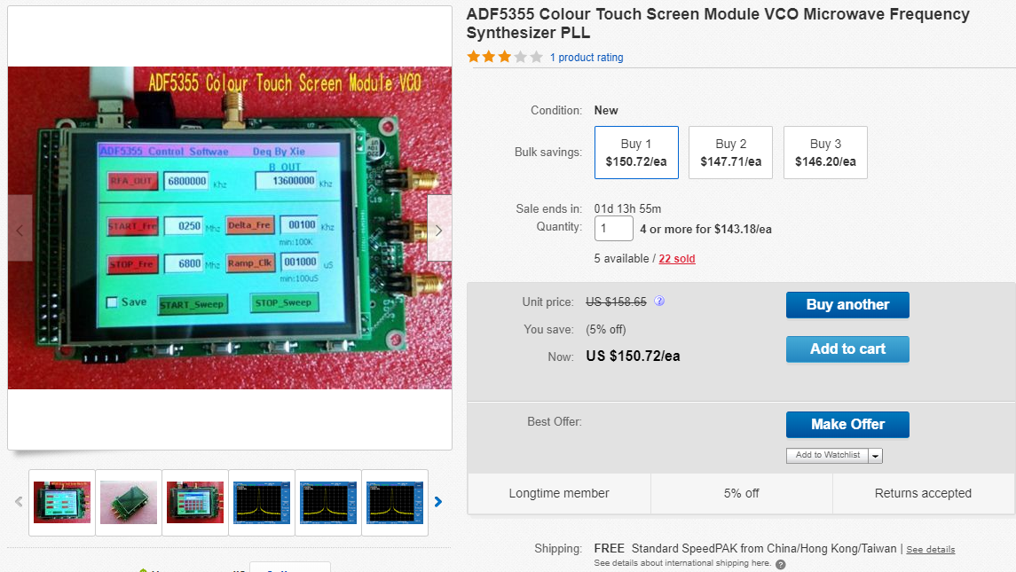
Signal Source 250Mhz – 13.6 Ghz

Slide 79
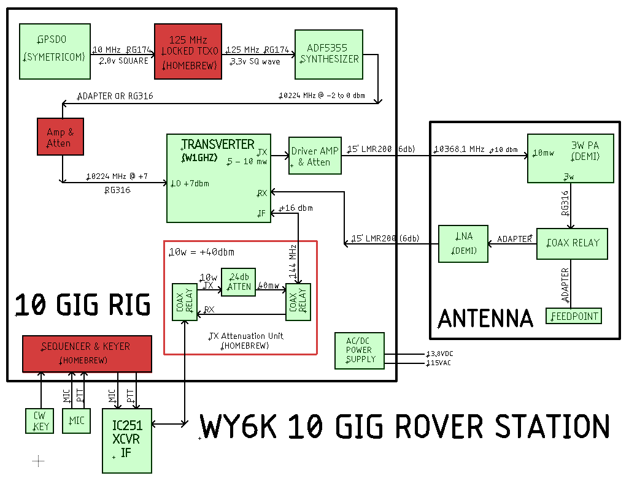
10 gig rig

Slide 80
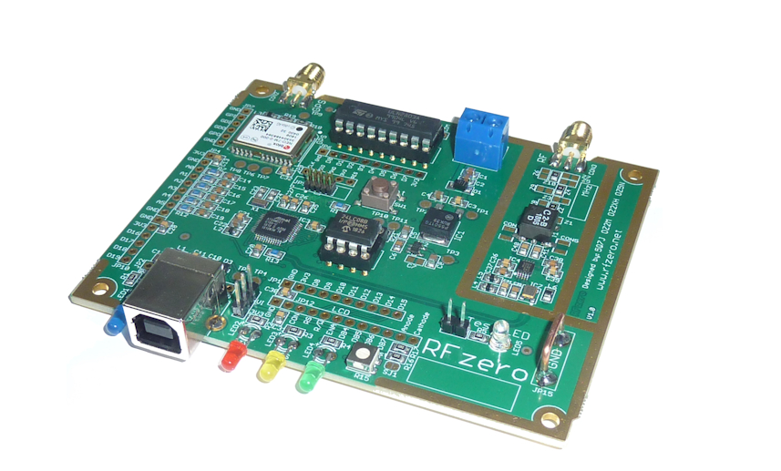
RF Zero - $55 delivered
Multi-purpose GPS locked RF Unit. Can be a beacon, signal generator, VFO, GPSDO. Arduino compatible. Already used for CW, FT4, FT8, Js8, JT9, WSPR, etc.

Slide 81
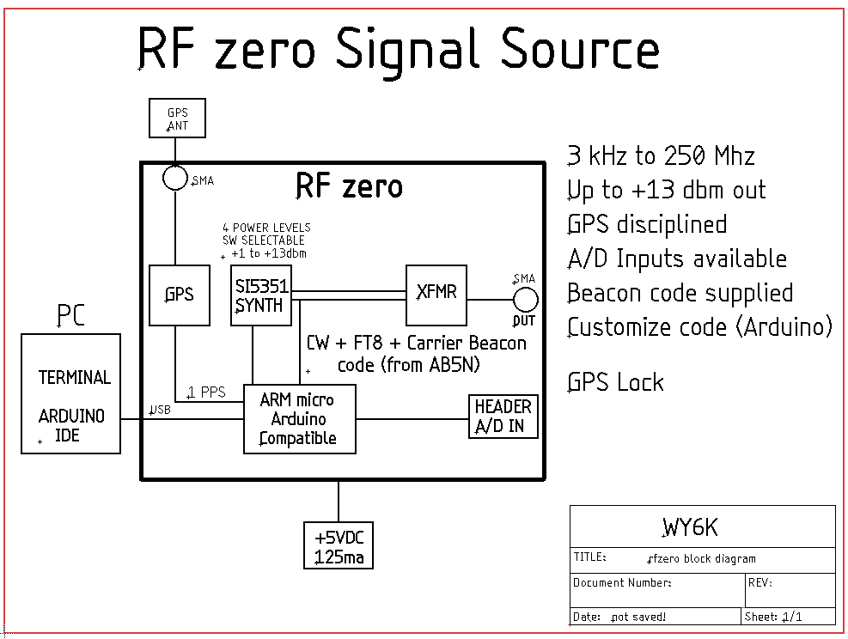

Slide 82
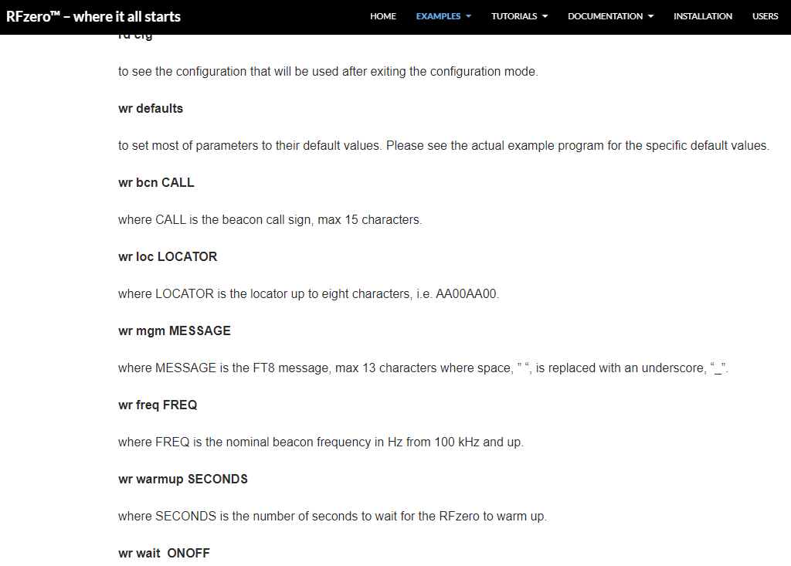
Easy setup with Terminal Program

Slide 83
2 meter Beacon
Based on RF zero and AB5N code (CW & FT8)
Add filters, Power Amp, power supply
1 to 25 watts output
Only remote control is ON/OFF
Use A/D inputs to measure Forward & Reflected Power
Reduce power when SWR > 2.0
Will reduce as much as 12 db in software
Can also shutdown the Power Amp
Modify code to add Power/SWR to beacon msg
WY6K EM13QB 9w/1.4

Slide 85
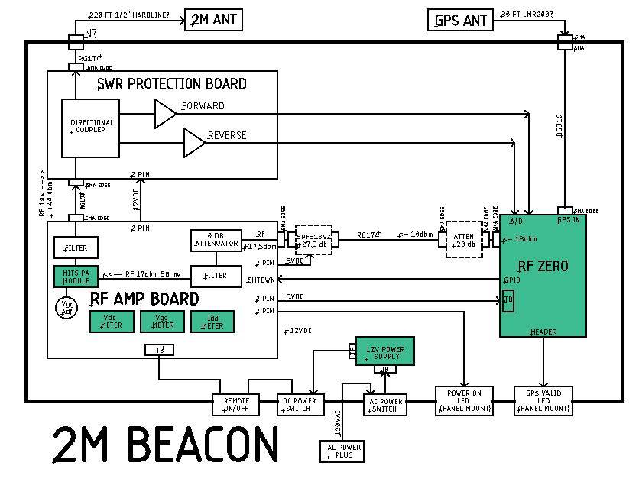

Slide 86
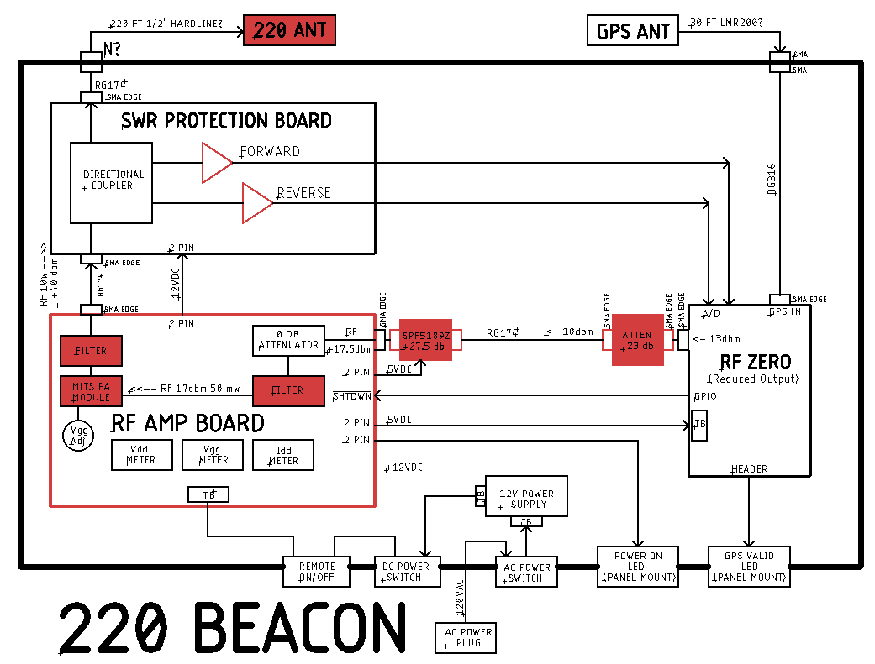

Slide 87
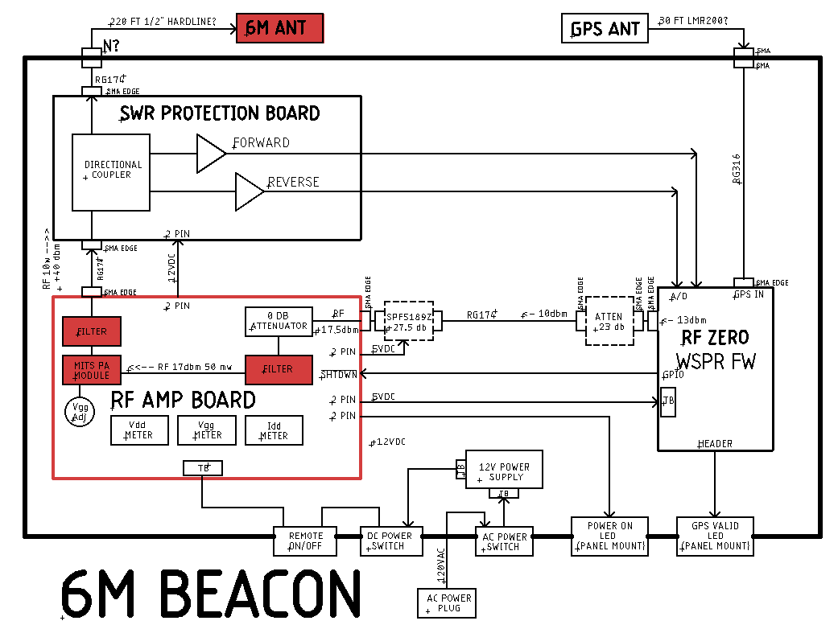

Slide 88
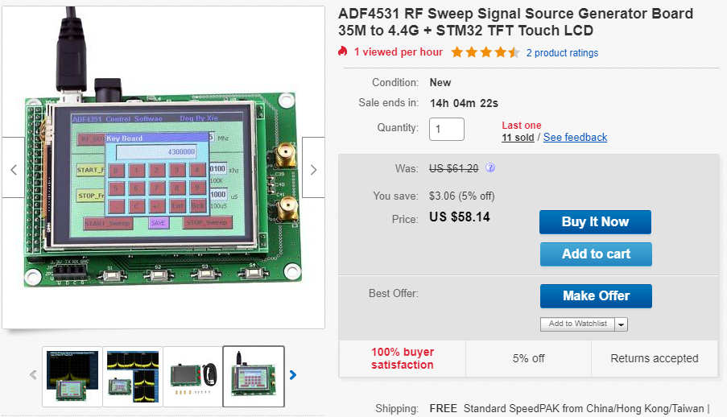
Little Brother: ADF4351 4.5 GHz for $58

Slide 89
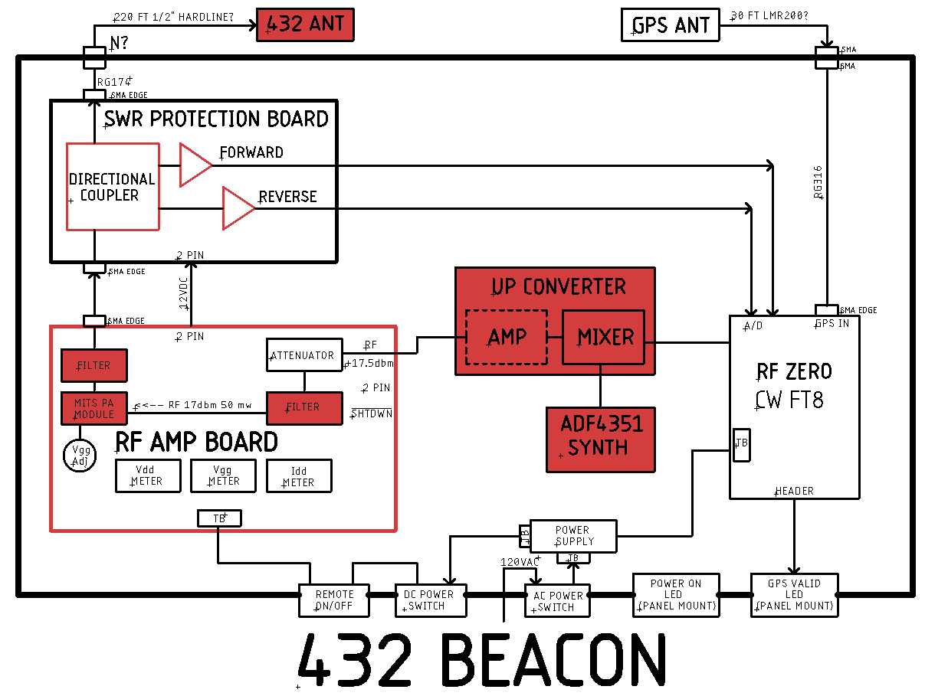

Slide 90
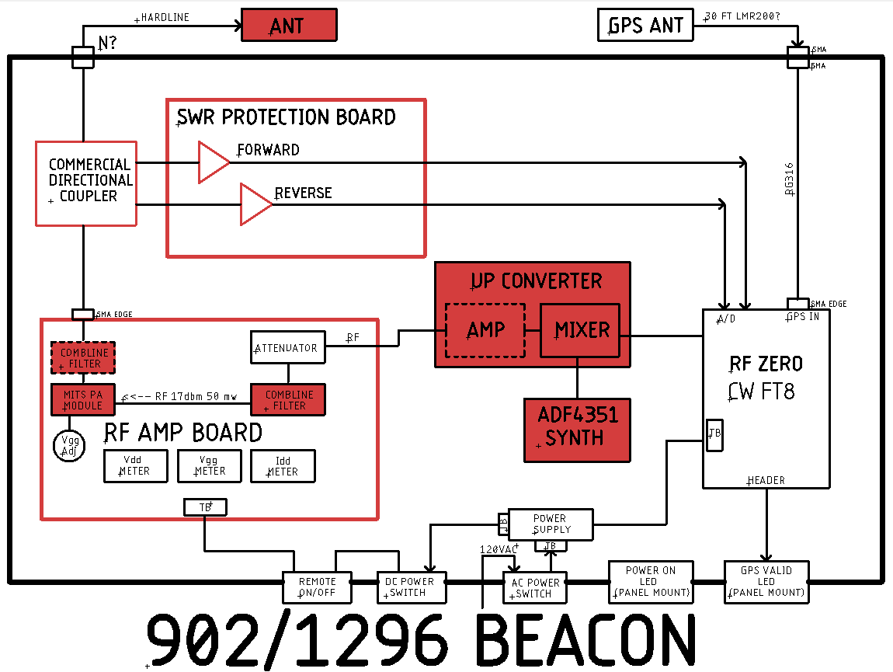

Slide 91
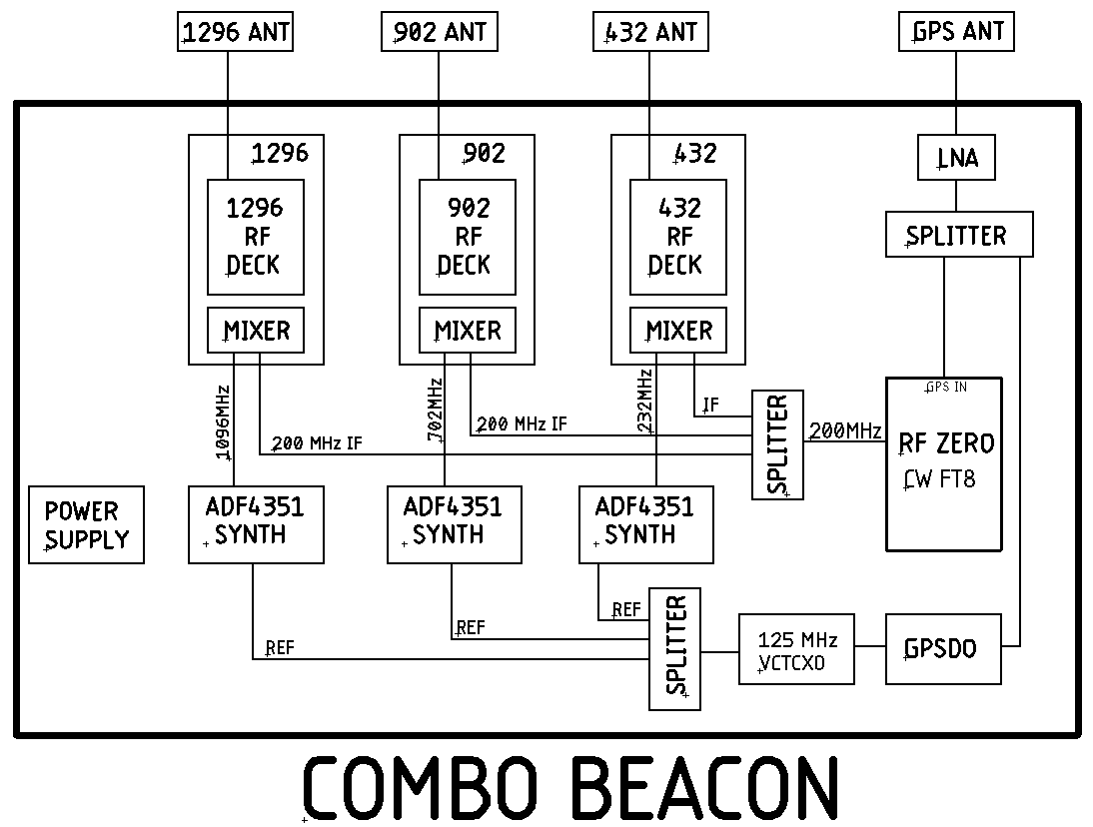

Slide 92
