Slide 1
LDO noise effects – part 1 July 1, 2023 KM5PO & KI5EMN

Slide 2
“Noise” is everywhere
Noise is an unwanted disturbance in an electrical signal
Noise generated by electronic devices varies greatly as it is produced by several different effects.
In particular, noise is inherent in physics and central to thermodynamics. Any conductor with electrical resistance will generate thermal noise inherently. The final elimination of thermal noise in electronics can only be achieved cryogenically, and even then quantum noise would remain inherent.

Slide 3
“Noise” types
Thermal generated by the random thermal motion of charge carriers (usually electrons), inside an electrical conductor, which happens regardless of any applied voltage
Shot random statistical fluctuations of the electric current when the charge carriers (such as electrons) traverse a gap. If electrons flow across a barrier, then they have discrete arrival times
Partition where current divides between two (or more) paths
Flicker a signal or process with a frequency spectrum that falls off steadily into the higher frequencies
Burst sudden step-like transitions between two or more discrete voltage or current levels
Transit-time If the time taken by the electrons to travel from emitter to collector in a transistor becomes comparable to the period of the signal being amplified
Coupled
can be coupled into a circuit from the external environment, by inductive coupling or capacitive coupling, or through an antenna..
Intermod/Crosstalk/Interference/Atmospheric/Industrial/Solar

Slide 4
Mitigation
Faraday cage – A Faraday cage enclosing a circuit can be used to isolate the circuit from external noise sources. A Faraday cage cannot address noise sources that originate in the circuit itself or those carried in on its inputs, including the power supply.
Capacitive coupling – Capacitive coupling allows an AC signal from one part of the circuit to be picked up in another part through the interaction of electric fields. Where coupling is unintended, the effects can be addressed through improved circuit layout and grounding.
Ground loops – When grounding a circuit, it is important to avoid ground loops. Ground loops occur when there is a voltage difference between two ground connections. A good way to fix this is to bring all the ground wires to the same potential in a ground bus.

Slide 5
Mitigation
Shielding cables – A shielded cable can be thought of as a Faraday cage for wiring and can protect the wires from unwanted noise in a sensitive circuit. The shield must be grounded to be effective. Grounding the shield at only one end can avoid a ground loop on the shield.
Twisted pair wiring – Twisting wires in a circuit will reduce electromagnetic noise. Twisting the wires decreases the loop size in which a magnetic field can run through to produce a current between the wires. Small loops may exist between wires twisted together, but the magnetic field going through these loops induces a current flowing in opposite directions in alternate loops on each wire and so there is no net noise current.
Notch filters – Notch filters or band-rejection filters are useful for eliminating a specific noise frequency. For example, power lines within a building run at 50 or 60 Hz line frequency. A sensitive circuit will pick up this frequency as noise. A notch filter tuned to the line frequency can remove the noise.

Slide 6
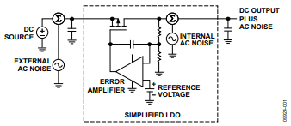
LDO PSRR vs other noise
Power Supply Rejection Ratio (PSRR)
Is a measure of circuit’s power supply rejection expressed as a ratio of output noise to noise at the power supply input – is a function of frequency/affected by the gain bandwidth of the EA/load current variation has impacts
PSRR = 20 log ( Ripple input divided by Ripple output )
Other LDO noise
Noise generated by the transistors and resistors in the LDO’s internal circuitry (thermal, flicker, shot) and by the external components

Slide 7
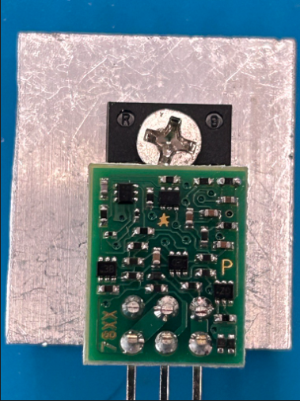
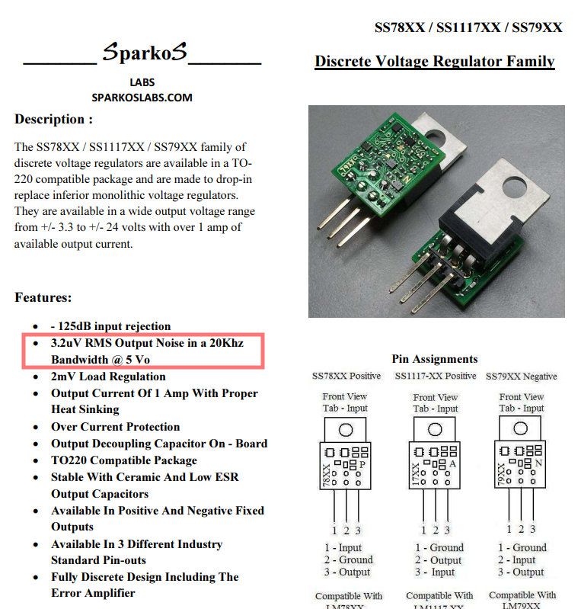
In the shop
Mats referred me to the Sparkos LDO

Slide 8
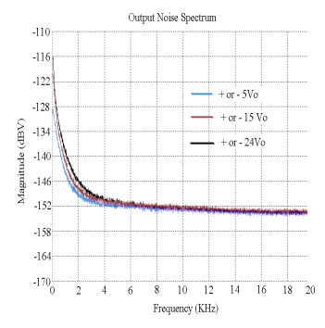
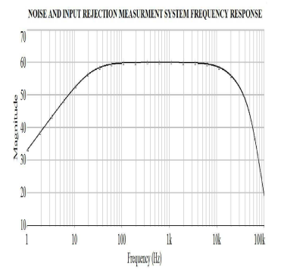
In the shop
In the datasheet

Slide 9
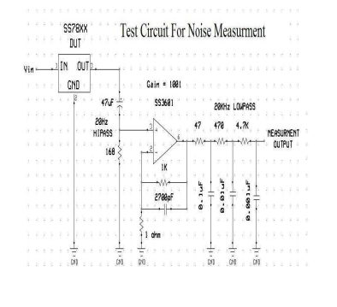
In the shop
In the datasheet

Slide 10
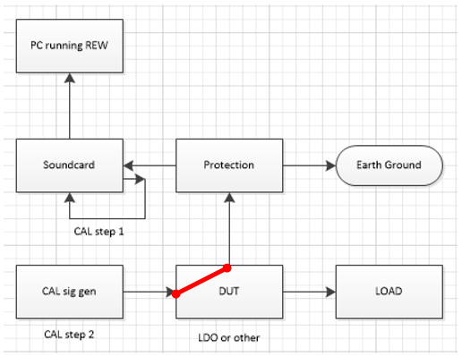
In the shop
Noise measuring setup

Slide 11
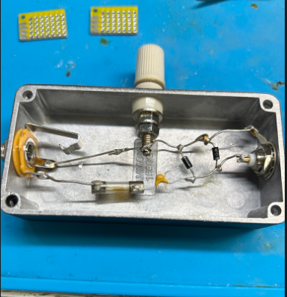
In the shop
Protection for soundcard

Slide 12
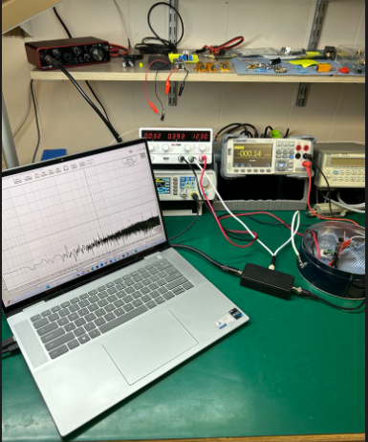
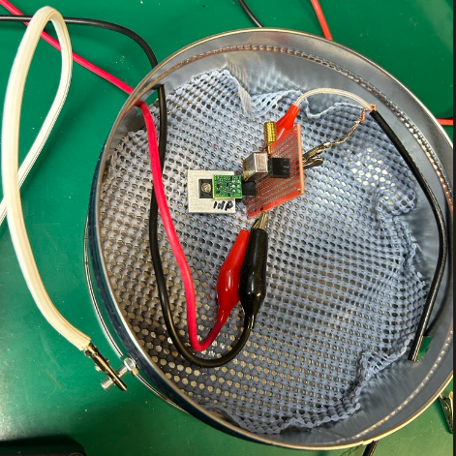
In the shop
Ready to measure

Slide 13
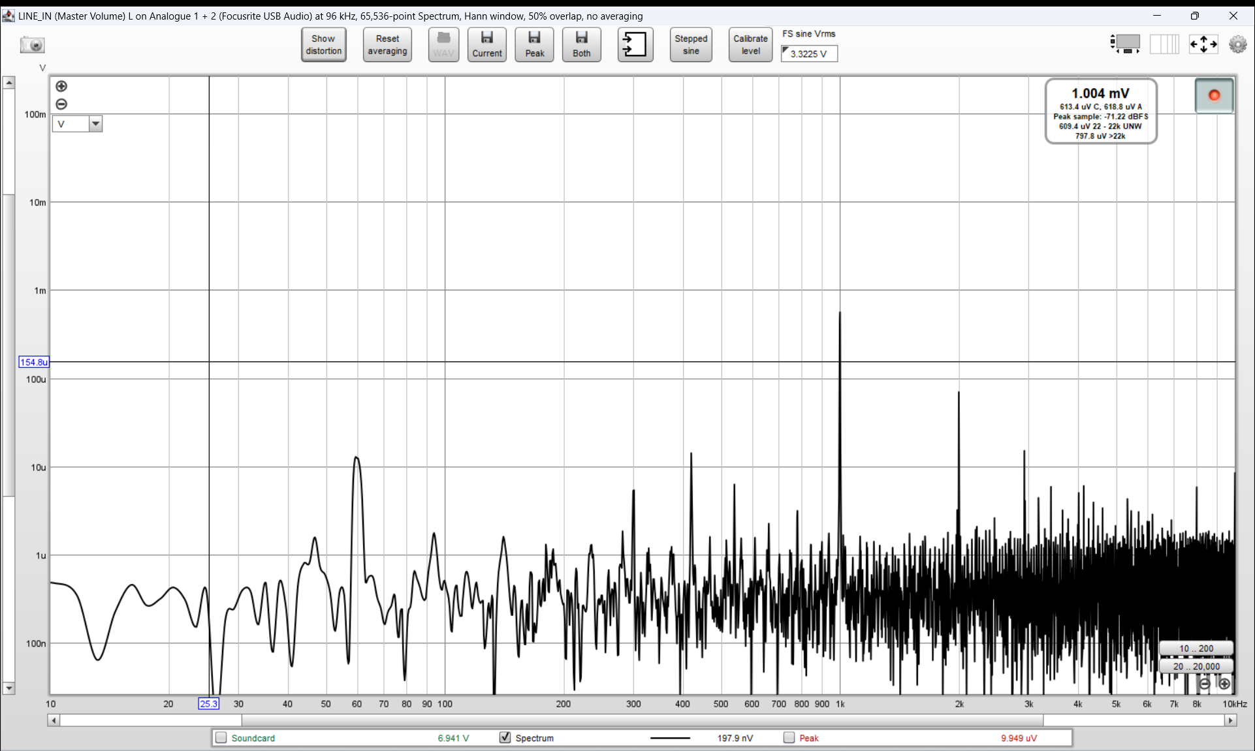
Noise measures
Calibrated system – laptop powered 6-10-23
Measurement of 1 Khz at .001v (1 mV) in the tin can
Calibrated system – laptop powered 6-10-23
Measurement of 1 Khz at .001v (1 mV) in the tin can

Slide 14
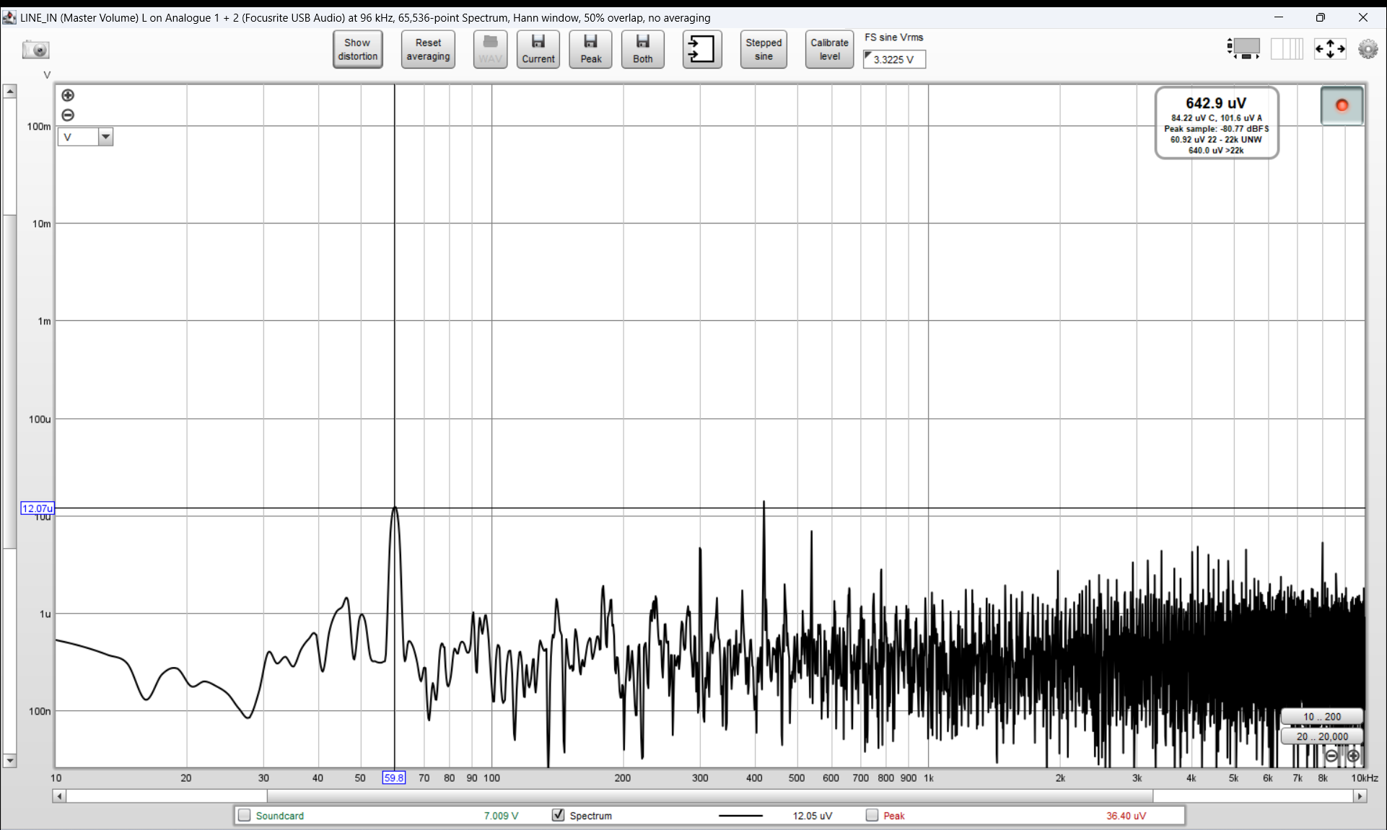
Noise measures
Calibrated system – laptop powered 6-10-23
Measurement of 51 ohm resistor in the tin can
12 uV of ripple at 60 hz

Slide 15
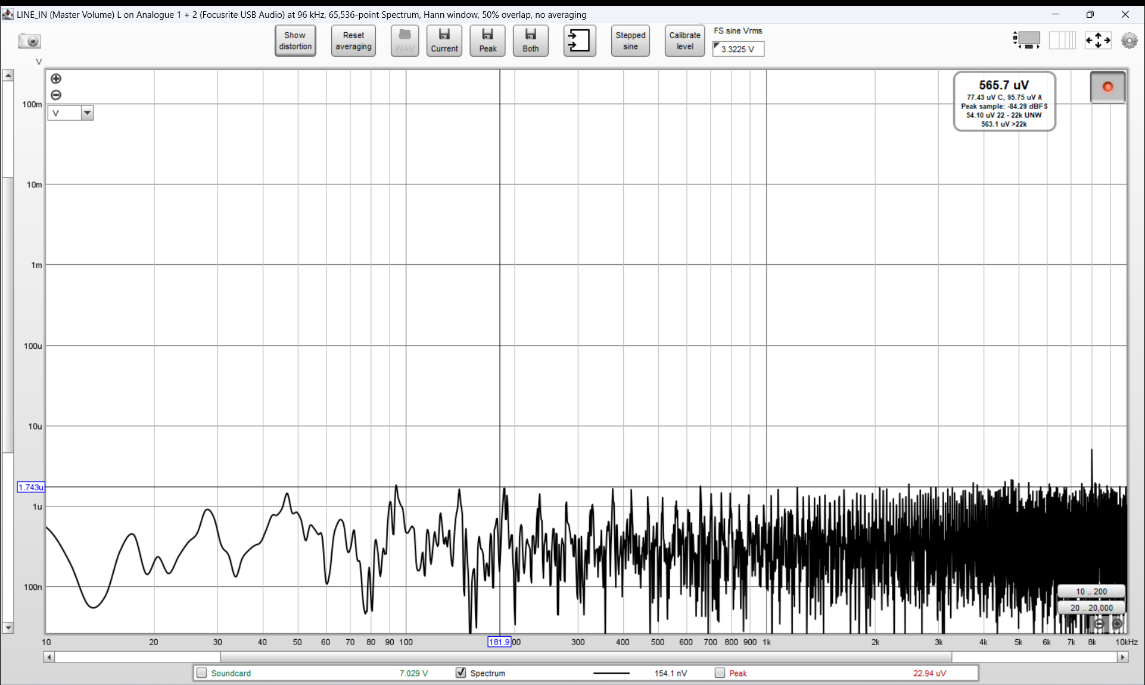
Noise measures
Calibrated system – laptop on battery 6-10-23
Measurement of 51 ohm resistor in the tin can
Peak of 1.74 uV < 20 KHz ~280 nV average noise < 20 Khz

Slide 16
Noise measures
Calibrated system – laptop on battery 6-10-23
Measurement of 51 ohm resistor in the tin can
Peak of 1.74 uV < 20 KHz ~280 nV average noise < 20 Khz

Slide 17
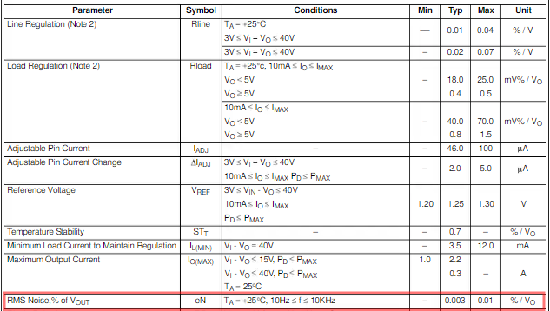
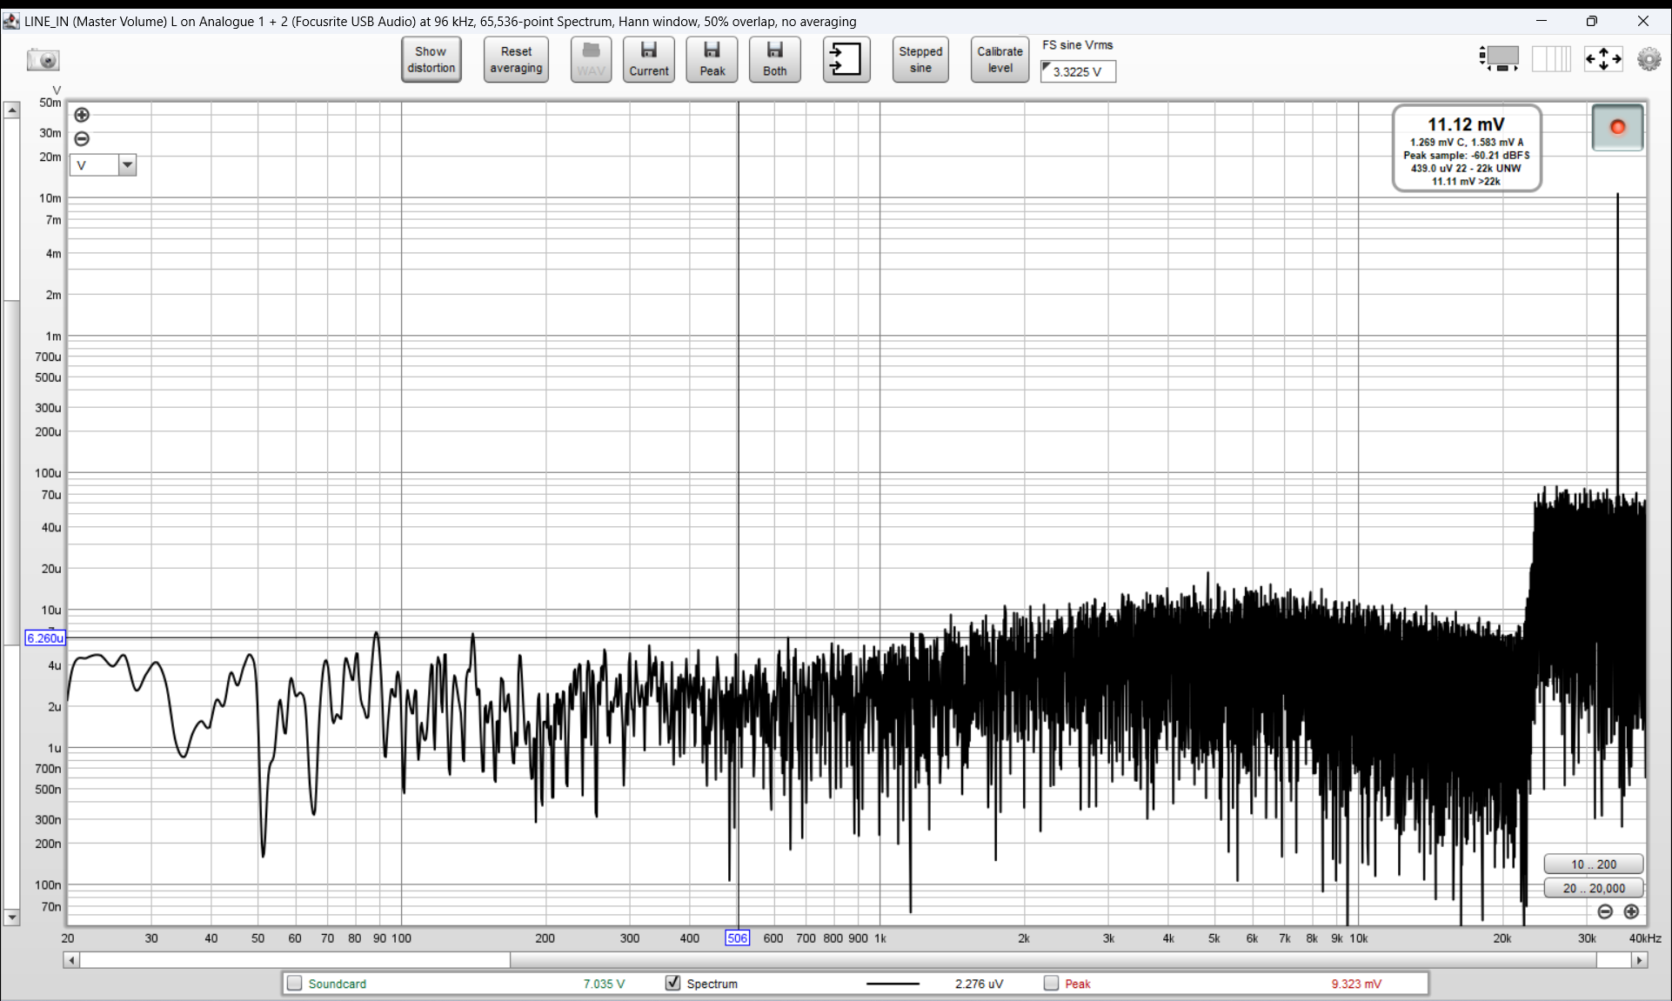
Noise measures
LM317 number 1 breadboarded circuit (12 vDC in – 5 vDC out – 51 ohm load - 75 mA draw) ~ 5-7 uV peaks below 2 khz, broad peak of 15 uV on 5 KHz, 10 mV spike at 35 Khz
.003 % of 5v=15 uV

Slide 18
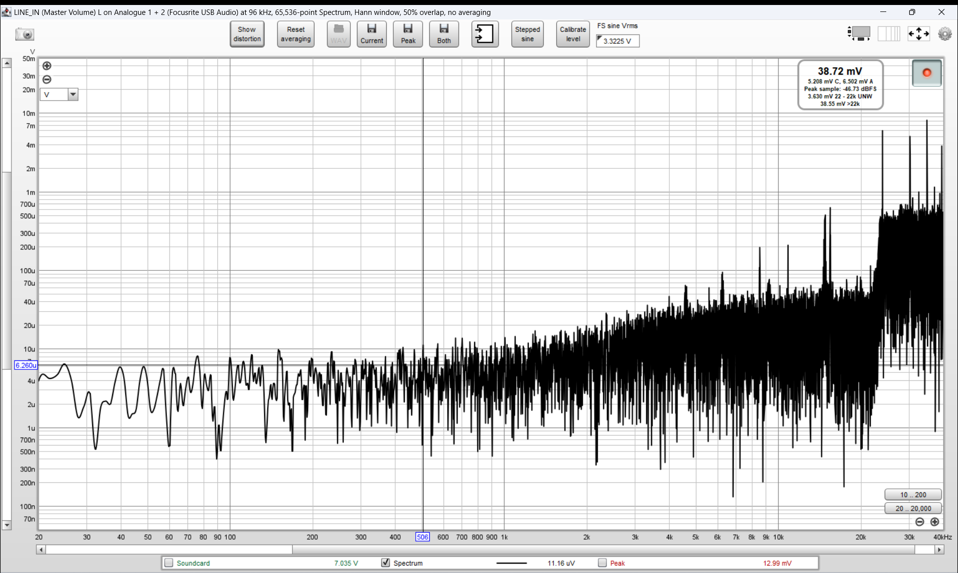
Noise measures
MH-MINI-360 (12 vDC in – 5 vDC out – 51 ohm load) ~6 to 10 uV peaks <500 Hz, rising noise of 10 to 40 uV at 20 KHz, peak of ~ 1 mV at 12 KHz

Slide 19
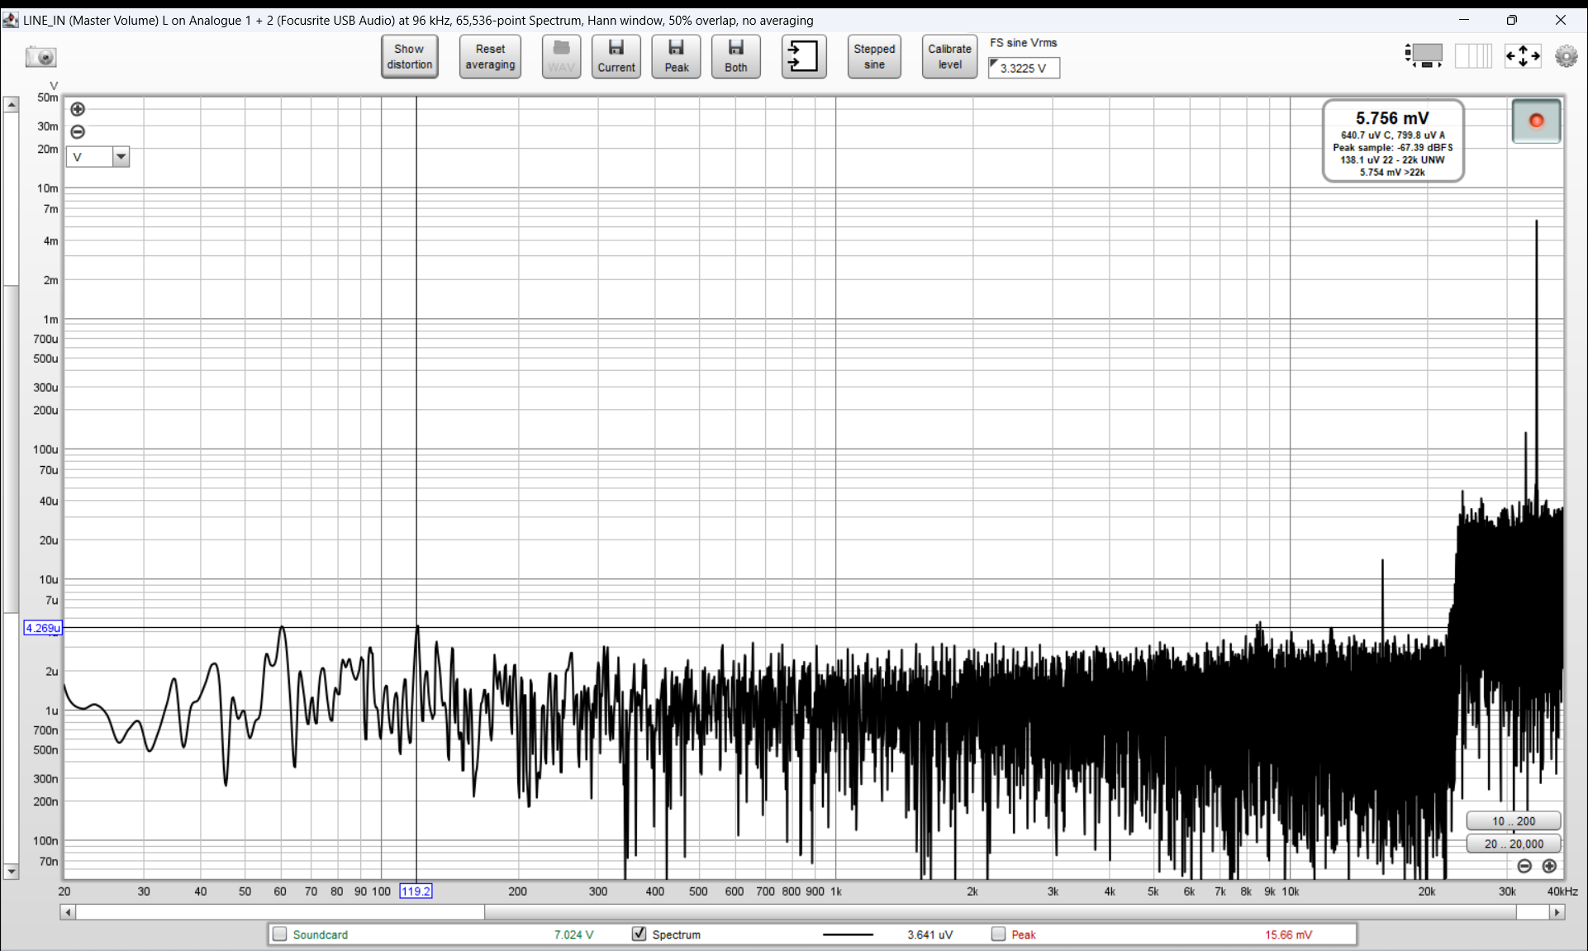
Noise measures
Sparkos lab SS7805 (12 vDC in – 5 vDC out – 51 ohm load - 120 mA draw) ~ 4 uV peak at 120 hz otherwise < 3 uV from 50 hz to 20 khz and 5 mV spike at 35 khz

Slide 20
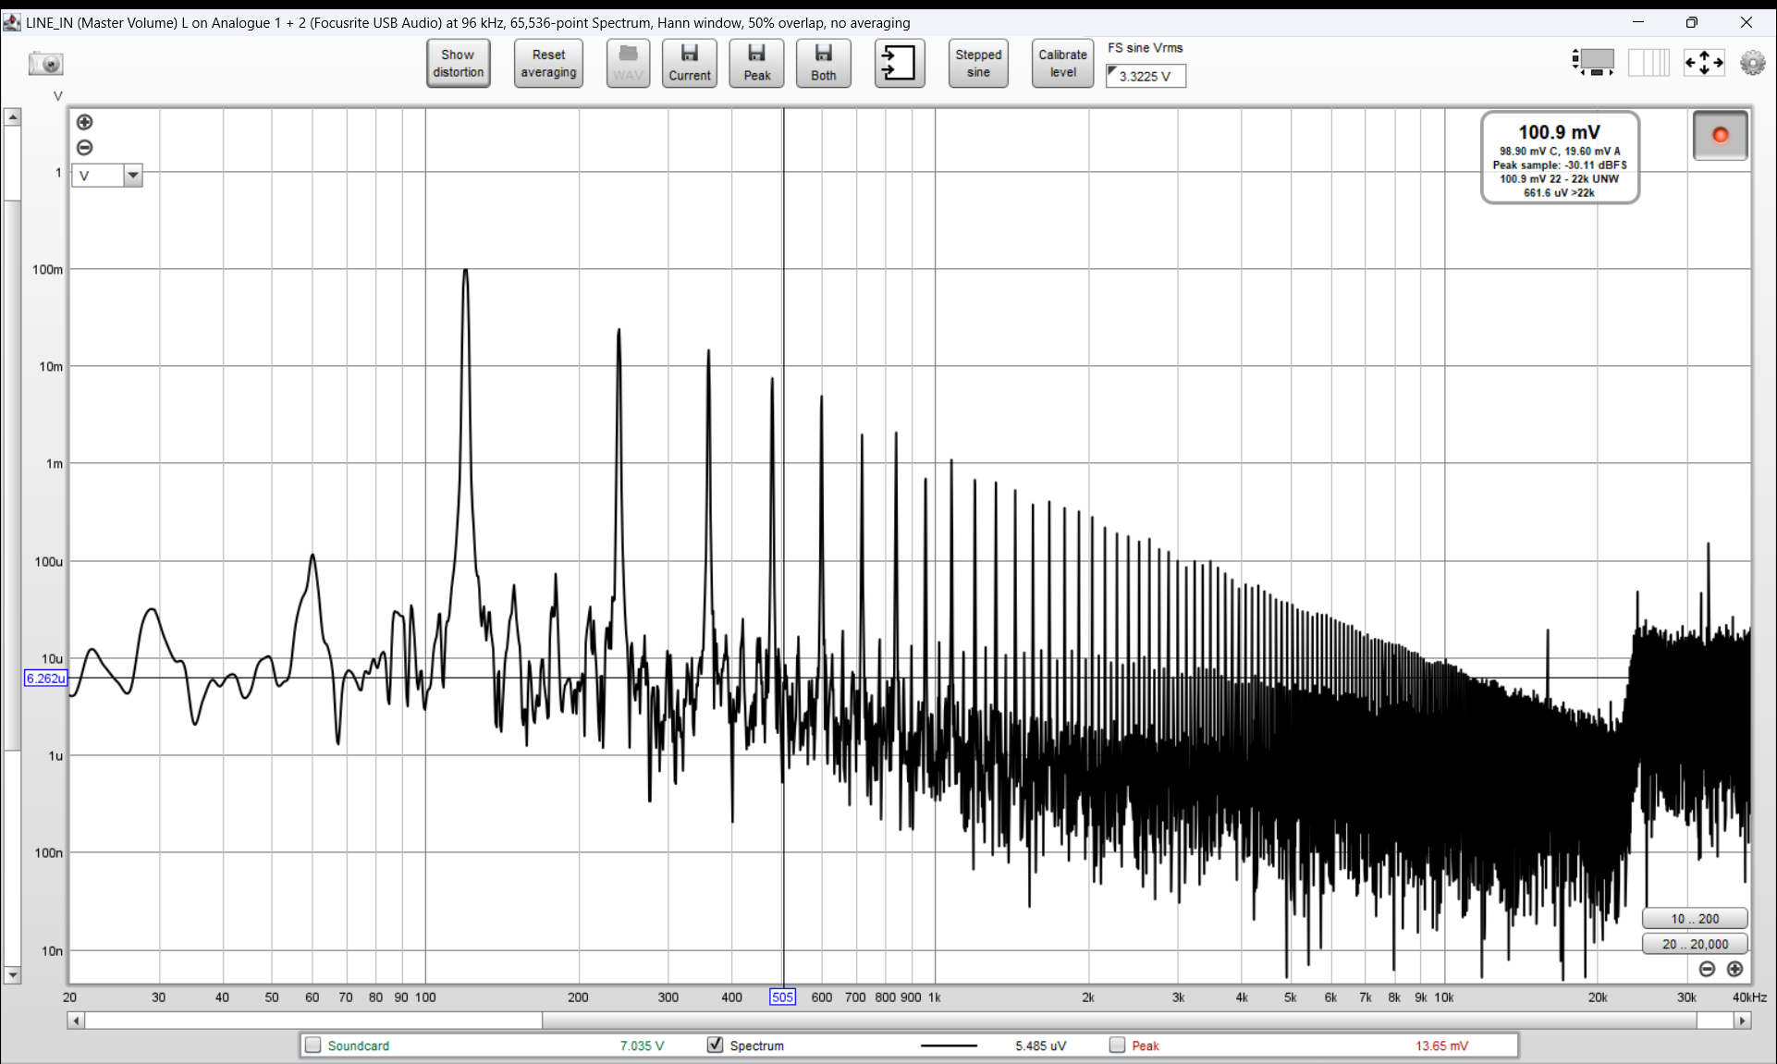
Noise measures
DigiLO wal wart power supply 100 mV ripple at 120 hz

Slide 21
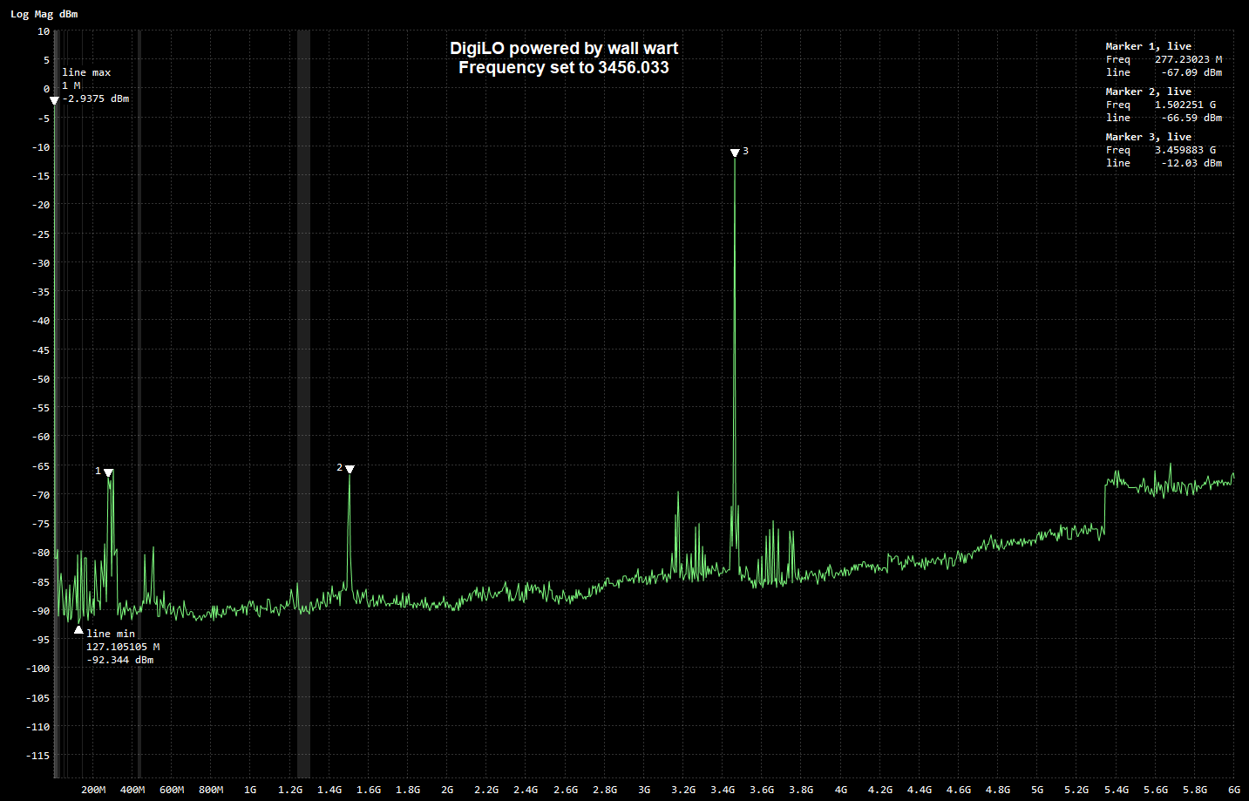
Spectrum effects
DigiLO output spectrum

Slide 22
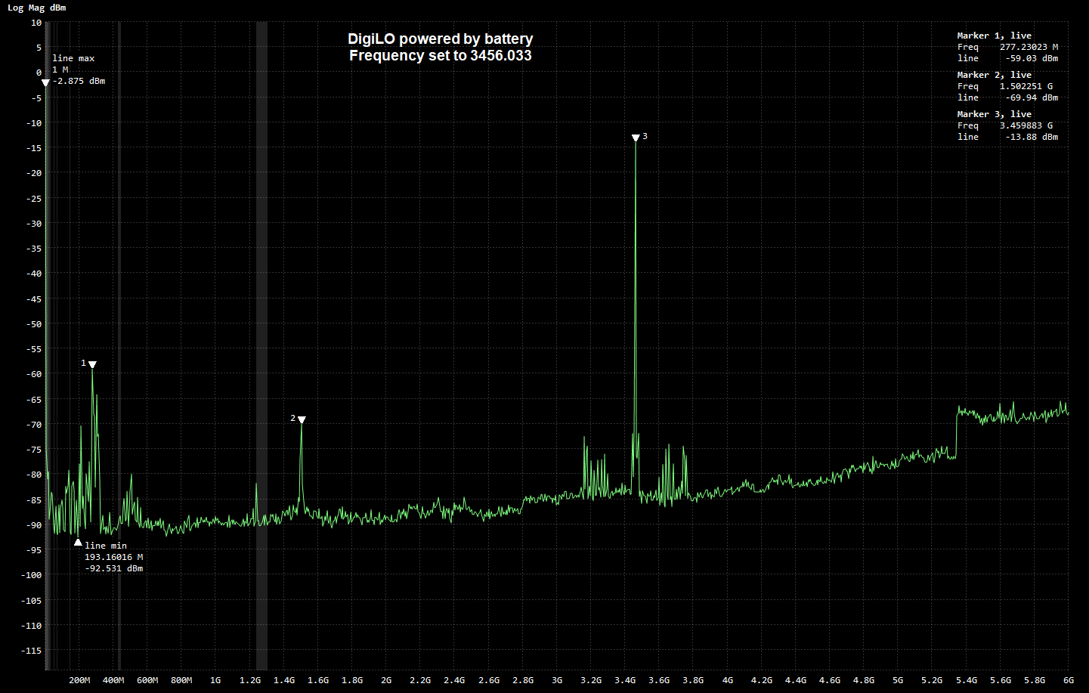
Spectrum effects
DigiLO output spectrum

Slide 23
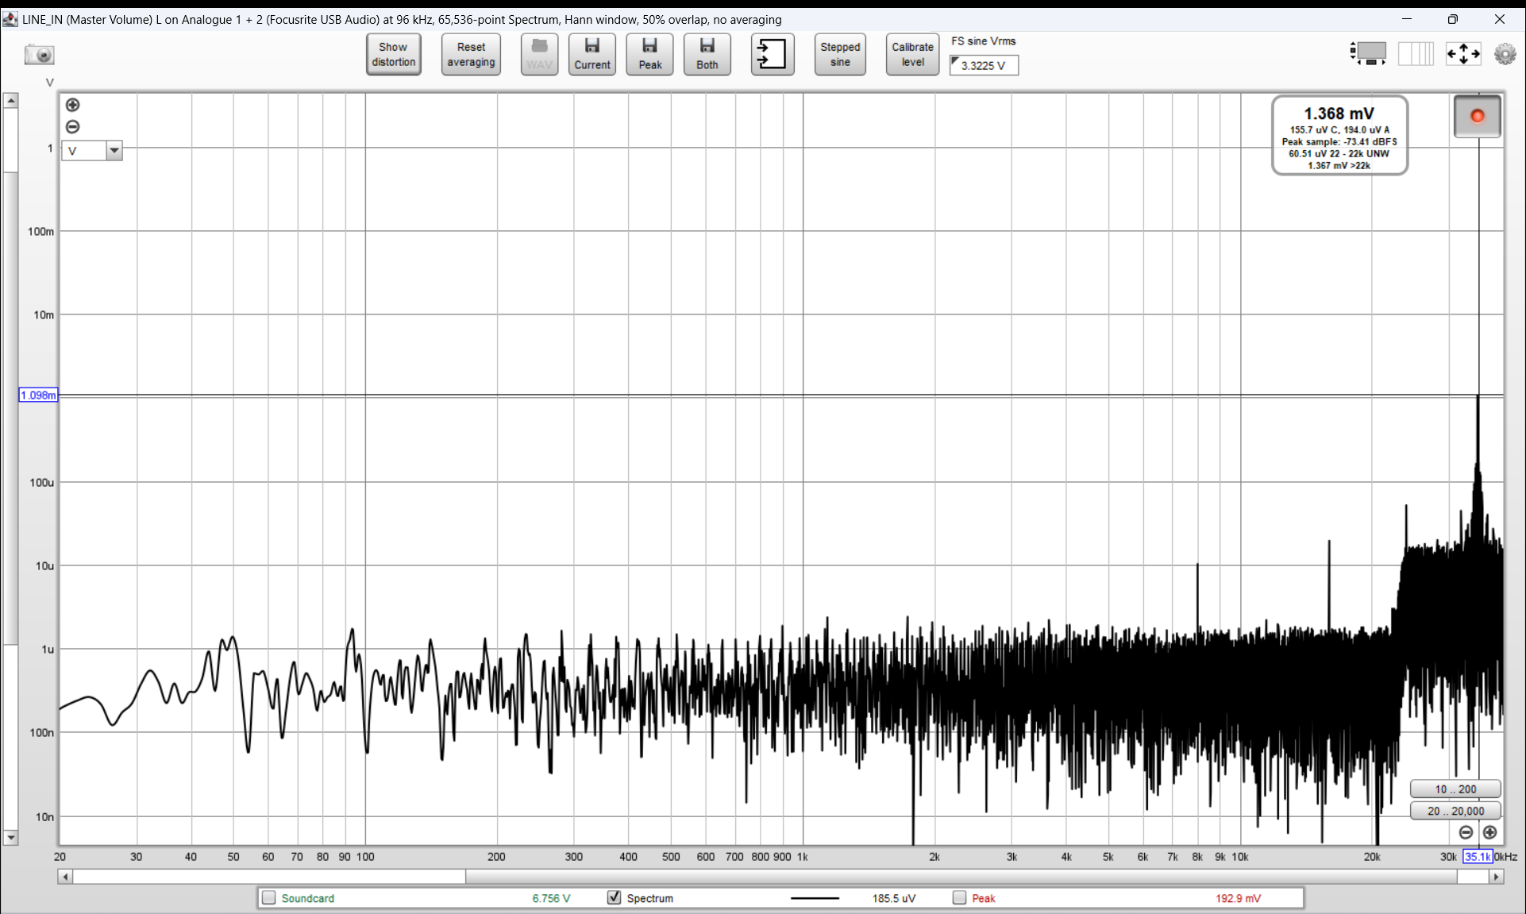
Noise measures
iPhone charger (120vAC in 5.0 vDC out) 1 mV spike at 35 KHz

Slide 24
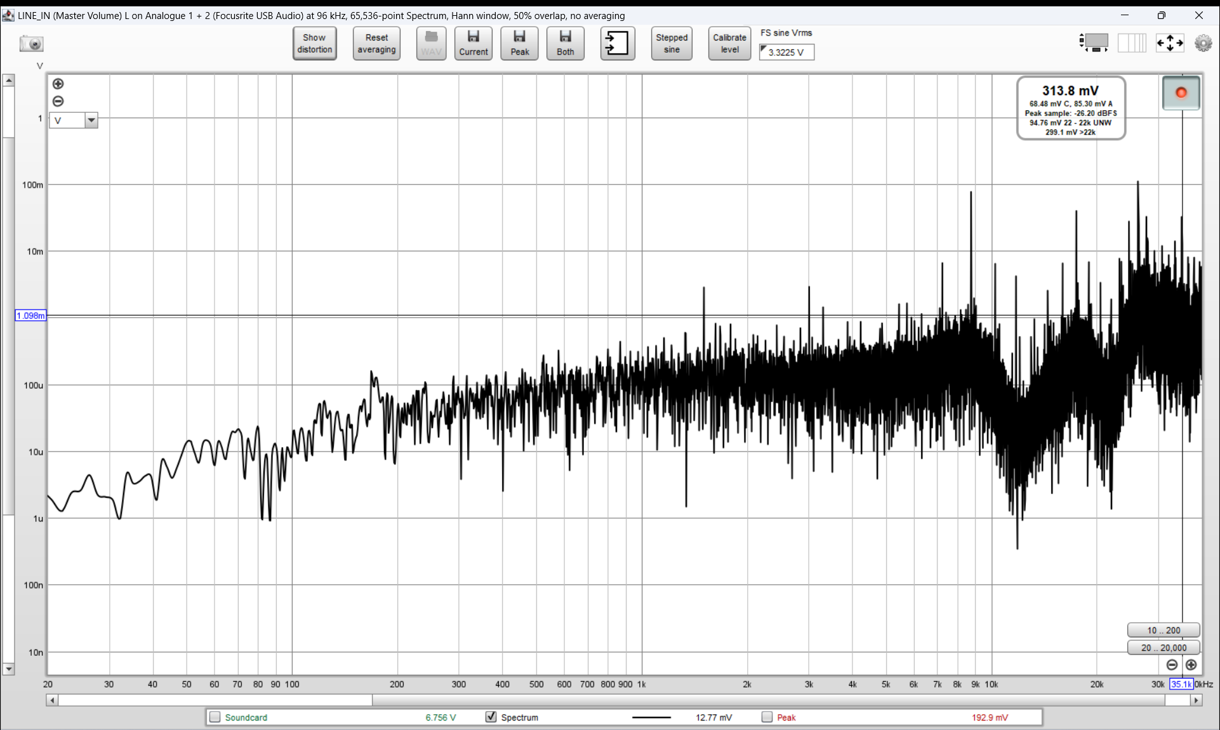
Noise measures
“Switcher power supply” (120vAC in 6.0 vDC out) I was using back in 2008 to drive a T/R relay for 1296 MHz

Slide 25
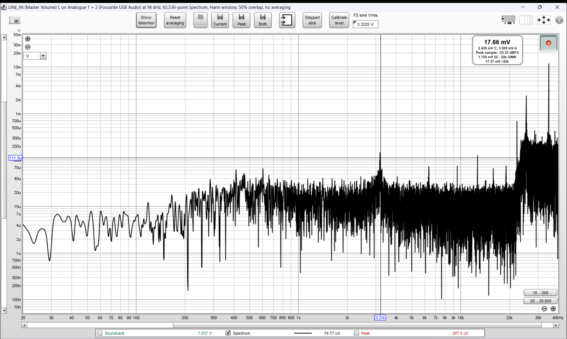
Noise measures
Buck converter XL4016E1 number 1 (12vDC in – 5.0vDC out – 100 ohm load – 50 mA draw) ~40 uV < 20 Khz, broad 100+ uV spike at 43.2 Khz, 11 mV spike at 35

Slide 26
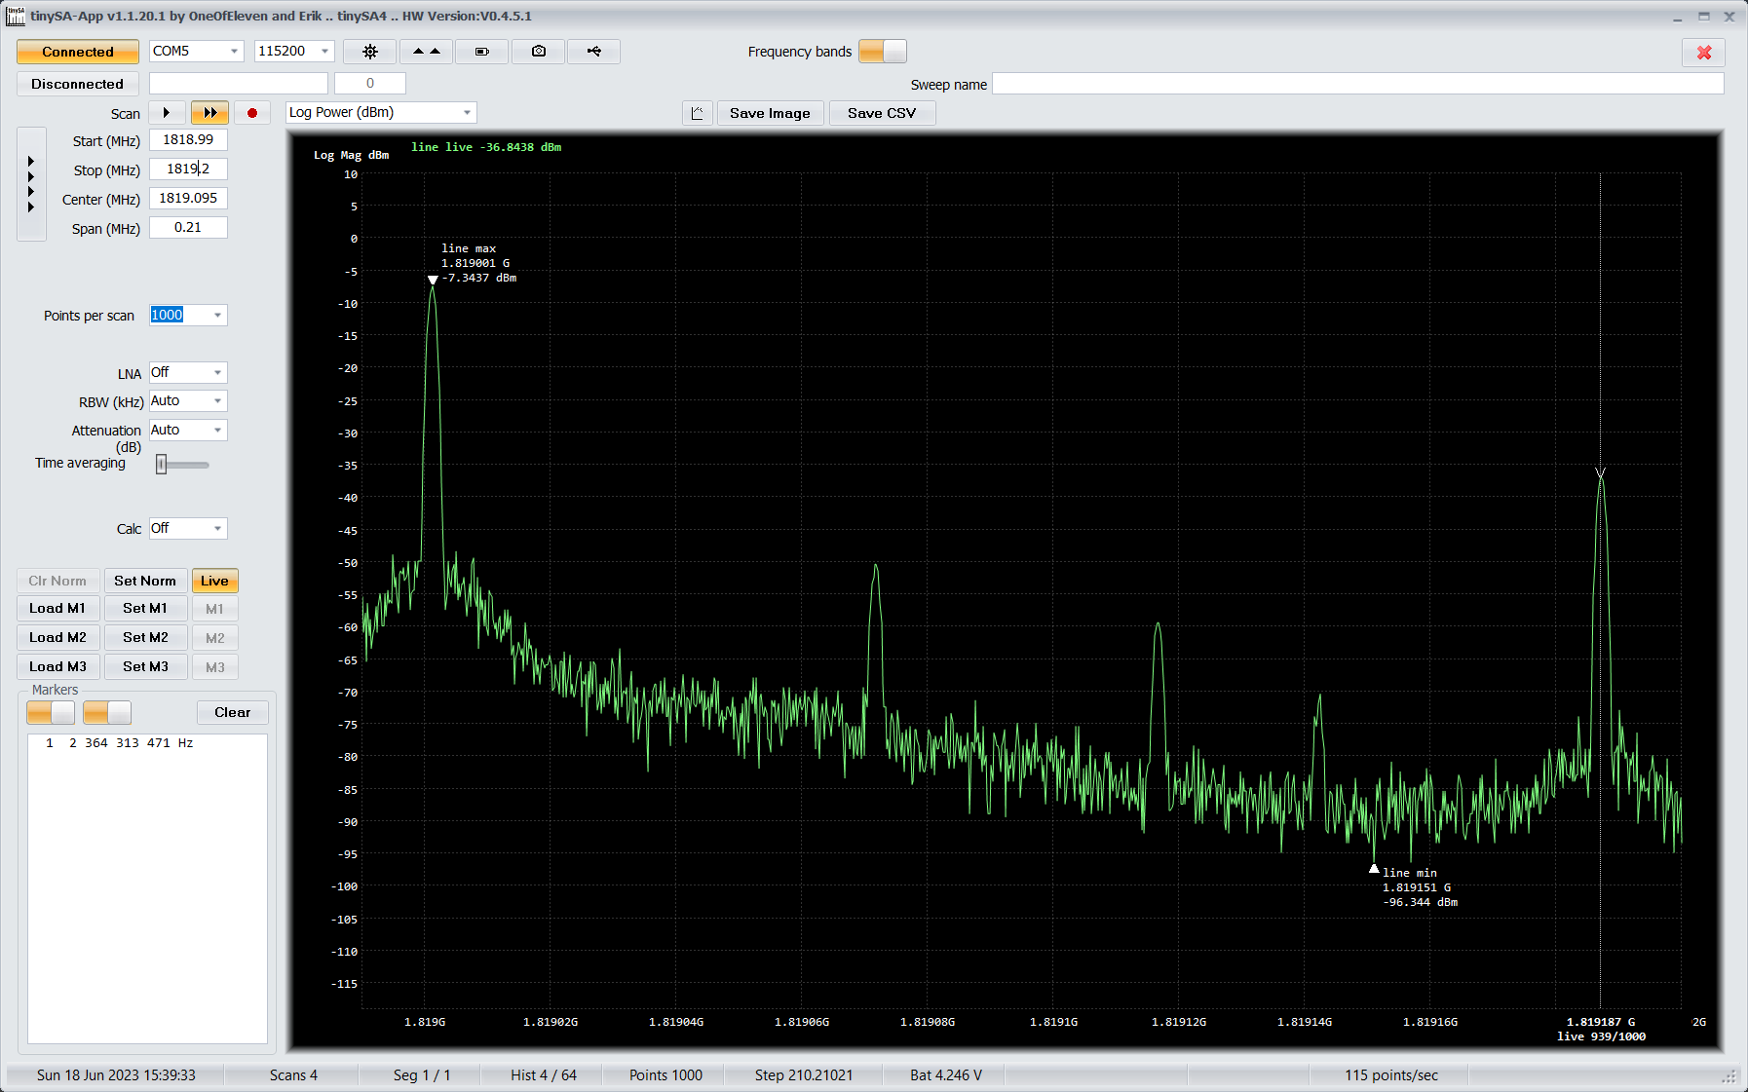
Spectrum effects
Wavelab 1819 MHz LO - McCoy 10 MHz OCXO (12 vDC) sharing PDU with 24 GHz system (uses XL4016 buck conv) – spur is -37 ~+184 KHz

Slide 27
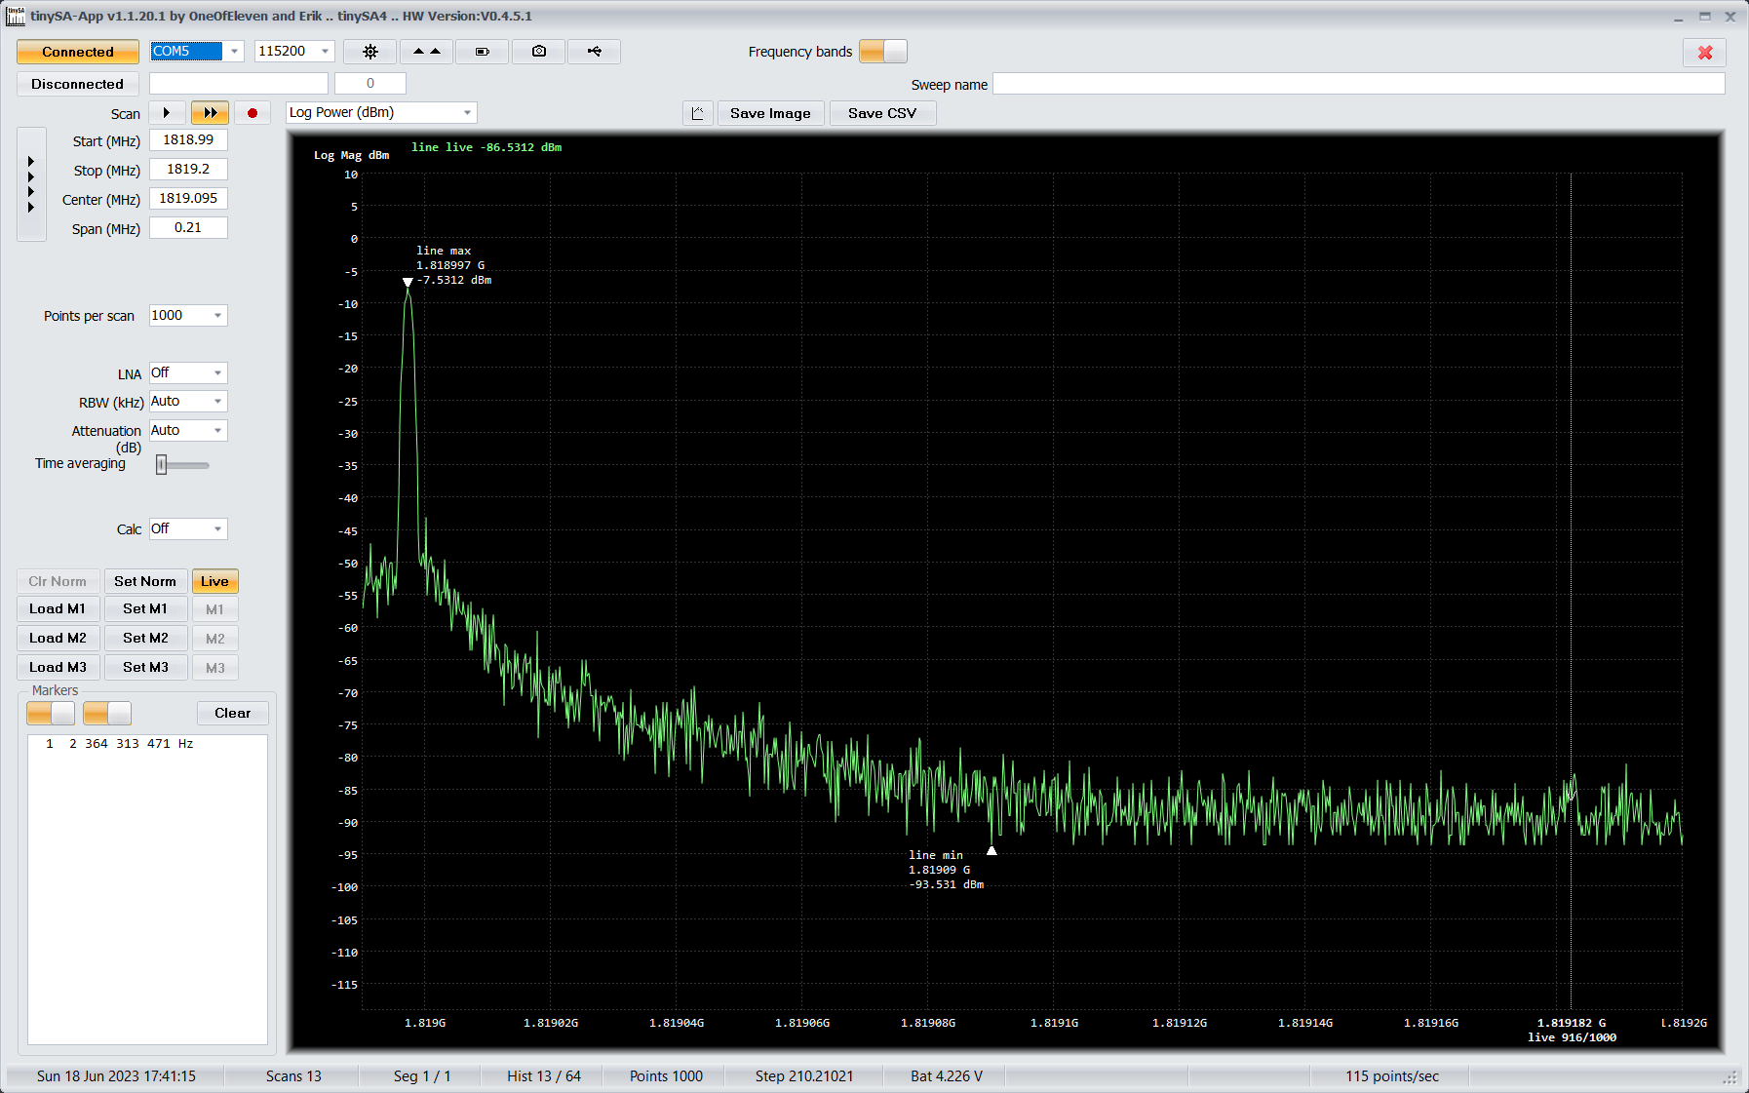
Spectrum effects
Wavelab 1819 MHz LO - 5v 10 MHz OCXO powered by Sparkos LDO sharing PDU with 24 GHz system (uses XL4016 buck conv) – spur is negligible

Slide 28
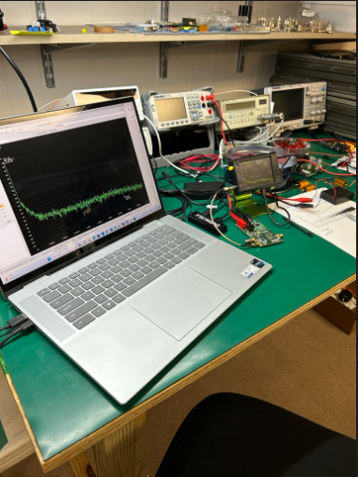
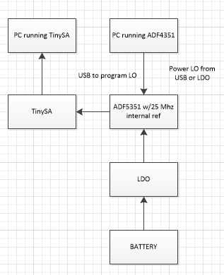
Focus testing

Slide 29
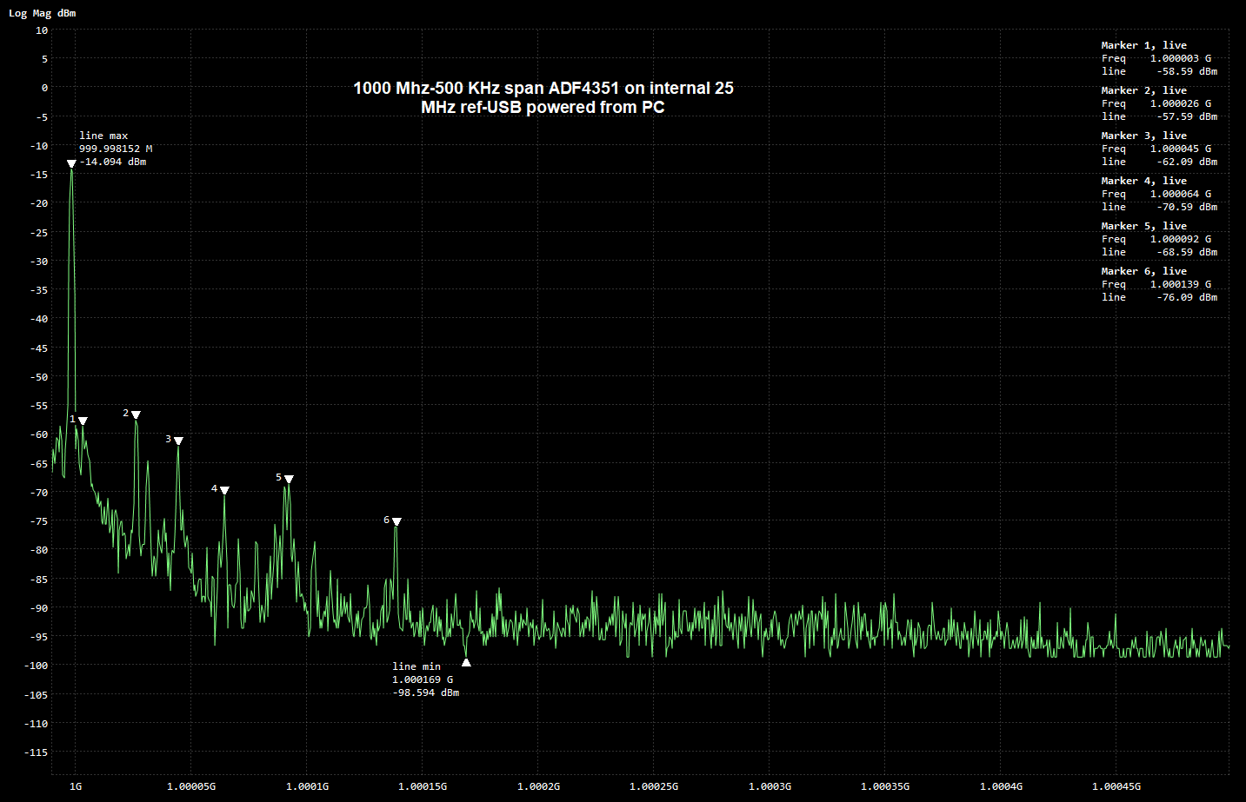
Focus testing

Slide 30
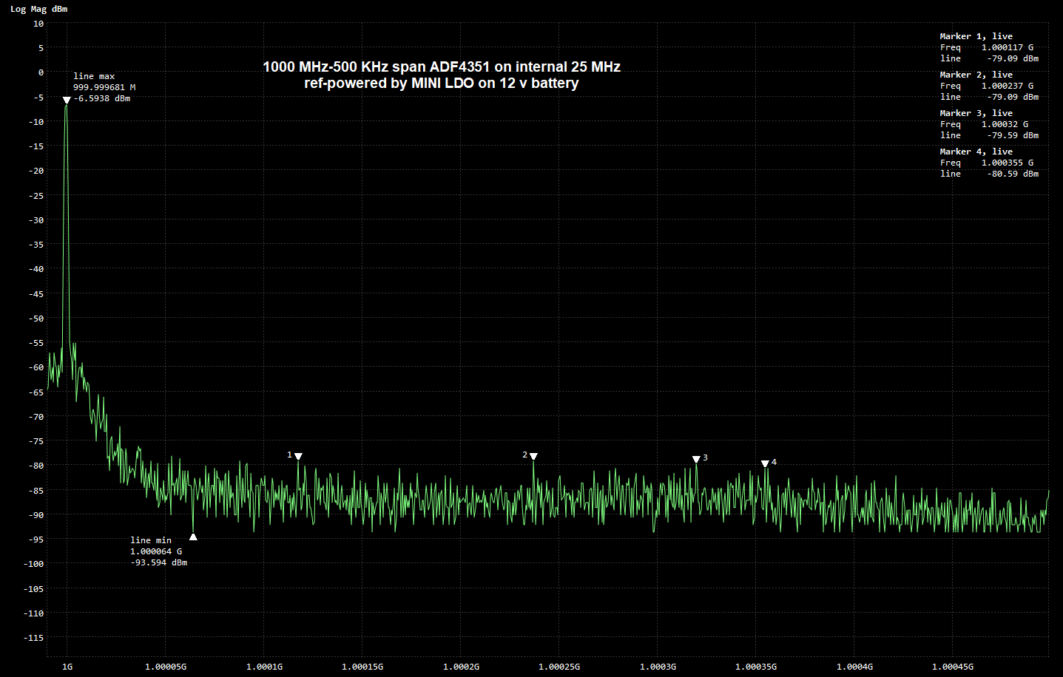
Focus testing

Slide 31
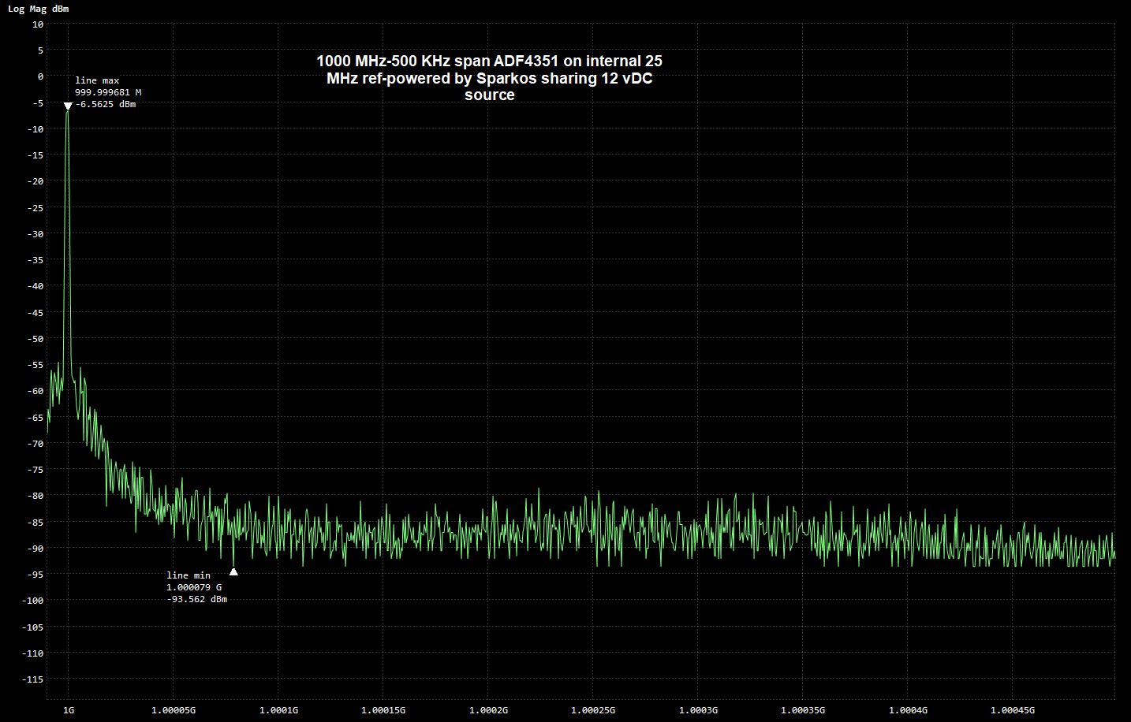
Focus testing

Slide 32
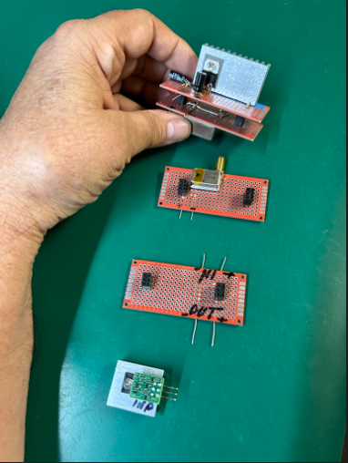
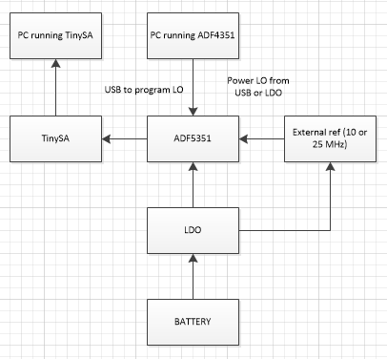
Focus testing

Slide 33
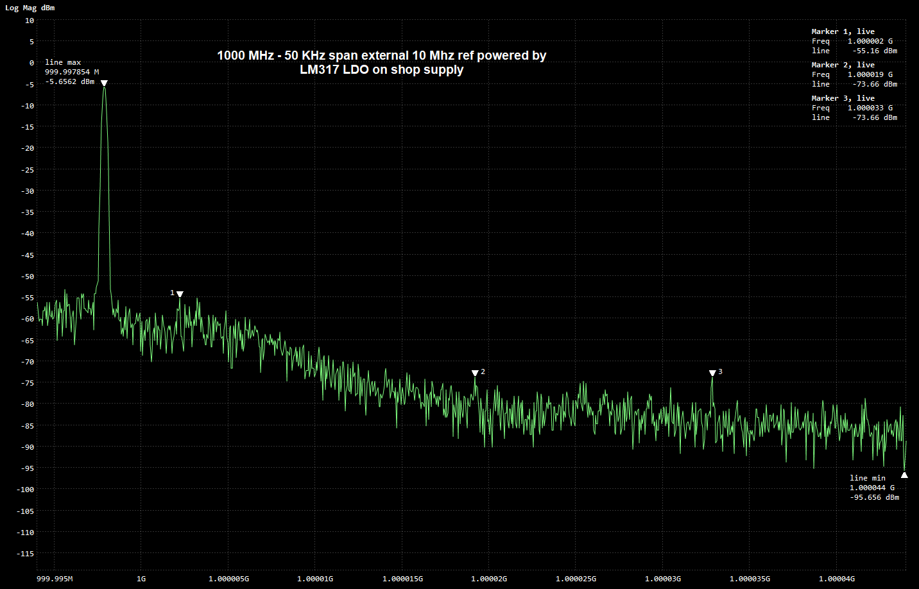
Focus testing – 50 KHz span

Slide 34
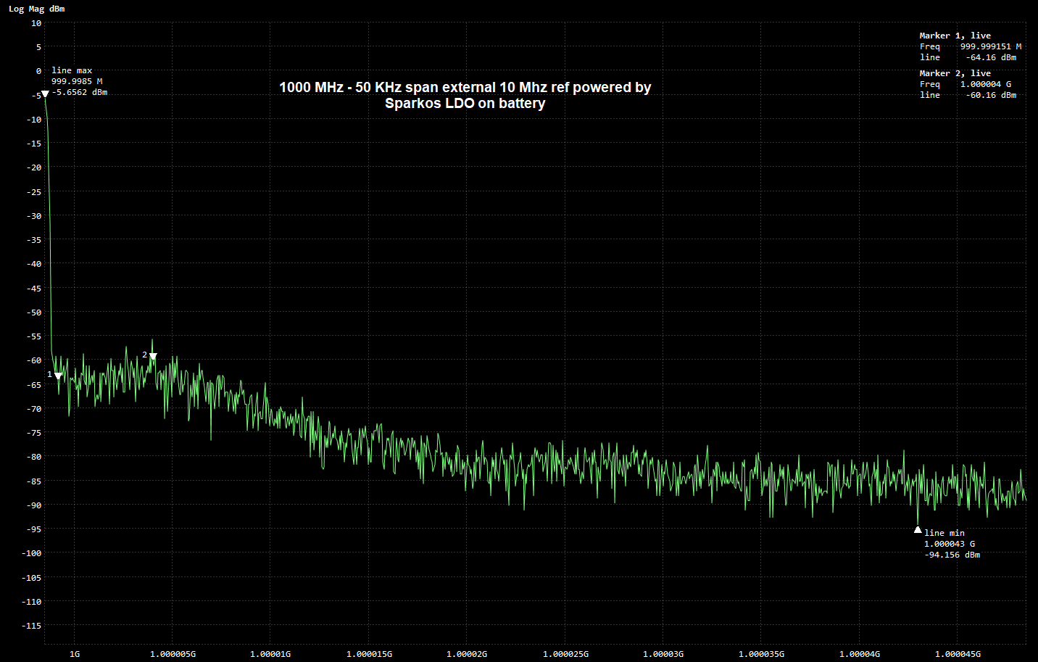
Focus testing

Slide 35
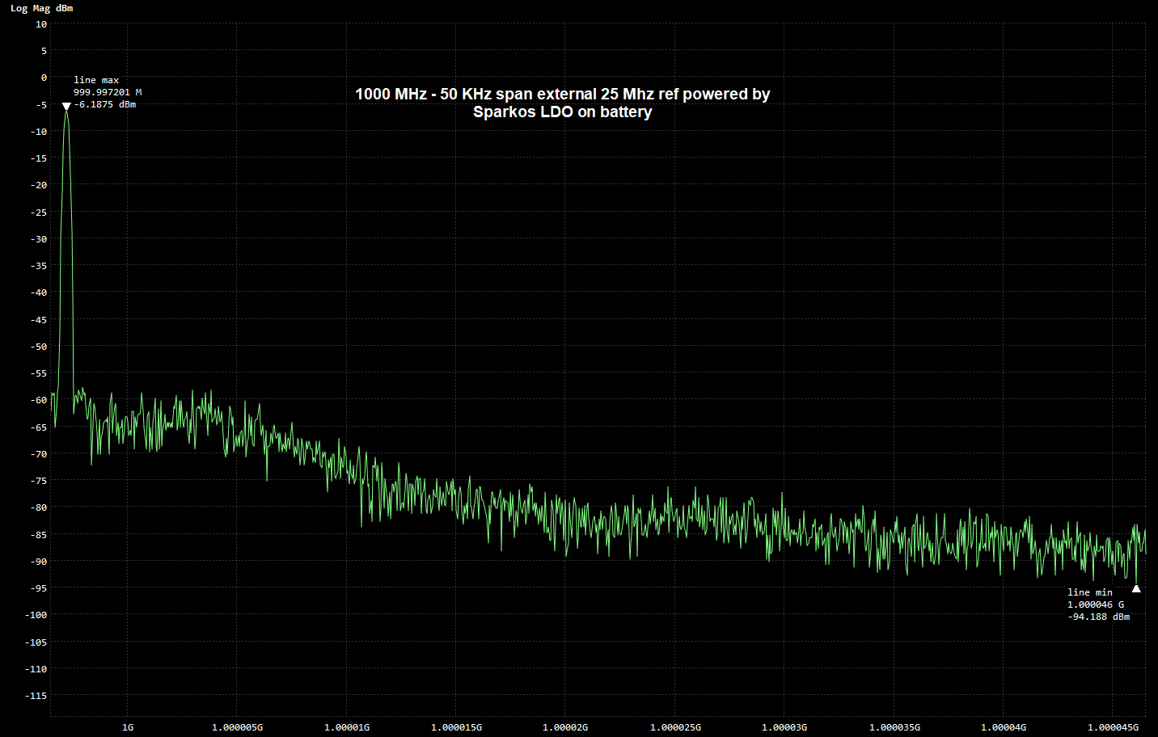
Focus testing

Slide 36
Focus testing

Slide 37
Next steps – to be continued
Spectral Noise density curve and a rising noise floor for RF apps
Effects on ADC or DAC. Sampling system causes high frequency noise to fold to lower frequencies due to aliasing
Reducing LDO noise-
Understanding the datasheet
Use best LDO you can afford
Cascade multiple LDOs

Slide 38
Questions?

