Slide 1
North Texas Microwave activities and how to get started
July 10, 2025

Slide 2
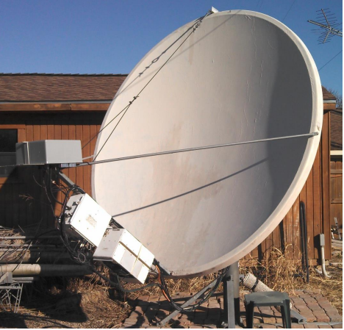
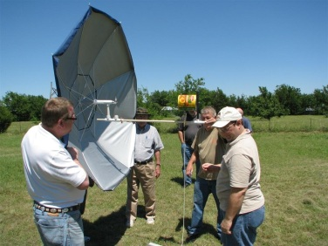
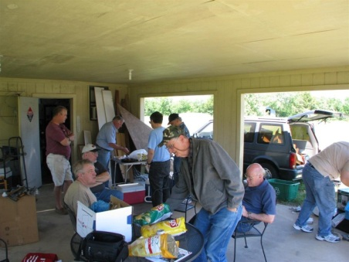
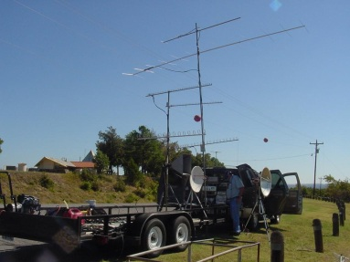
The North Texas Microwave Society was formed in 1986
Dedicated to Promoting Activity, the State of the Art in Equipment Design, and
the Exchange of Ideas and Technology for the Amateur Bands Above 902 MHz
President – Jim McMasters KM5PO
Vice President – Matt Kube W5ZCA
Secretary – Eric Haskell AG5XV
Treasurer - Wes Atchison WA5TKU
Web – Jim McMasters KM5PO
NTMS web page www.ntms.org
WWW.NTMS.ORG
2
Notes:
www.ntms.org
2

Slide 3
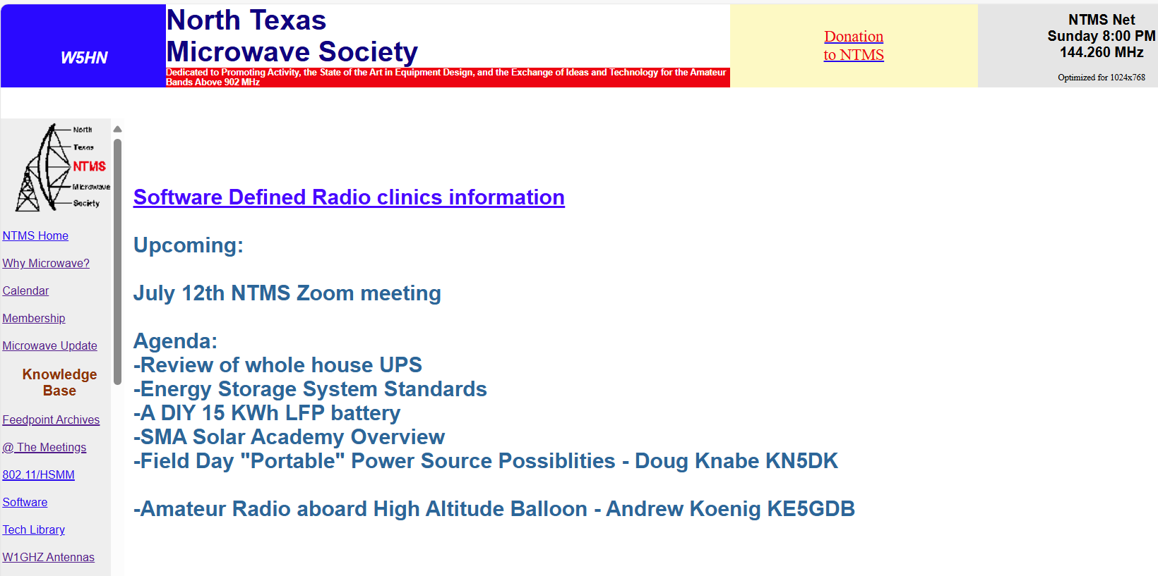
Ntms.org

Slide 4
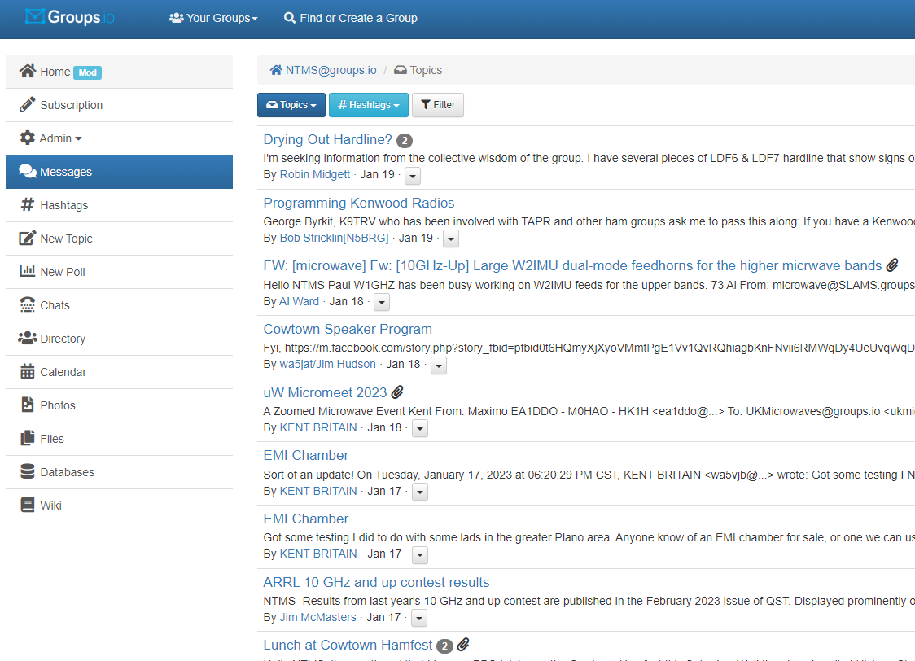
NTMS Groups.io

Slide 5
Calling Frequencies for Weak Signal Work on CW and SSB and EME
Band Weak Signal Calling Frequency
902-928 MHz 902.1 MHz (902.0 to 902.150 used for EME)
1240-1300 MHz 1296.1 MHz (1296.0 to 1296.2 used for EME)
2300-2310 MHz 2304.1 MHz (2304.0 to 2304.2 used for EME)
2390-2450 MHz 2400.1 MHz (used only for EME to work Japan)
3400-3450 MHz 3400.1 MHz (3400.0 to 3400.150 used for EME)
5650-5925 MHz 5760.1 MHz (5760.0 to 5760.2 used for EME)
10.0-10.5 GHz 10368.1 MHz (10368.0 to 10368.2 used for EME)
24.0-24.25 GHz 24192.1 MHz (24048.0 to 24048.2 used for EME)
47.0-47.2 GHz 47088.1 MHz (47088.0 to 47088.2 used for EME)
76 - 81.0 GHz 78192.1 MHz and 76032.1 MHz (up to .200 EME)
122.25 - 123 GHz
134 - 141 GHz
241-250 GHz
All above 275 GHz

Slide 6
NTMS Activities
Regular meetings with informal “bull and swap” session followed by technical presentations
Noise figure and network analyzer test sessions at meetings or at members houses
Antenna range for measuring antenna gain
Equipment Construction
Contesting
Social events
Sponsor Microwave Update conference

Slide 7
Weekly Lunches
East Side - Tuesday 11:30AM
Texas SmokeHouse BBQ
800 E. Arapaho Rd, Suite #101
Richardson, TX 75081

Slide 8
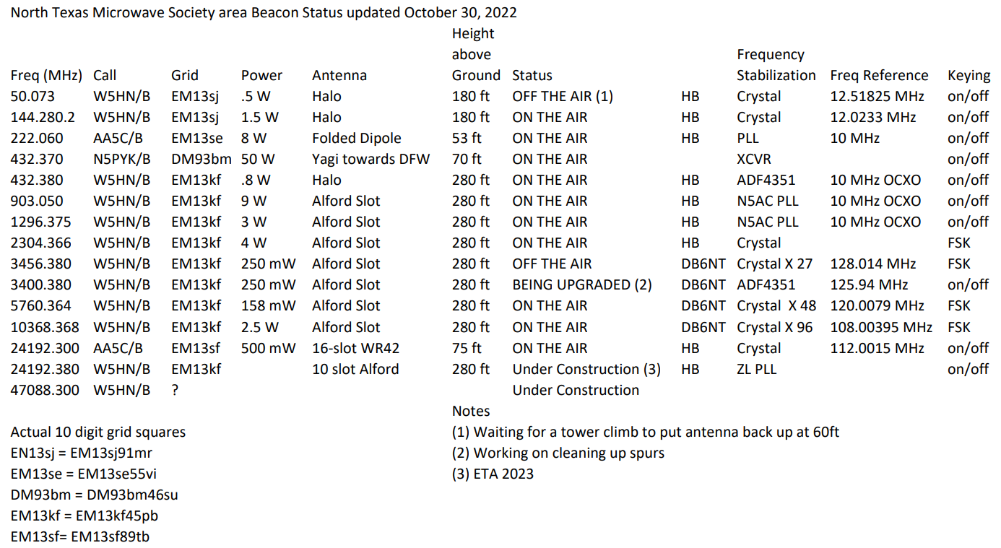
North Texas Beacons

Slide 9
NTMS Sunday Night NET
Local to DFW gathering on 144.260 MHz USB starting at 8PM
Generally run by Ross K5ZSJ from the Carrollton area
Very informal

Slide 10
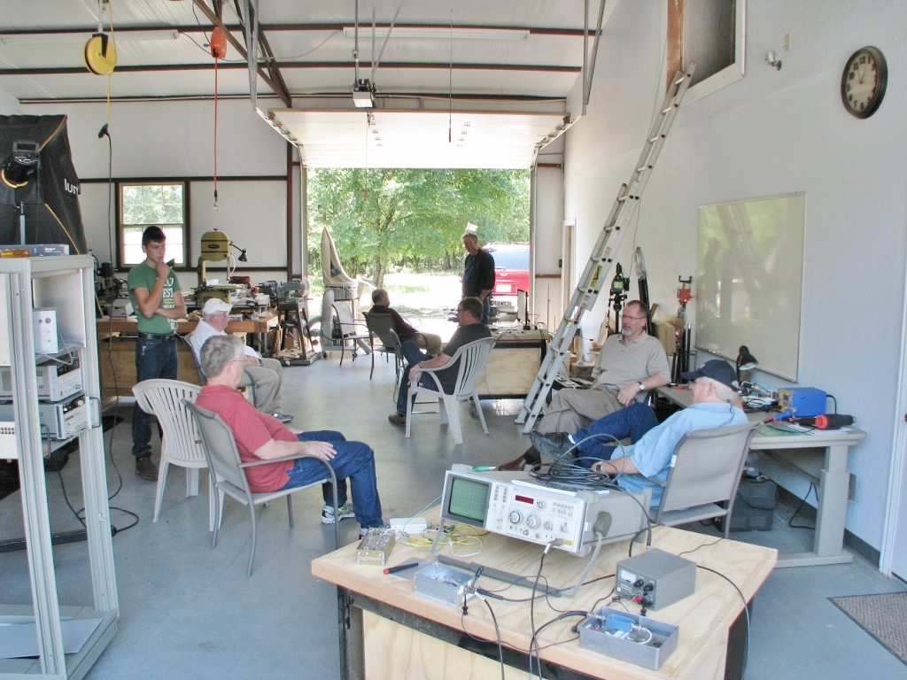
Meeting and Tune-up Party at N5BRG’s QTH

Slide 11
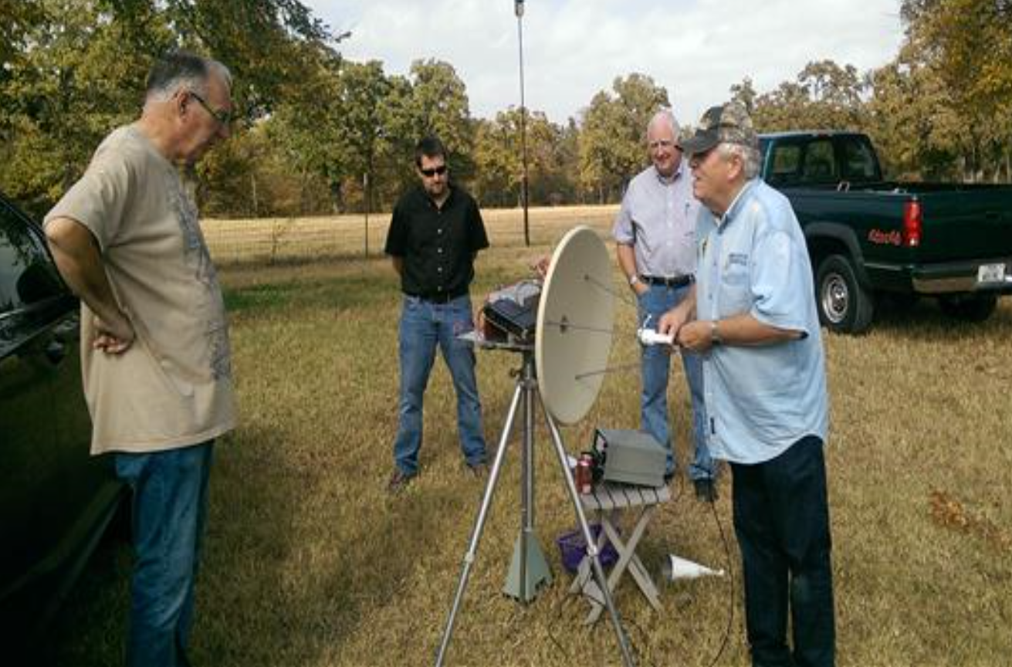
Previous gathering
Testing - Show and Tell - Build

Slide 12
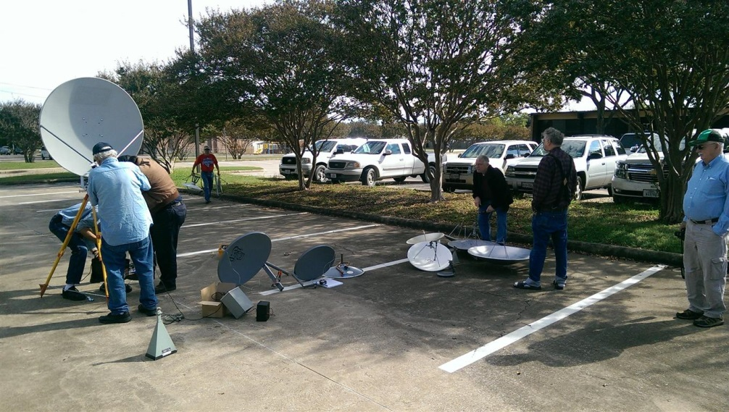
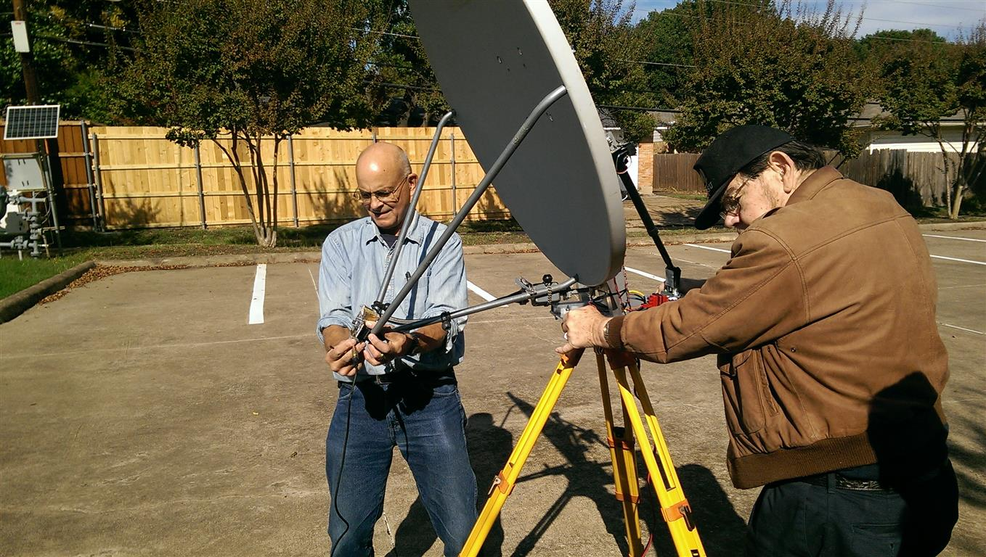
10 GHz Antenna Range
St. Barnabas Church parking lot antenna range.
Kent, WA5VJB and Jim, WA5JAT
Jim, K0MHC and Jim, WA5JAT

Slide 13
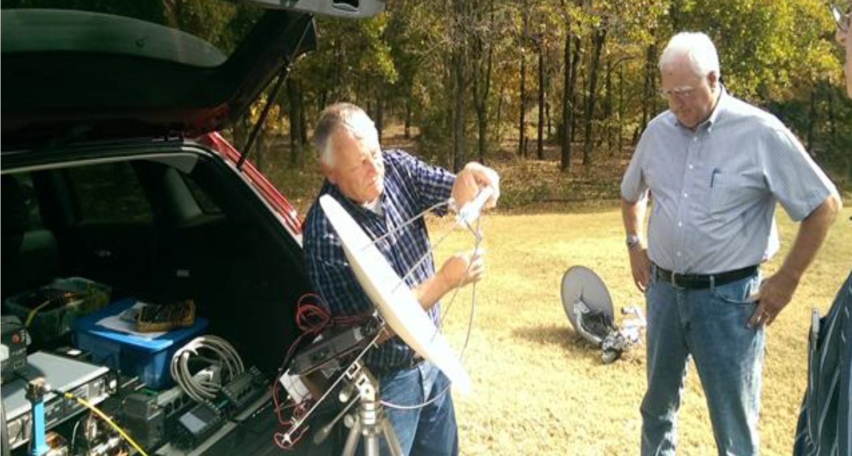
Previous gathering
Testing - Show and Tell - Build

Slide 14
Microwave Propagation
Terrestrial weak signal CW/SSB/WSJT modes – work up to 1000 miles plus under the right tropospheric conditions
Rain & Snow Scatter CW/FM – work hundreds of miles
EME (Earth – Moon - Earth) CW/SSB/WSJT Modes

Slide 15
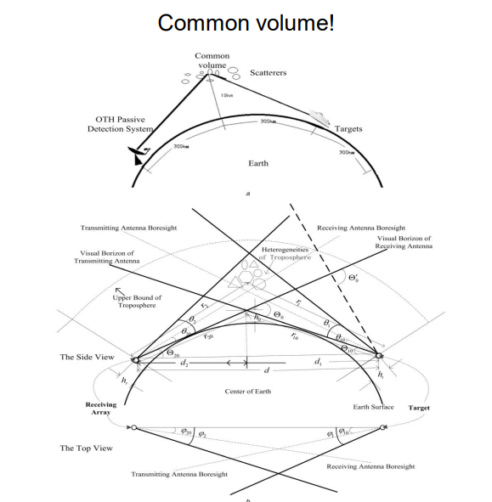
Microwave Propagation

Slide 16
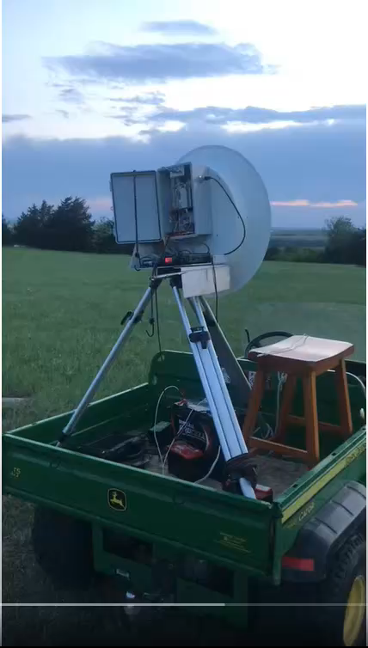
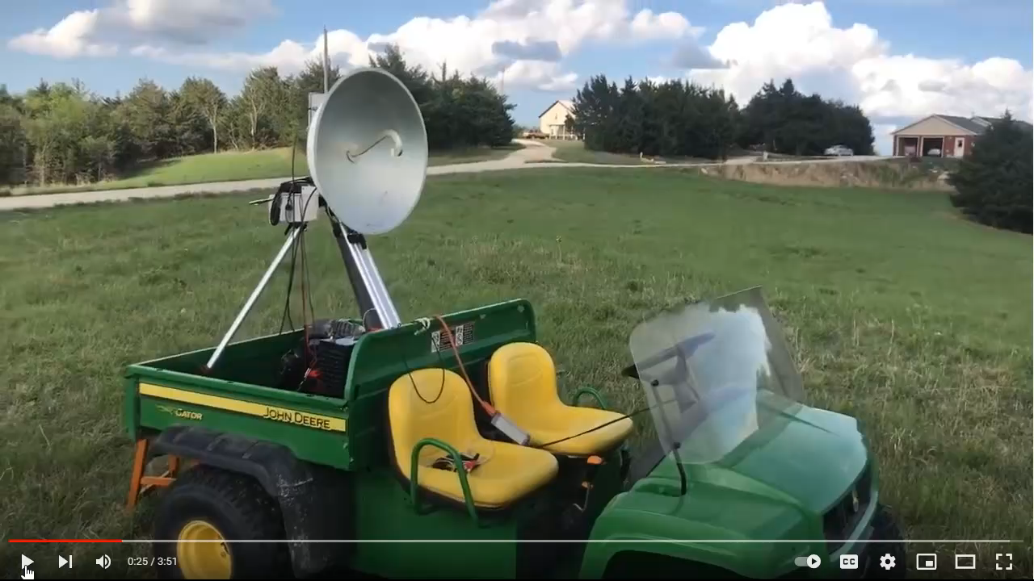
Rainscatter
WQ0P-KM5PO FM voice contact 10 GHz 442 miles – 711.6 km.
WQ0P-N0OY contact 10 GHz 91 miles
https://youtu.be/uBHhppojH9w
https://youtu.be/60LiQkfdz5o

Slide 17
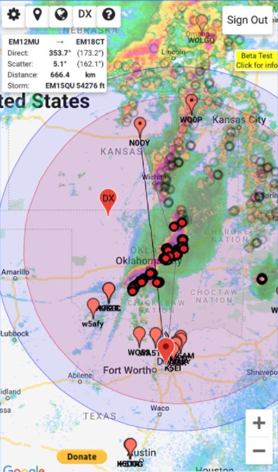
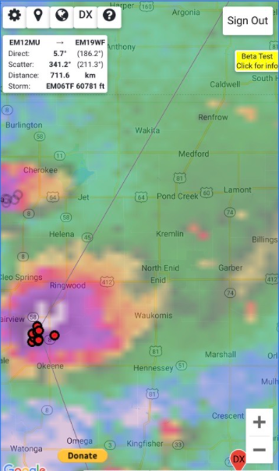
Rainscatter tools

Slide 18
Getting on Microwave
Conventional method is to use your favorite VHF Multiband SSB-CW Transceiver and connect to a Transverter.
A transverter uses a local oscillator and mixers to upconvert from an IF like 2m to an RF frequency like 10368 MHz on transmit and the reciprocal on receive.
As an example an LO of 10224 MHz can be used to mix with 144 MHz to achieve 10368 MHz
Now to build or buy?

Slide 19
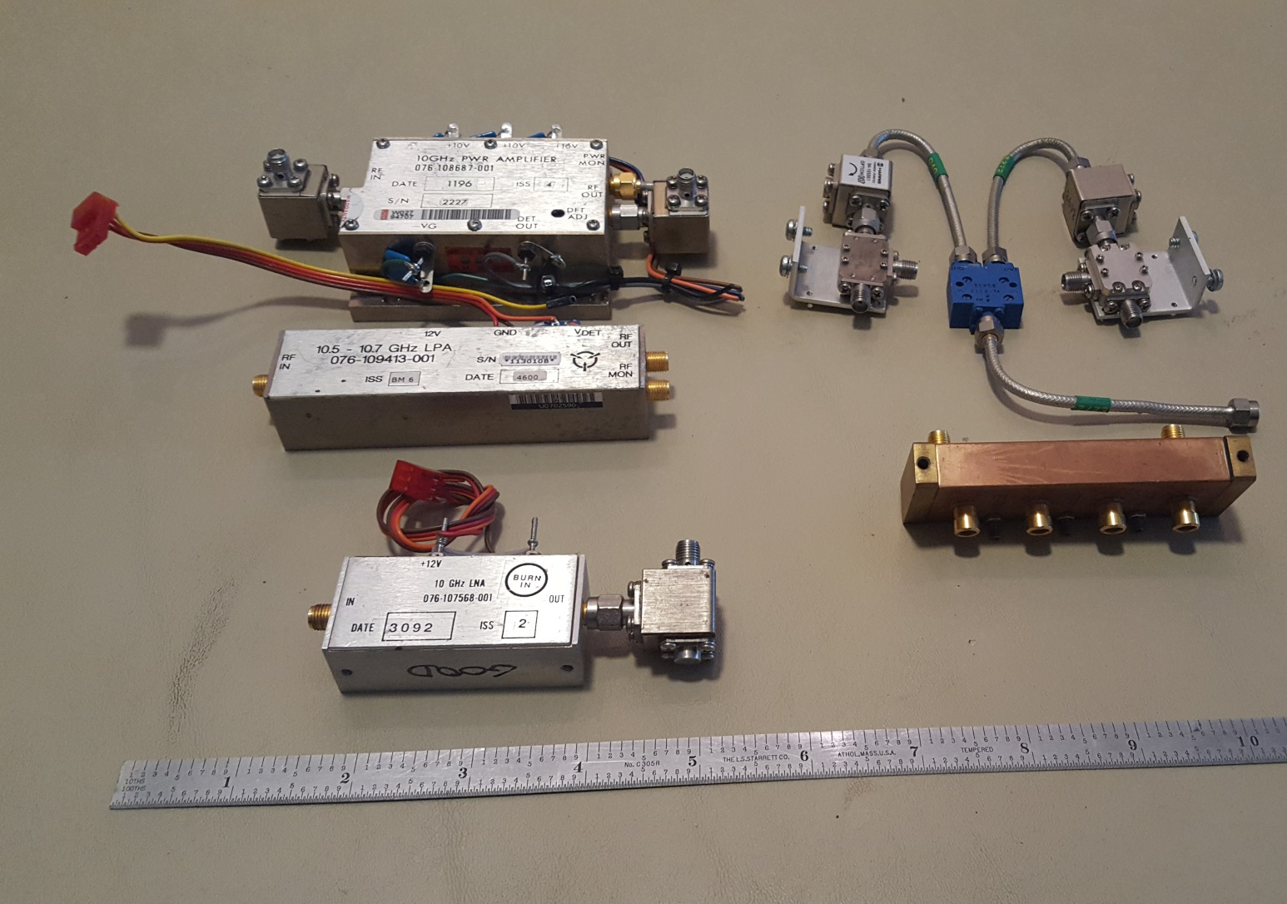
Various 10 GHz surplus items that could be used to build a transverter
Harris 10 GHz 3W PWR AMP
076-108687-001
Harris Isolators. Mixers & LO Pwr Divider
Harris 10 GHz LOW PWR AMP
076-109413-001
Harris 10 GHz LNA
076-107568-001
NF 2dB, G 28 dB
Farinon 10GHz WG Filter

Slide 20
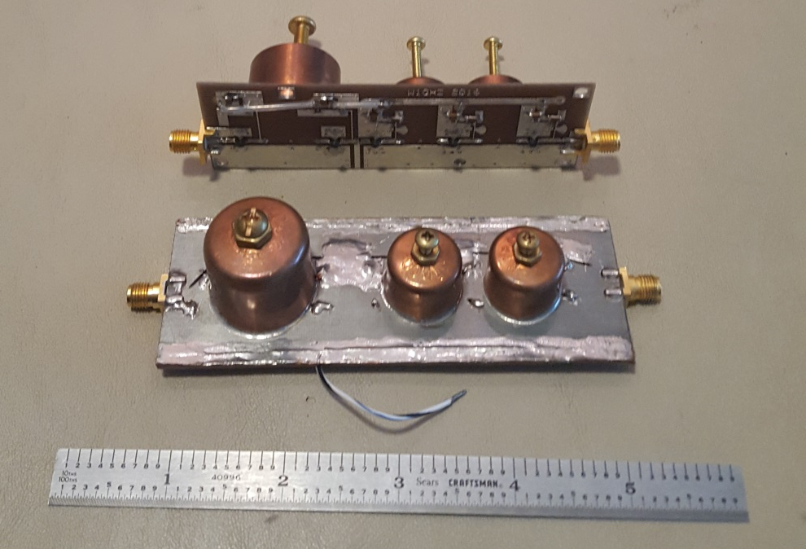
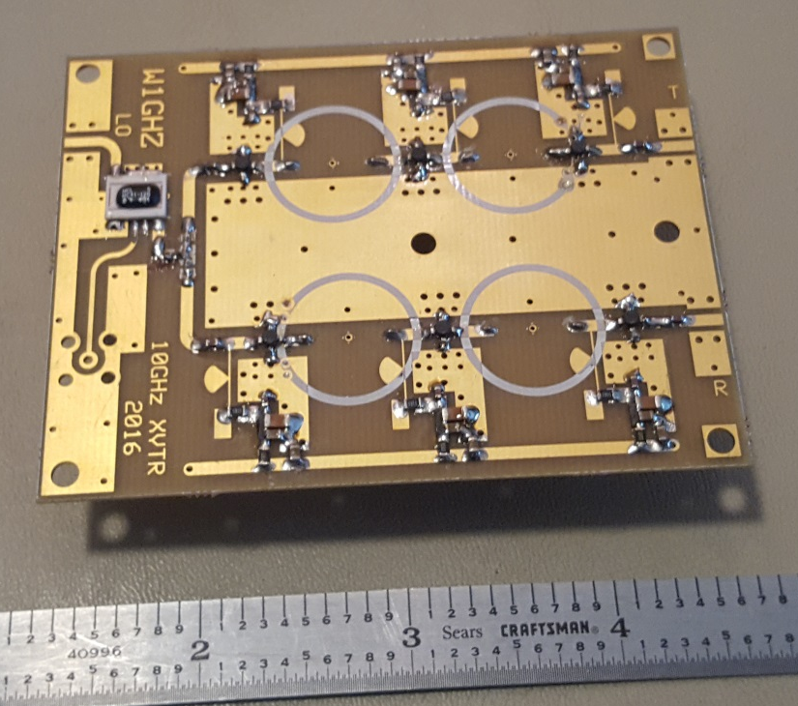
www.w1ghz.org
Paul Wade makes numerous circuit boards for many microwave projects. Here are 2 PCBs for 10 GHz
X9 Multiplier
Fin=1136 MHz Fout=10224 MHz
10 GHz Transverter 10368 MHz to 144 MHz
LO in = 10224 MHz

Slide 21
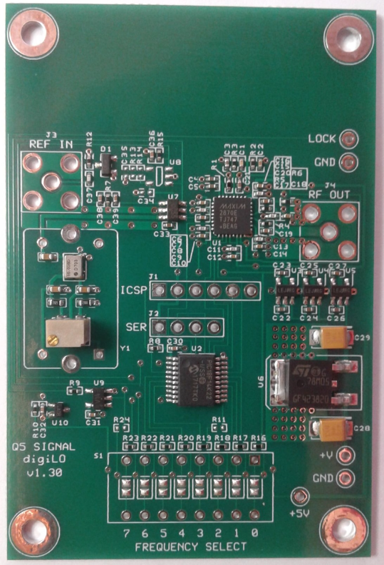
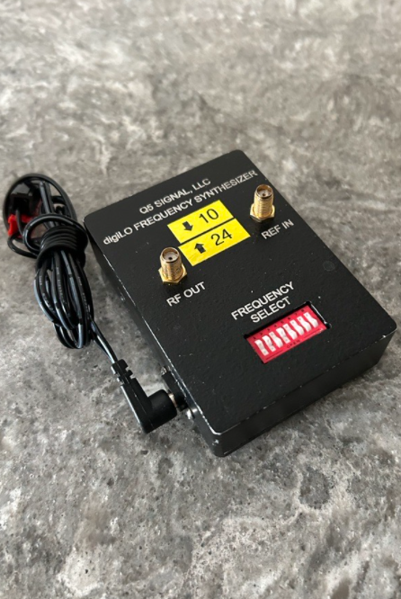
Local Oscillator Units
DEMI/Q5Signal
DigiLO PLL
23.5MHz - 6GHz
Internal Ref or
External10 MHz Ref

Slide 22
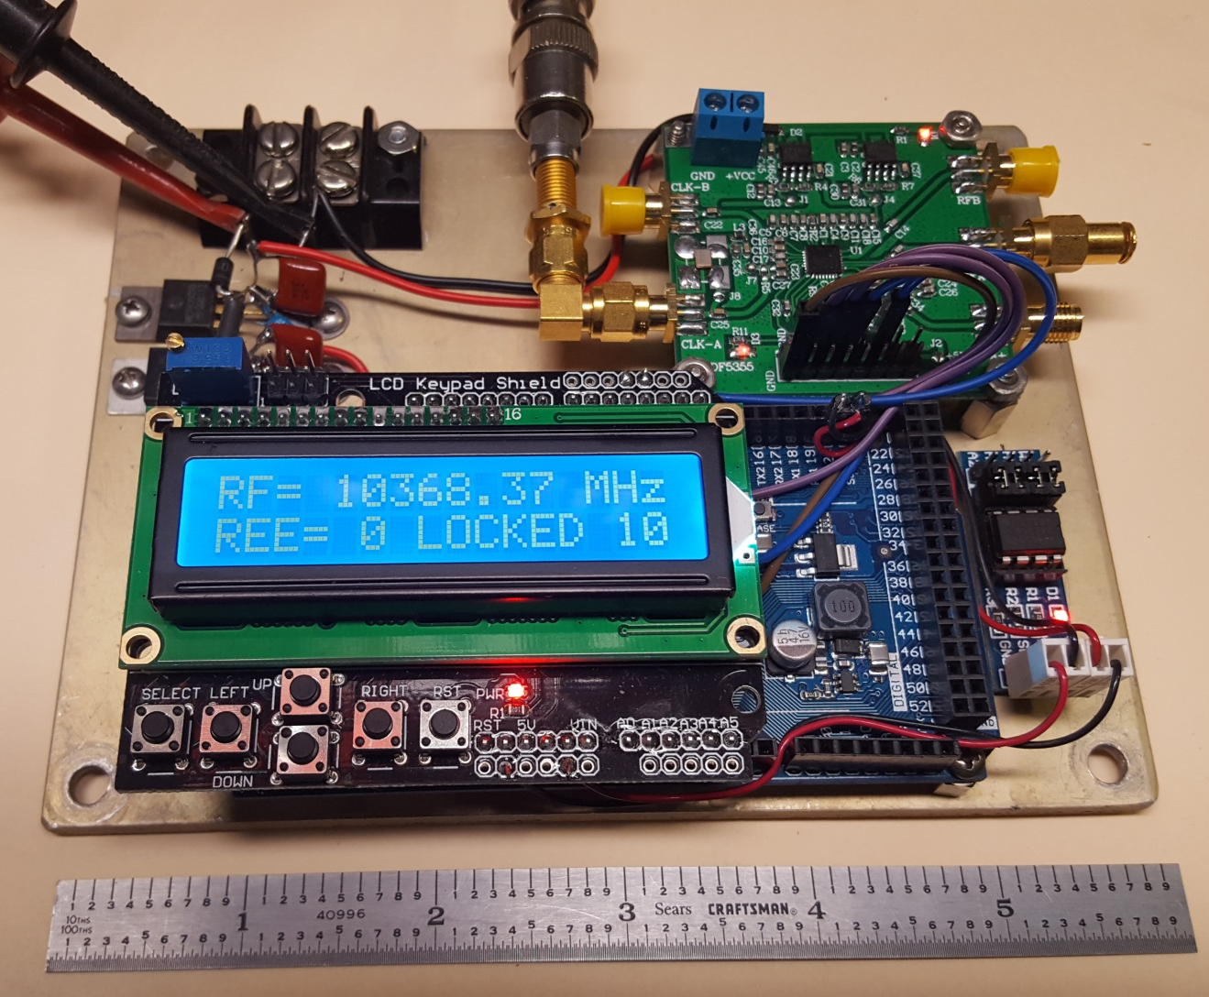
ADF5355 PLL Synthesizer
54 MHz to 13.6 GHz
ADF5355 Eval Board
Presentation on www.ntms.org
-Knowledge Base
-At the meetings
-September 2017
“ADF-4351 and ADF5355 Update by Greg McIntire AA5C
Arduino Due & LCD Shield & EEProm Board
Built by W5LUA

Slide 23
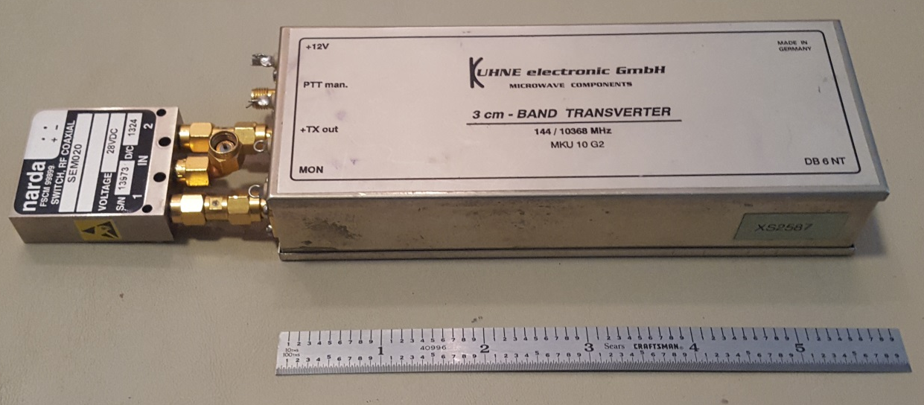
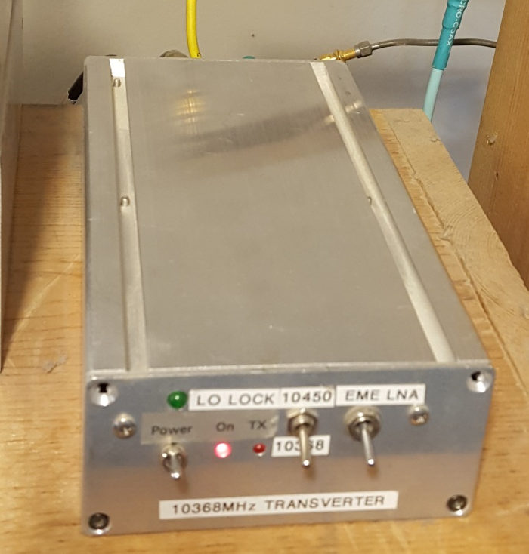
Most Popular Commercial XVTRs
DB6NT
DEMI
https://shop.kuhne-electronic.com/kuhne/en/shop/
https://www.downeastmicrowave.com/
Others as well…

Slide 24
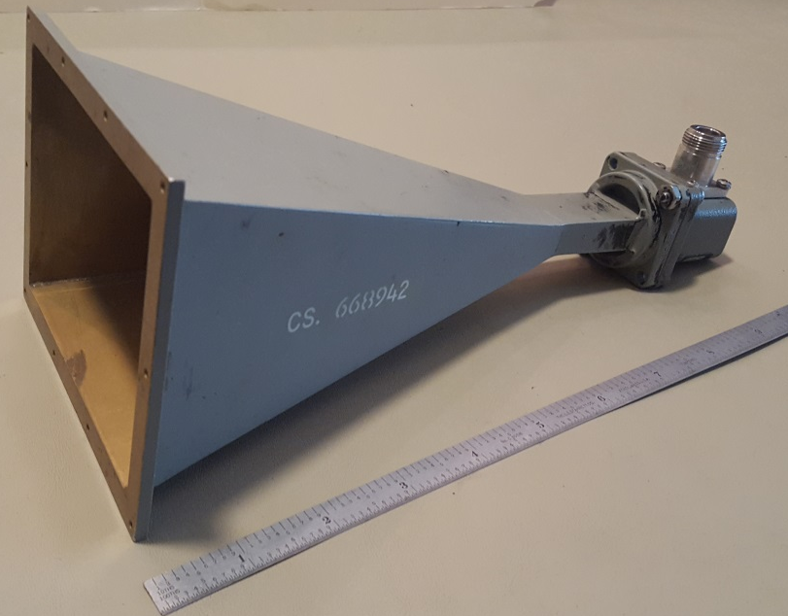
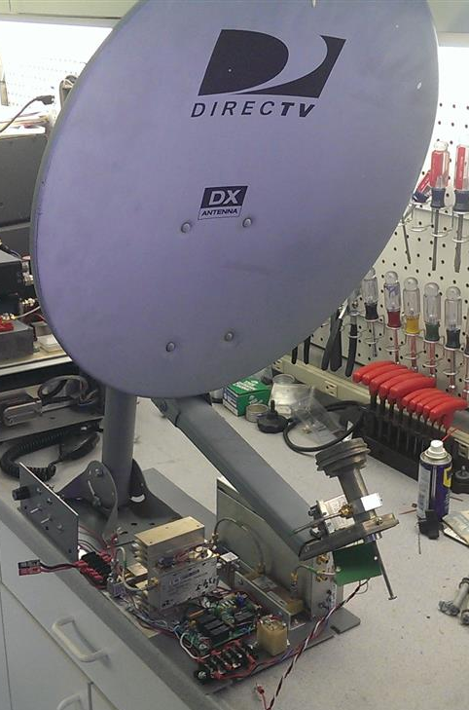
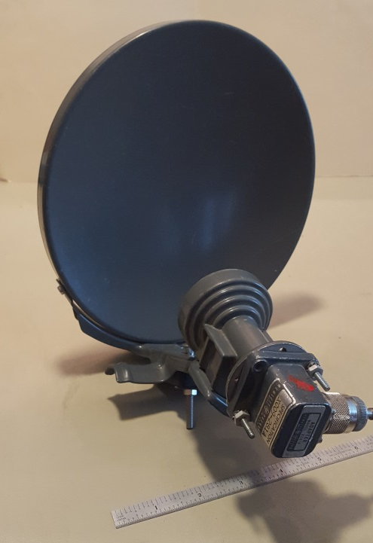
Antenna options for 10 GHz
4.3” X 2.3” Horn
G = 20 dBi
3dB Beamwidth ~ 17 deg
8” Offset Fed Dish
G = 25 dBi
3dB Beamwidth ~ 9 deg
18” Offset Fed Dish
G = 32 dBi
3dB Beamwidth ~ 4.3 deg

Slide 25
Roving on 10 GHz
The major event for the NTMS is to participate in the ARRL 10 GHz and Up Contest in both August and September
Some stations operate from home and a number of stations are rovers.
The object of the contest is to work as many stations in as many 6 digit grid squares as possible. Rovers are required to move at least 16km (10 miles) before a station is reworked. Every contact has a distance multiplier in km. The sum of the distance multiplier plus 100 points for each unique call sign provides the total score.
See Feb 2023 QST for results. Full report will be at http://contests.arrl.org

Slide 26
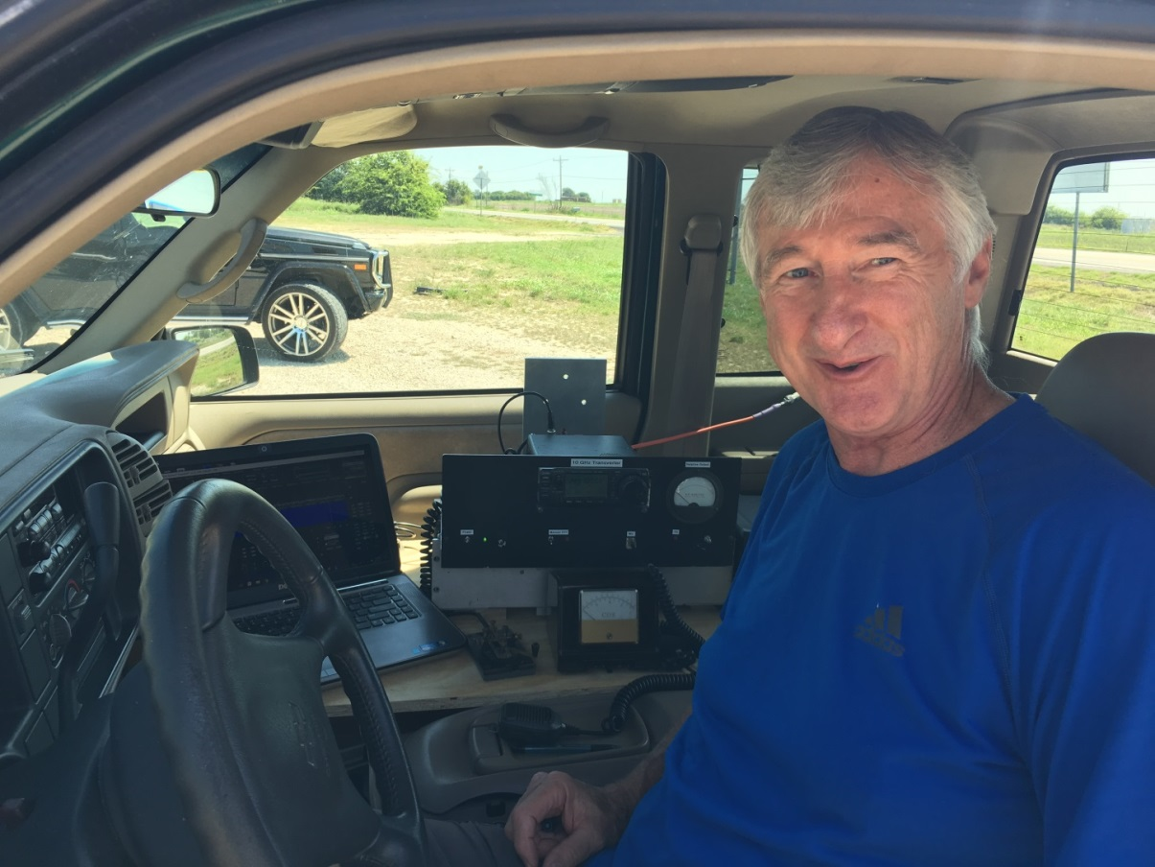
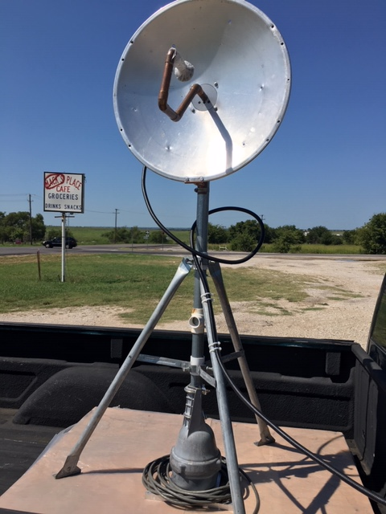
WA5YWC (sk) in 2019 ARRL 10GHz Contest
Operating position in cab of truck
2 ft prime focus dish in bed of truck
November 21, 1944 – October 21, 2018

Slide 27
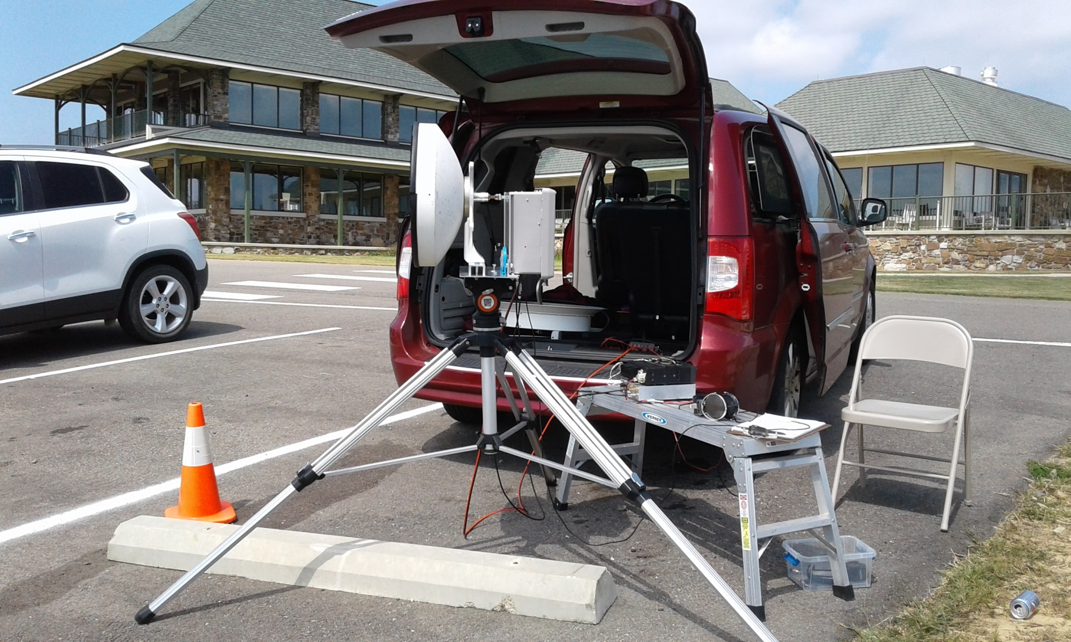
K8ZR/R 24 GHz EM24tq
Sept 16, 2017

Slide 28
NTMS 10 GHz and up contest results 2022
10 GHz
Call | Score
WB5ZDP | 12,835
W5VY/R | 6,116
K5LLL | 2,558
WA5TKU | 2,467
10 GHz and up
Call | Score
WQ5S/R | 25,532
W5LUA | 13,516
AA5C | 12,026
AA5AM | 9,802
KM5PO/R | 9,295

Slide 29
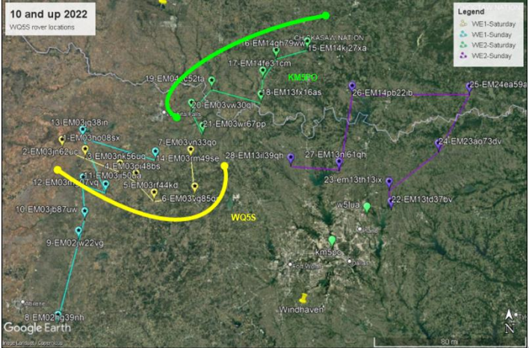
WQ5S/KI5EMN/KM5PO

Slide 30
WQ5S/R 10 GHz and up contest results
10 Ghz-147 QSOs
1000 - Points for Unique Calls
24251 - DX points
25251 – 10 GHz points
24 GHz- 10 QSOs
300 - Points for Unique Calls
347 – DX points
647 – 24 GHz Points
Total Score submitted 25,898!

Slide 31
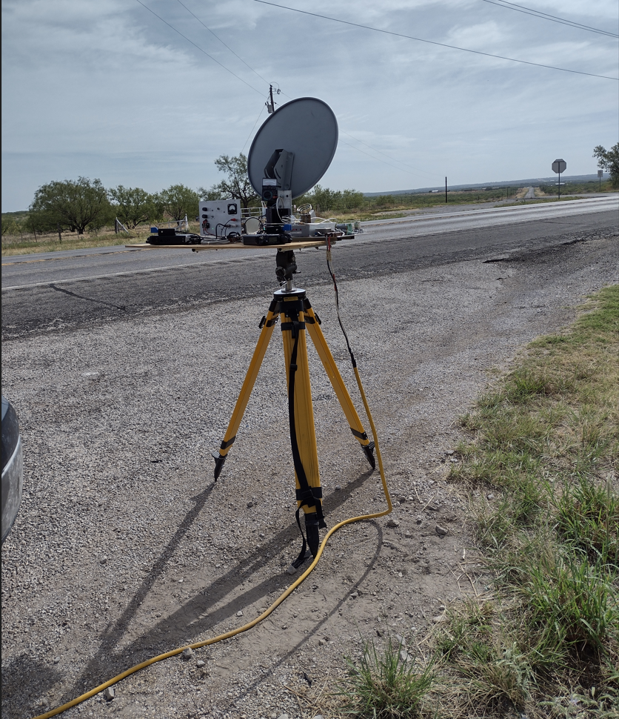
WQ5S 10/24 GHz Rover 10 GHz and up contest

Slide 32
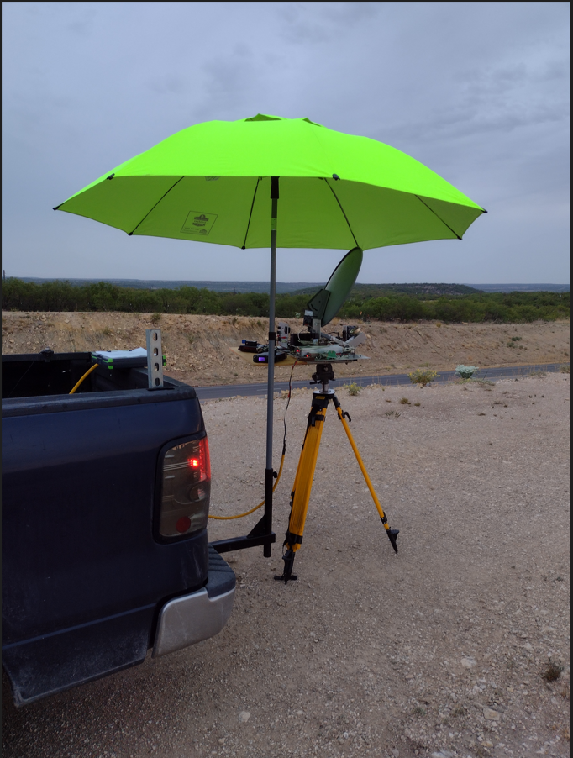
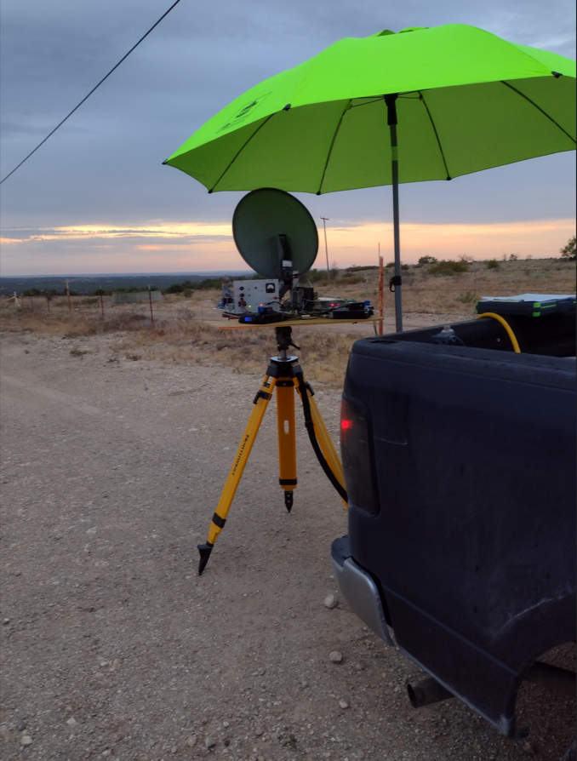
WQ5S working rainscatter 10 GHz & up contest

Slide 33
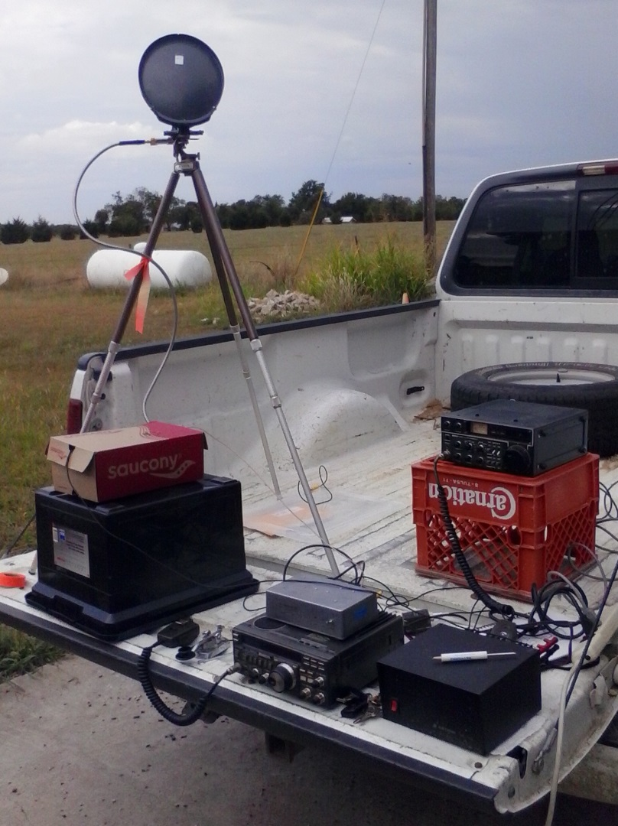
Initial AA5AM 10 GHz Success
Double Balanced Mixer and 8 inch offset fed dish
W5LUA worked at 13 miles
Scott also heard W5RLG at 68 miles
And N5WCO at 56 miles
Scott has since improved his station to a larger dish plus 1watt PA and LNA

Slide 34
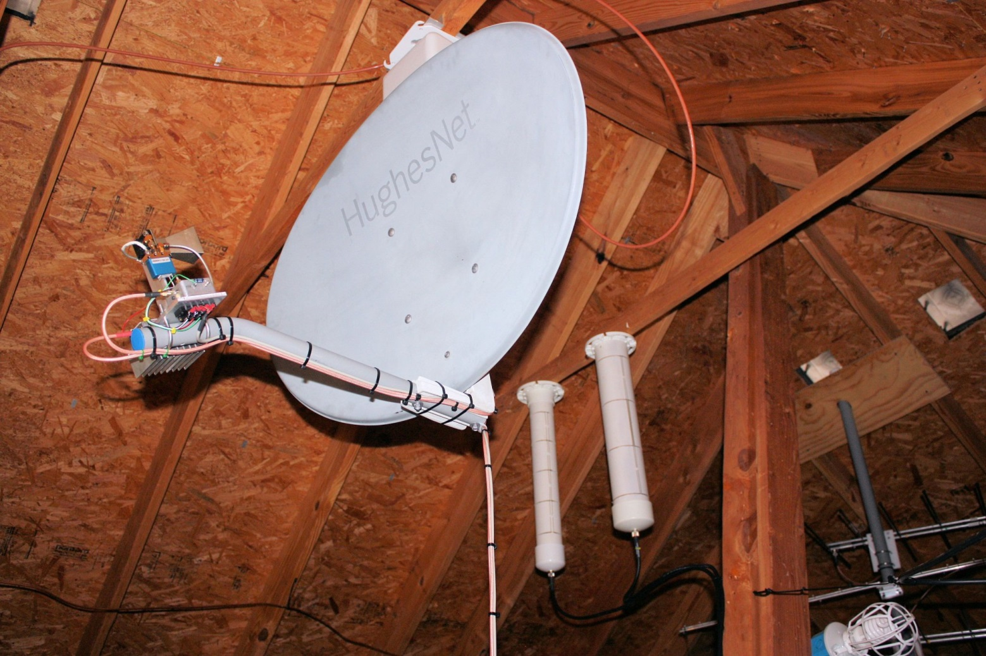
K5TRA’s Attic 10 GHz Antenna
W5LUA worked K5TRA on 10 GHz at a distance of over 200 miles

Slide 35
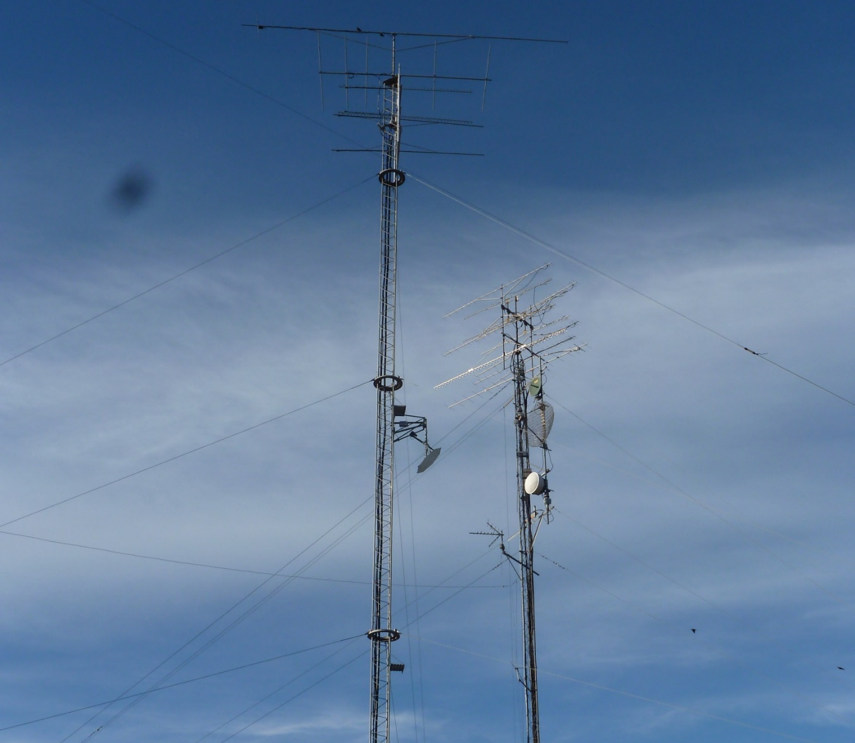
Flyswatter at W5LUA

Slide 36
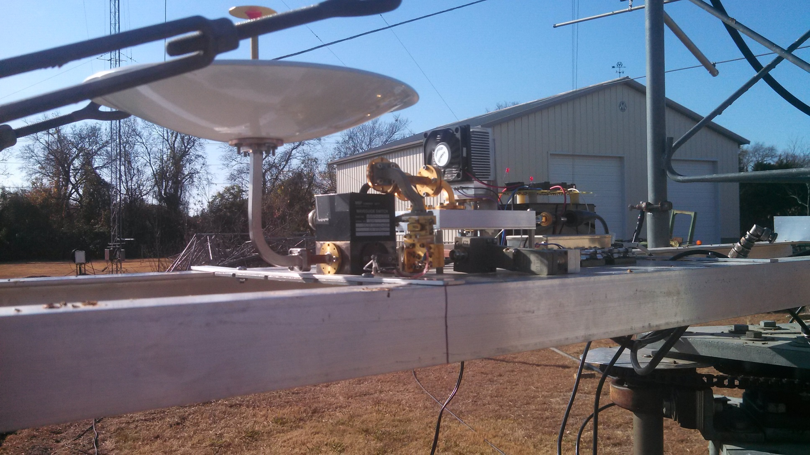
Lower table with 47 GHz XVTR

Slide 37
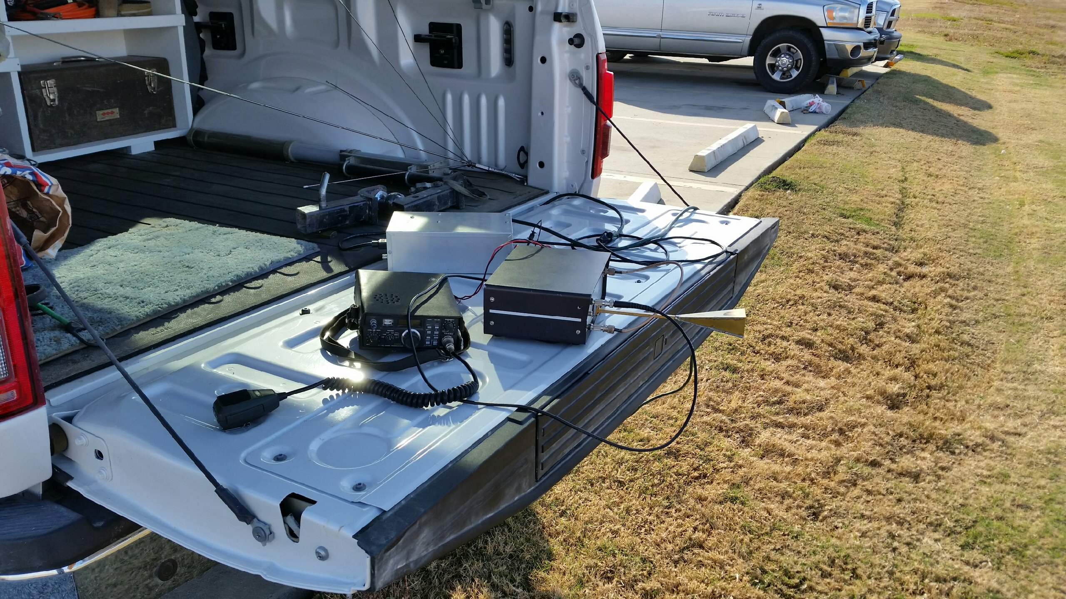
AA5AM/R Beacon Rig at 47088.1 MHz
Pout = -7 dBm (200 uW)
Ant G = 15 dBi

Slide 38
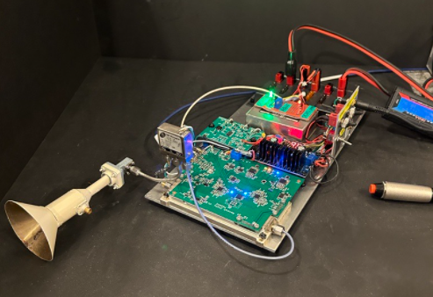
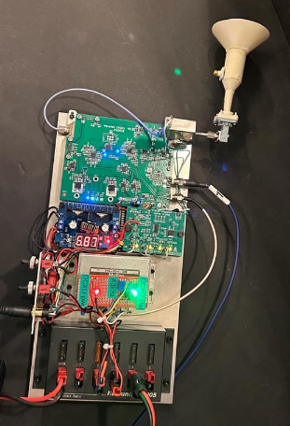
24 GHz system Jan ‘23 – Wavelab module & add-on board
NTMS group buy of 20 PCB boards manufactured in China.
Project described in article at www.ntms.org under “@ The Meetings” then under “December 2022” and then “2022 KM5PO Wavelab 23 GHz”

Slide 39
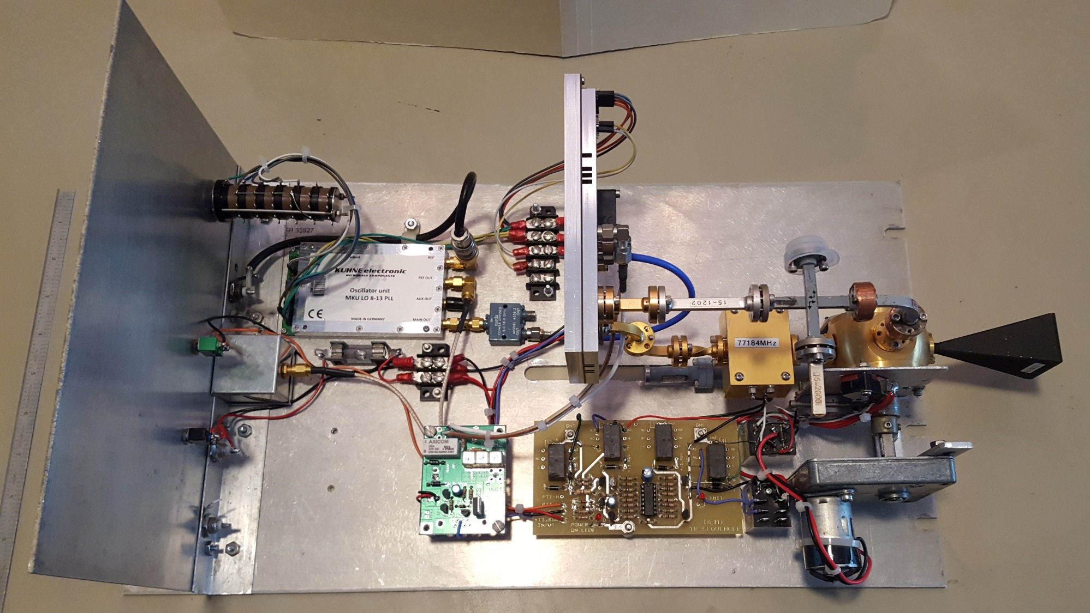
W5LUA 76 GHz Transverter using DB6NT MKU 76 G2 Transverter & WA1MBA LNA
NF = 4.7 dB
Pout = 275 mW
173 W EIRP
US stations are limited to 315 W EIRP
1.4” X 1.1” Horn
G ~ 28 dBi
3dB BW ~ 7 deg
Transverter described in article at www.ntms.org under “Knowledge Base” then under “Tech Library” and then “Millimeter Wave”

Slide 40
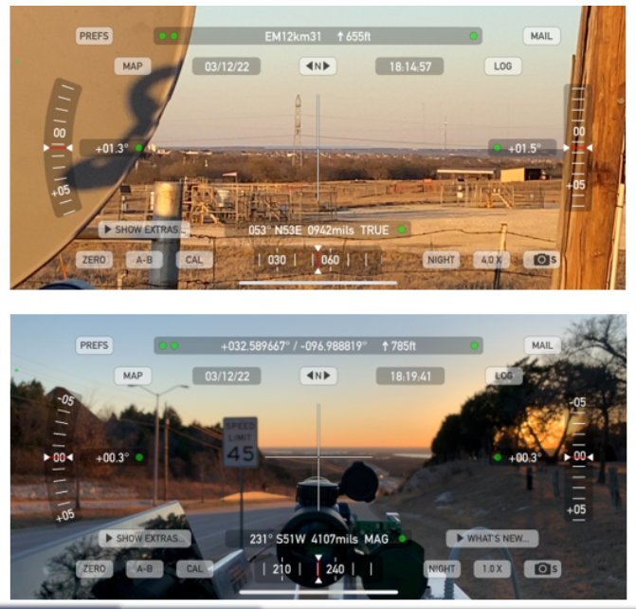
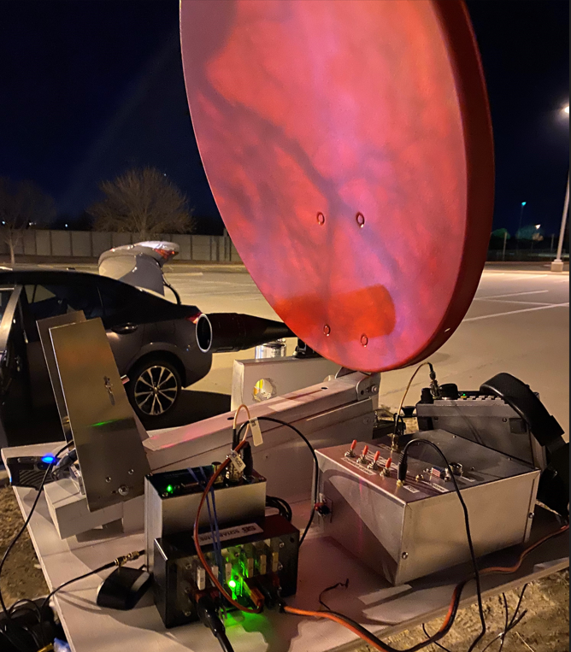
122 GHz from Cedar Hill to Alvarado – 17 km
Strong signals – ½ milliwatt & conical horn & Chapparal feed/2 foot dish

Slide 41

Questions?

