Slide 1
FTDI vs Prolific USB Serial Adapter
By
Wes Atchison
WA5TKU

Slide 2
Experience
Interference
  144.150 MHz – MSK144
  144.147 MHz – FT8
Surprise Outcome of Swap

Slide 3
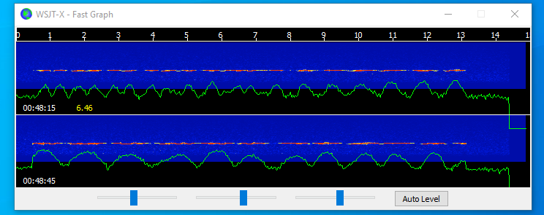
Prolific Chip Cable
144.150 MHz – MSK144 Interference

Slide 4
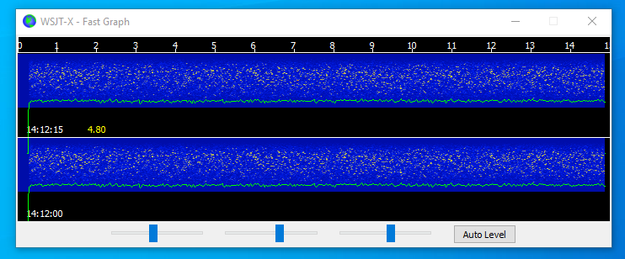
FDTI Chip Cable
Very low level trace still there

Slide 5
USB Serial Cable Problem
Since changing to a Windows 10 computer I have had problems with USB Serial adapters stopping working.
My solution was to close WSJT-X and power down and disconnect cables and USB Powered Hub.
This would work for a while but would happen again

Slide 6
Surprise Solution
Since change to the FTDI chip USB Serial cables the problem has gone away.
Not sure why but Happy it happened

Slide 7
Follow Up
Stay away from Prolific chip serial cables
Further investigation of interference problems generated by FDTI chip
  Have not searched for any additional problems

