Slide 1
122 GHz Update
W5LUA
March 7, 2020

Slide 2
ARRL News Reports New World Distance Record on 122 GHz
12F
60F

Slide 3
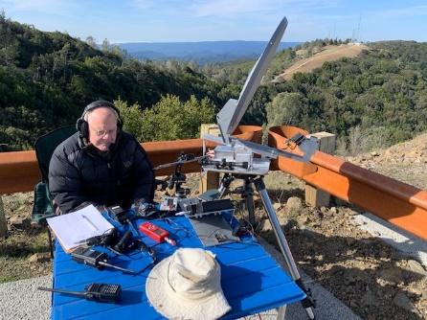
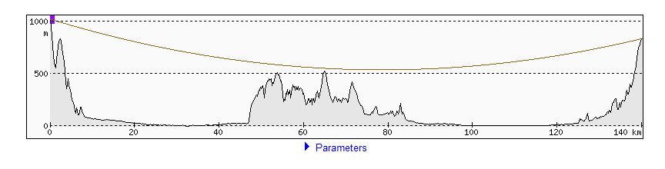
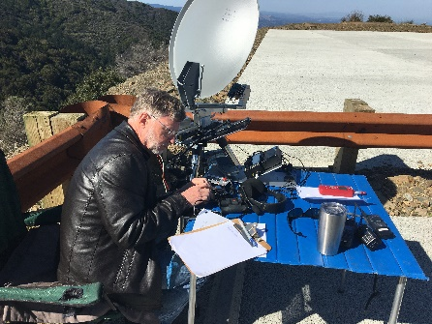
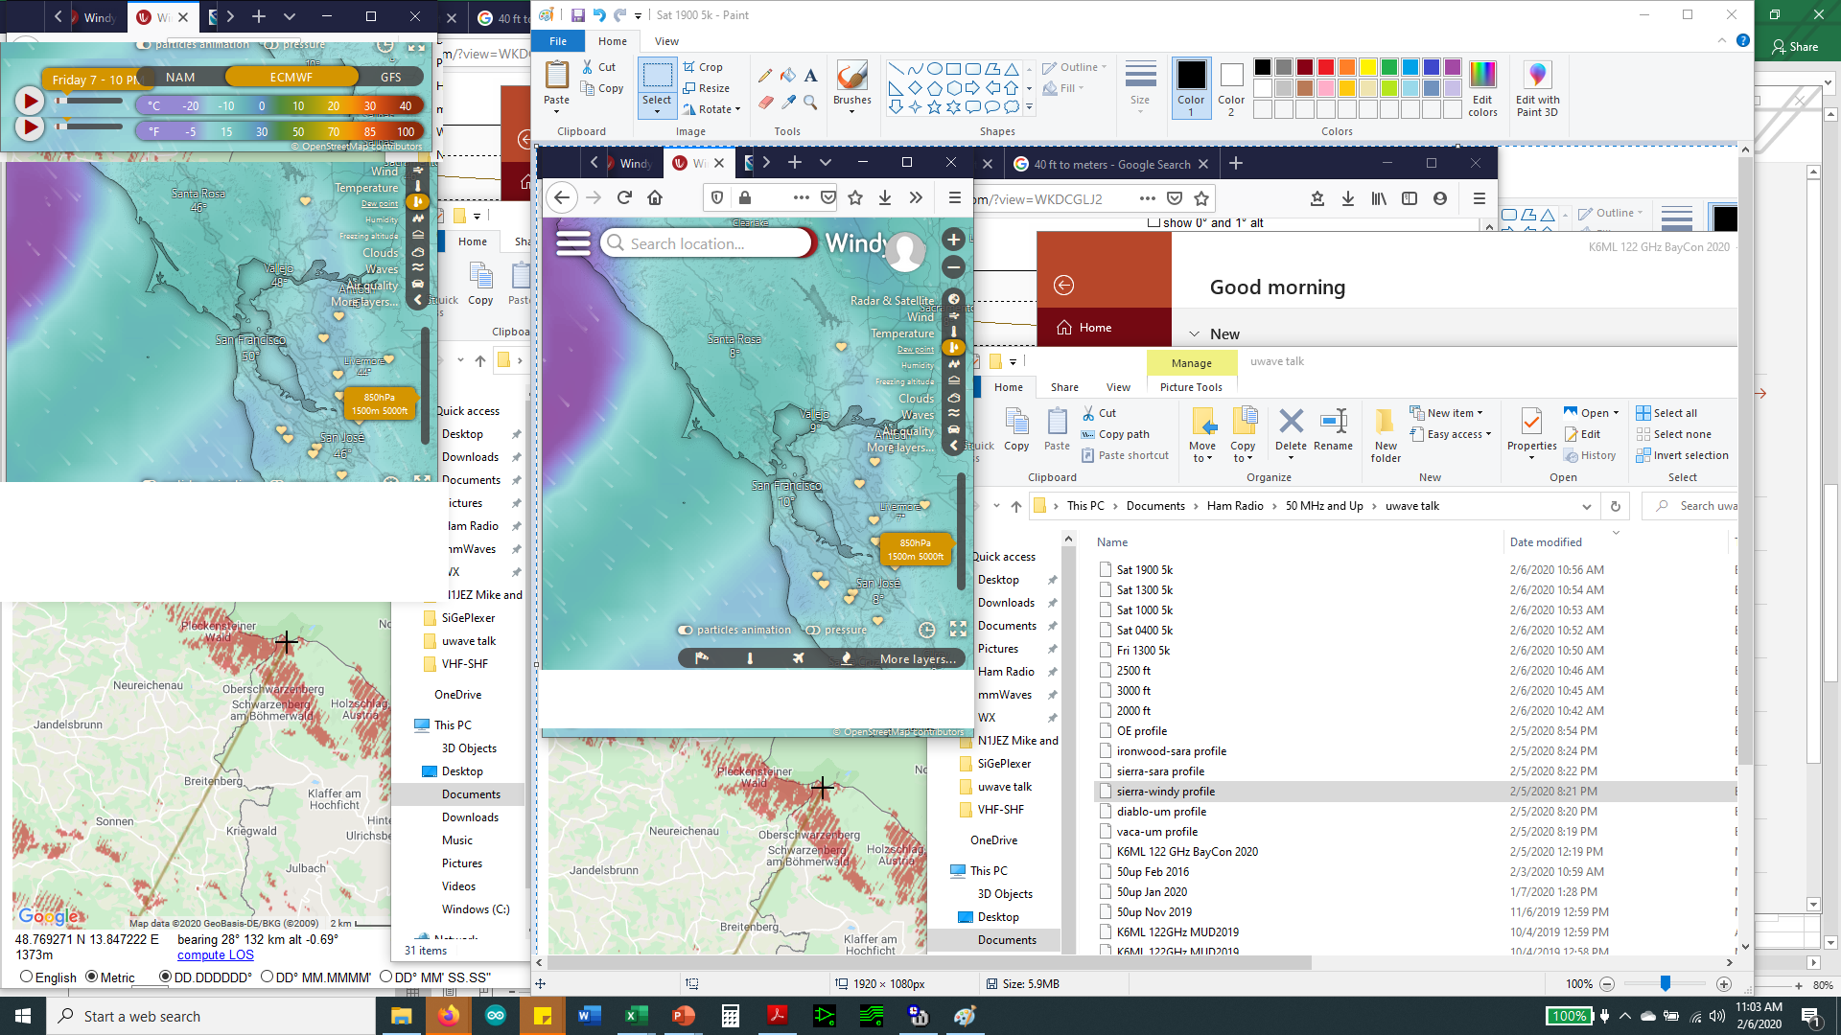
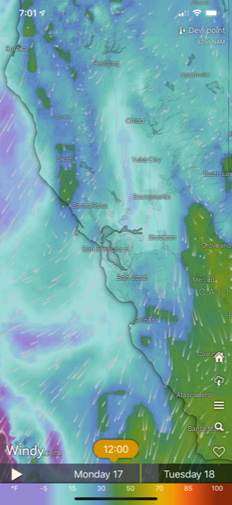


139km on 122 GHz
  K6ML on Mt Vaca / KB6BA & N9JIM on Mt Umunhum, 2/17/20
  -11C dew / +15C air / ~225 dB path loss (includes 8 “S” units atmospheric loss)
  +7 dB SNR (22 Hz) / -13 dB SNR (2500 Hz)
Vaca from Um, note clouds below the path
Path & dew point forecast @ QSO time
Umunhum seen from Vaca,
foreground ridge/bump is midpath point

Slide 4
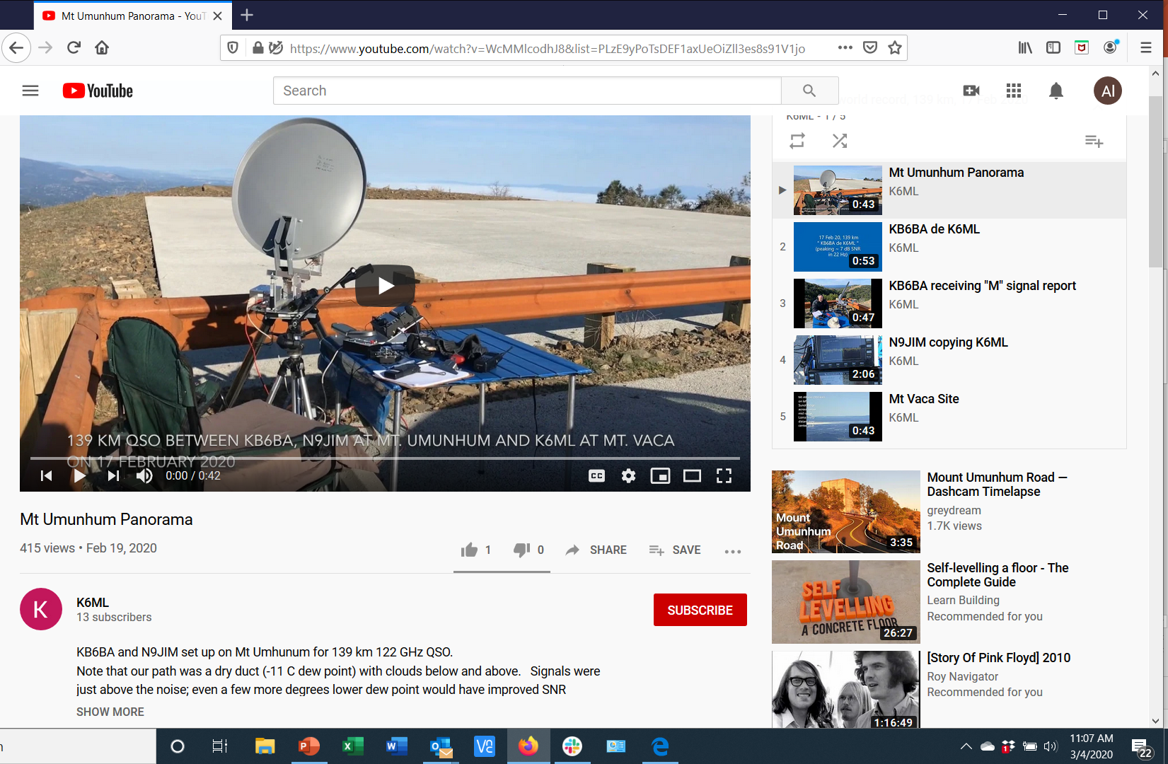
https://www.youtube.com/playlist?list=PLzE9yPoTsDEF1axUeOiZll3es8s91V1jo

Slide 5
The 122GProject@groups.io
Update #16 Feb 21, 2020
Hi all,
I've been in contact with our Chinese manufacturers again to get some sort of ETA.
The PCB guys tell me that production samples should ship to us on or about March 10th.
The CNC guys tell me that they still cant get to their factory until Monday 24th February, but should have new pre-production samples of the horns on their way to us so after that.
Th rest then depends on the couriers being able to get everything out of China in a timely manner.
Hopefully they'll be able to get on top of the situation and life will return to normal.
regards
Tim
--
VK2XAX : QF56if : ITU59 : CQ30 : BMARC : WIA

Slide 6
Update by Tim Tuck
March 6, 2020 11:40PM
Our PCB manufacturer is shipping the first part of our order of the blank PCB's, to us right now.
The shipment is coming via FEDEX and it is currently in Hangzhou, China.
The FEDEX statement on Coronavirus can be found here...
https://about.van.fedex.com/newsroom/coronavirus/
FEDEX indicate I should receive the shipment next Tuesday. I'll post a notification and pics once I have it in hand.
We will also check the PCBs' to make sure they are what we expect.
Along with the shipment of blank PCBs' will come two fully assembled units for us to test.
Provided the assembled units pass muster we will instruct them to make the rest.
I will sort the orders to find any that have orders for PCB only and didn't order horns and are not part of a group and start the process of packaging and notifying people of the individual postage charges once I have the individual items packed & weighed.
Once people have paid their postage I will ship the PCB's ASAP.
regards
Tim

Slide 7
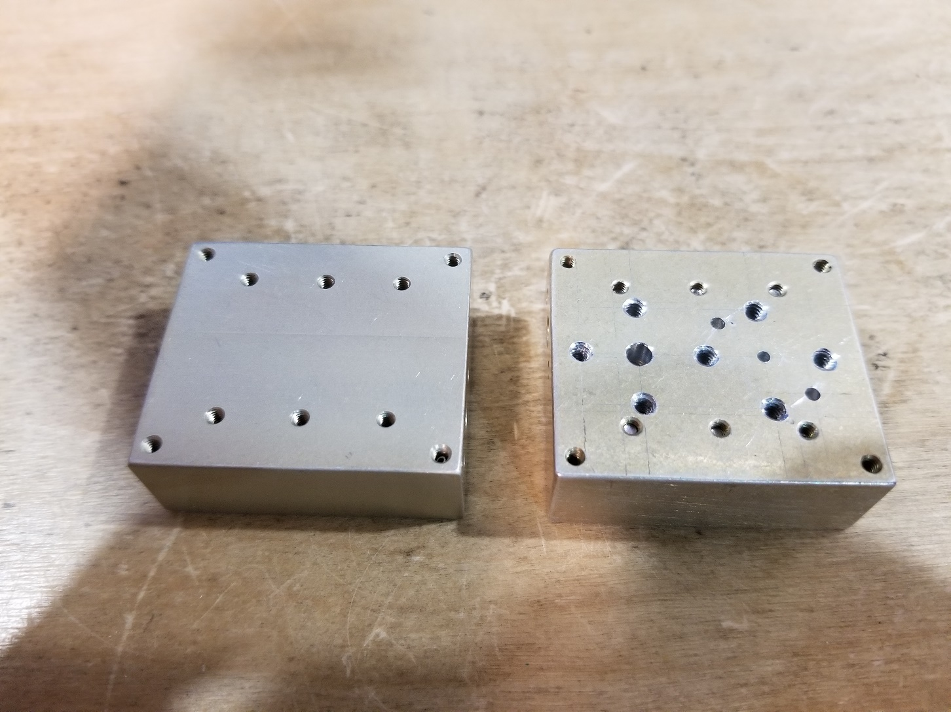
Drilling Housing for WR-12 and WR-06 Waveguide Flanges

Slide 8
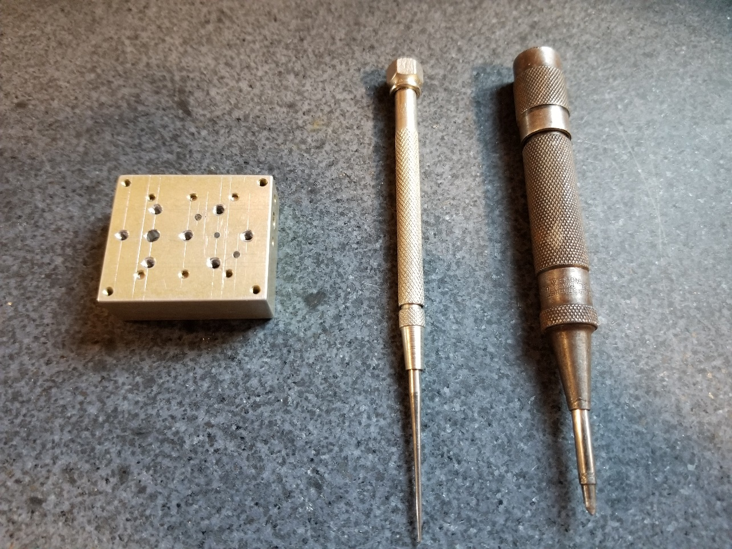
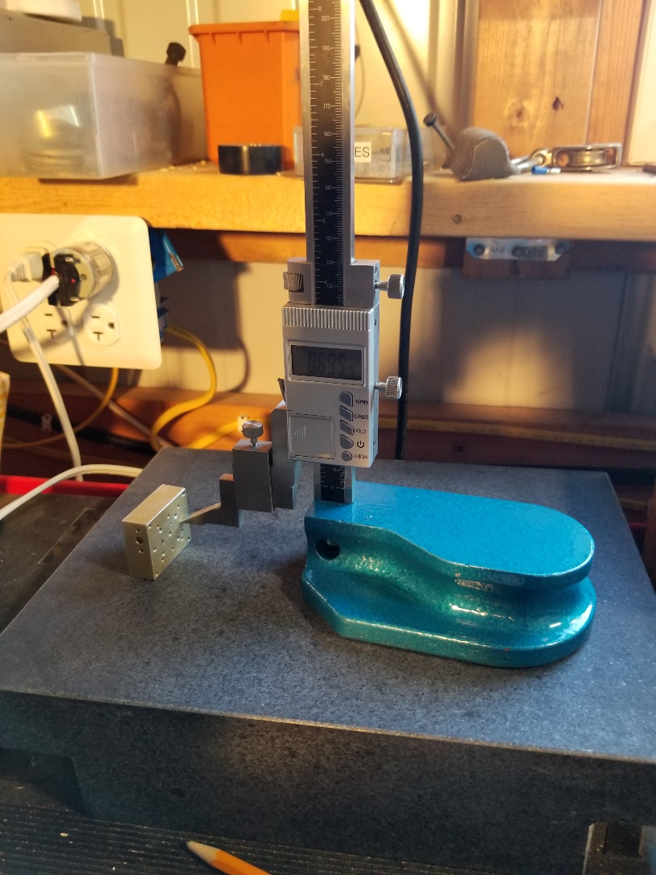
Using Granite Surface Plate and Digital Height Gage to scribe lines

Slide 9
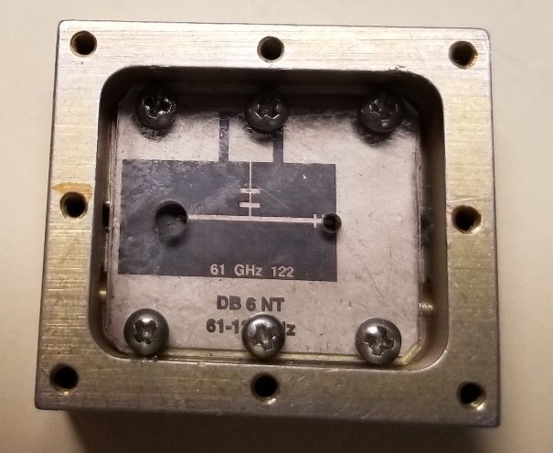
DB6NT 122 GHz Mixer PCB
Piece of acrylic plastic drilled to match holes in housing
Provides a drilling template for pcb and
will be used to apply pressure on board when silver
epoxying board into place
Next step is to make backshorts for LO and RF ports

