Slide 1
78 GHz on Lake Erie
W5LUA
March 7, 2020

Slide 2
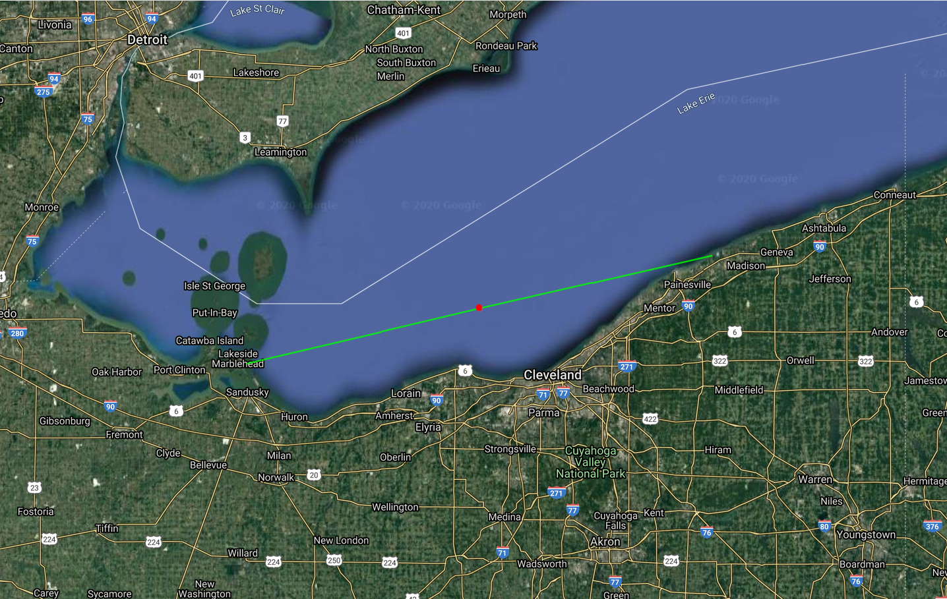
KB8VAO EN81pm46lk
K8ZR EN91kt00ix – DX 132.2 km
12F
60F
https://k7fry.com/grid/

Slide 3
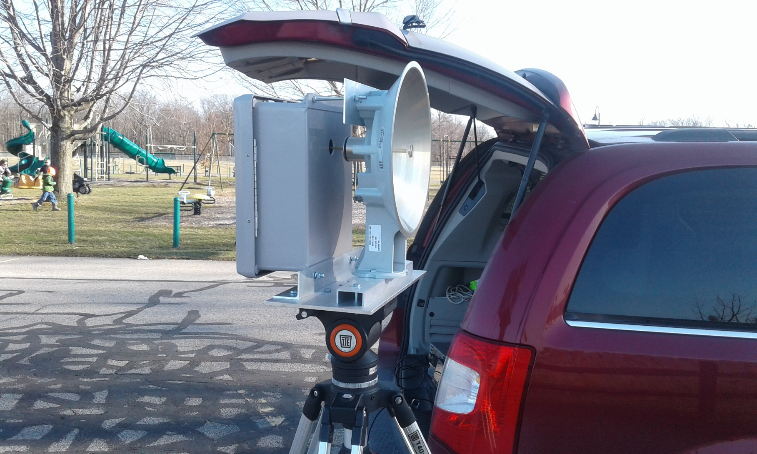
K8ZR 76GHZ Rig

Slide 4
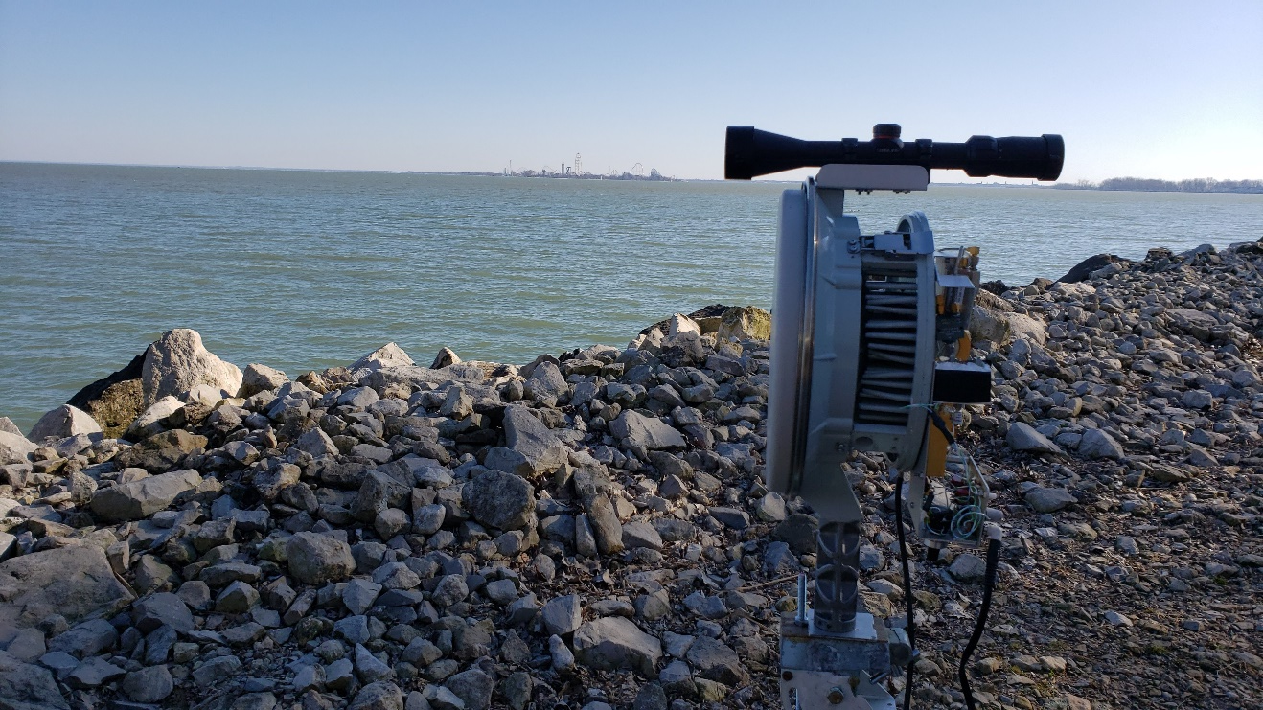
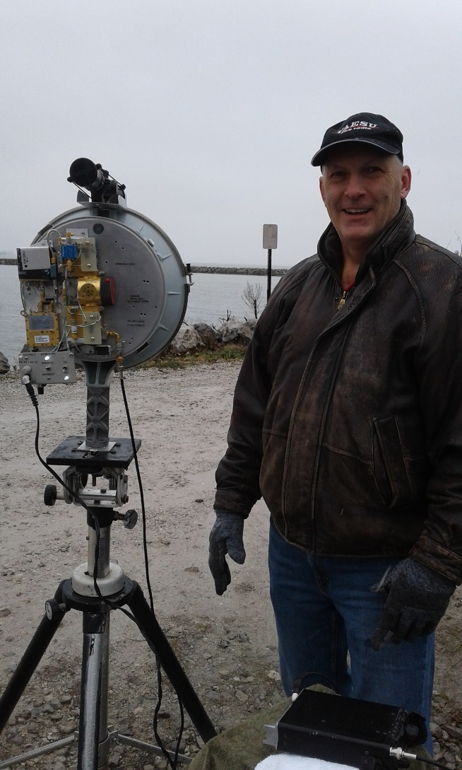
KB8VAO 76 GHz Rig

