Slide 1
NTMS Proposed Schedule
Month | Topic | Events
April
May | SDR | Sprints
June | Hamcom | VHF Contest
July | 10 GHz Test Set Up
August |  | 10 GHz Contest, UHF Cotest
September |  | VHF Contest, 2nd half 10 GHz
October | Antennas | Antenna
November
December | Elections
January | FT Worth Hamfest | VHF Contest
 | SDR Update
 | RPi

Slide 2
Oscillators
March 7, 2020
Chuck Clark AF8Z

Slide 3
Oscillator Charasitics
Stable….Don’t change with time, or environment.
  Measured in parts per million, or parts per billion.
  Short term
  Long term Allan Variance.
Accurate.
  Tolerance
  Is Accuracy NEEDED today?

Slide 4
Oscillator Applications….NTMS
Up/down conversion from a higher frequency.
Clock for our ADC/DAC in our SDR’s

Slide 5
10 GHz Example
10224 MHz…..102.24 MHz 7th Overtone, multiplied by 100
    Or maybe 71 MHz.
Lots of combinations but you need to keep harmonics of all the multipliers out of the 10368 MHz band.
Need a custom crystal supplier.
Each one is unique…not temperature compensated. We could couple in a Thermistor and a varactor to try to get temperature effects reduced. This could be a lot of trial and error.

Slide 6
“Modern” Approach
Use a ADF5355 or LMX2595 PLL with integrated VCO
Double VCO, Fewer spurs….
Many possible reference oscillators, TCXO, VCTCXO, OCXO.
Absolute frequency reference nice but not required.
  Fractional modulus 274,877,906,944 2³⁸
  That means 19.44*10⁶/2³⁸ 1.1587143 Hz steps, Hint ADIsimPLL
Control with Rpi Zero or Ardunio.
Major problem…..how to solder at home.

Slide 7
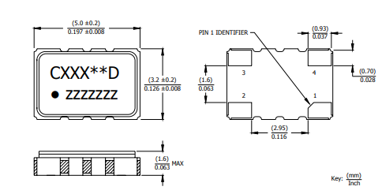
Available reference Oscillators
TCXO
CTS 520L15IA38M4000 38.4 MHz, 3.3V $3.28 single lot Mouser
CTS520L15IA19M2000 19.2 MHz, 3.3V $3.28 +/-1.5ppm -40-+85C
  +/- 15.6 kHz at 10 GHz

Slide 8
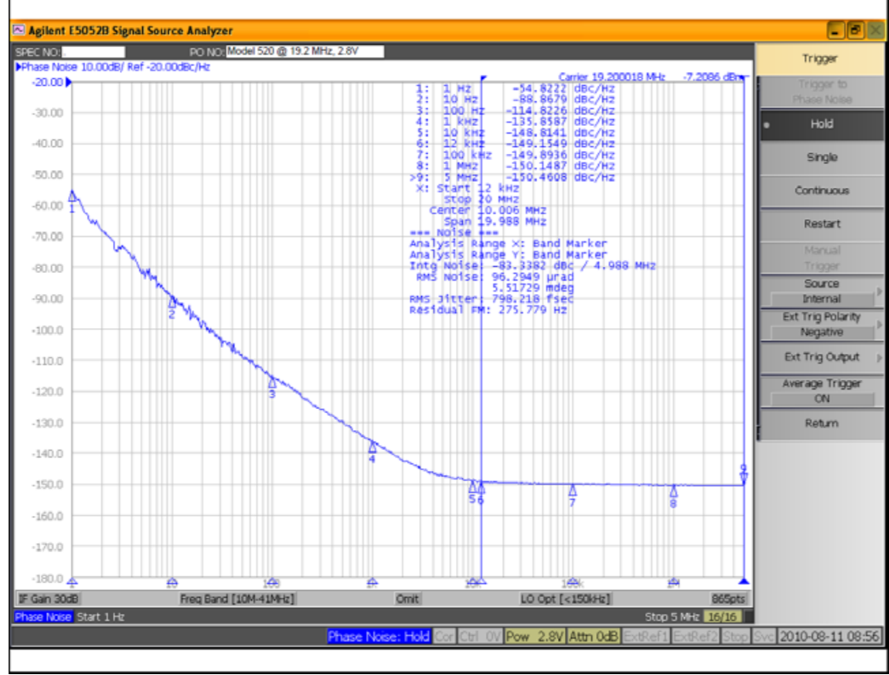

Slide 9
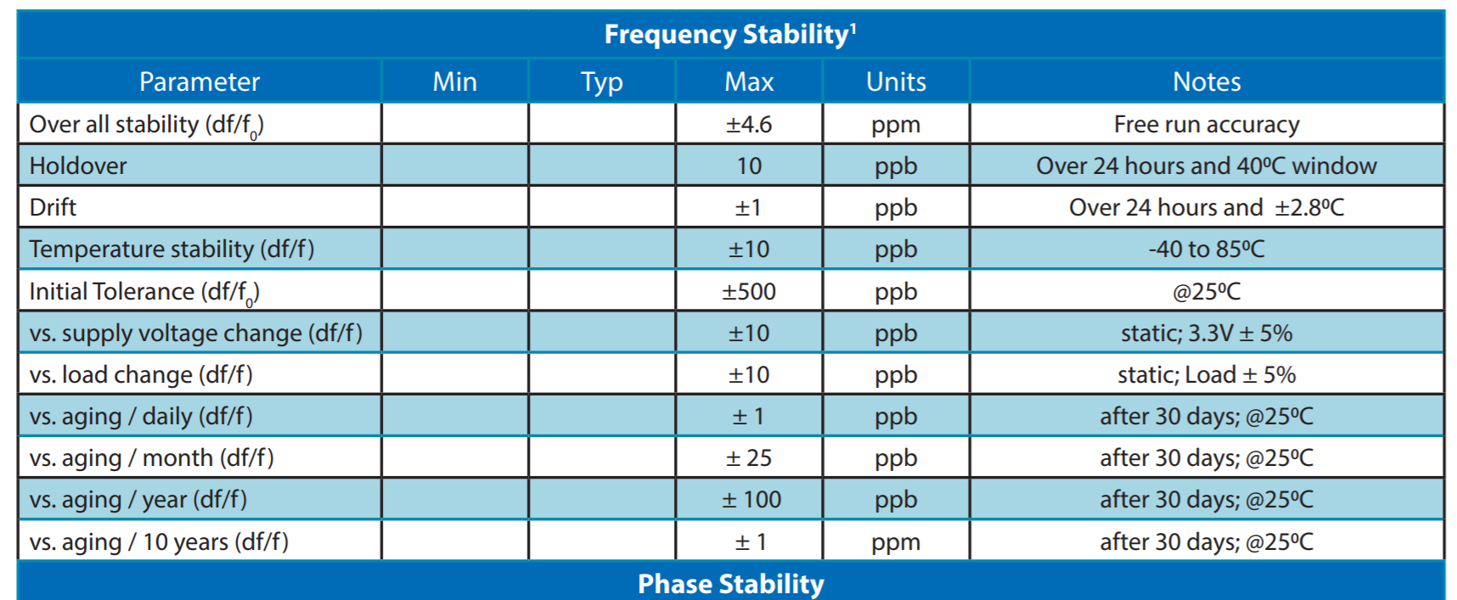
Ovenized…
Abracom AOC2021XAJC-19.44, 10ppb, -20 to 70C $72.33
Microchip(Vectron) OX-511-EAE-2080-25M00 25 MHz, 20ppb $58.82
  207 Hz @10368MHz

Slide 10
