Slide 1
Urban 10GHz DXing
Chris Cox, NØUK

Slide 2
Urban 10GHz DXing?
You must be joking!

Slide 3
No, not joking!
What do you need?

Slide 4
Equipment
Typical “Rover” station
VHF multi-mode I/F rig: FT-817, IC-705, KX-3, etc.
Modern Transverter: Downeast (US), Kuhne (Eu)
Small dish: Sat TV offset feed or surplus commercial
Sturdy tripod
Compass: you need to point accurately

Slide 5
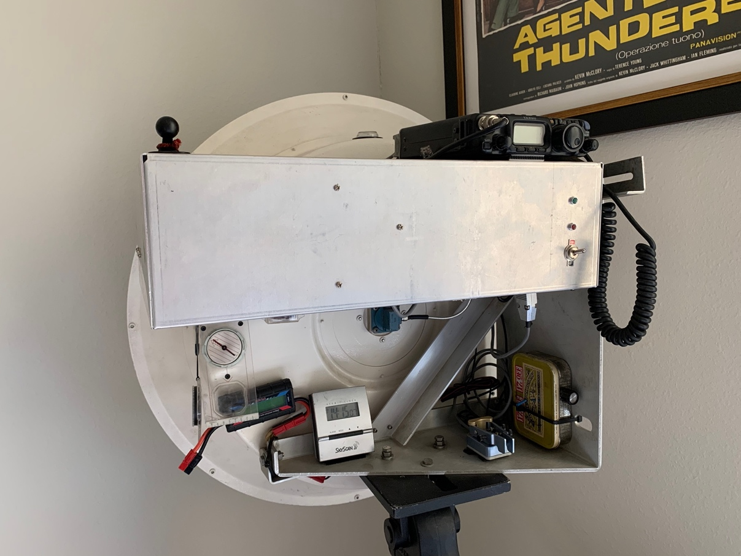
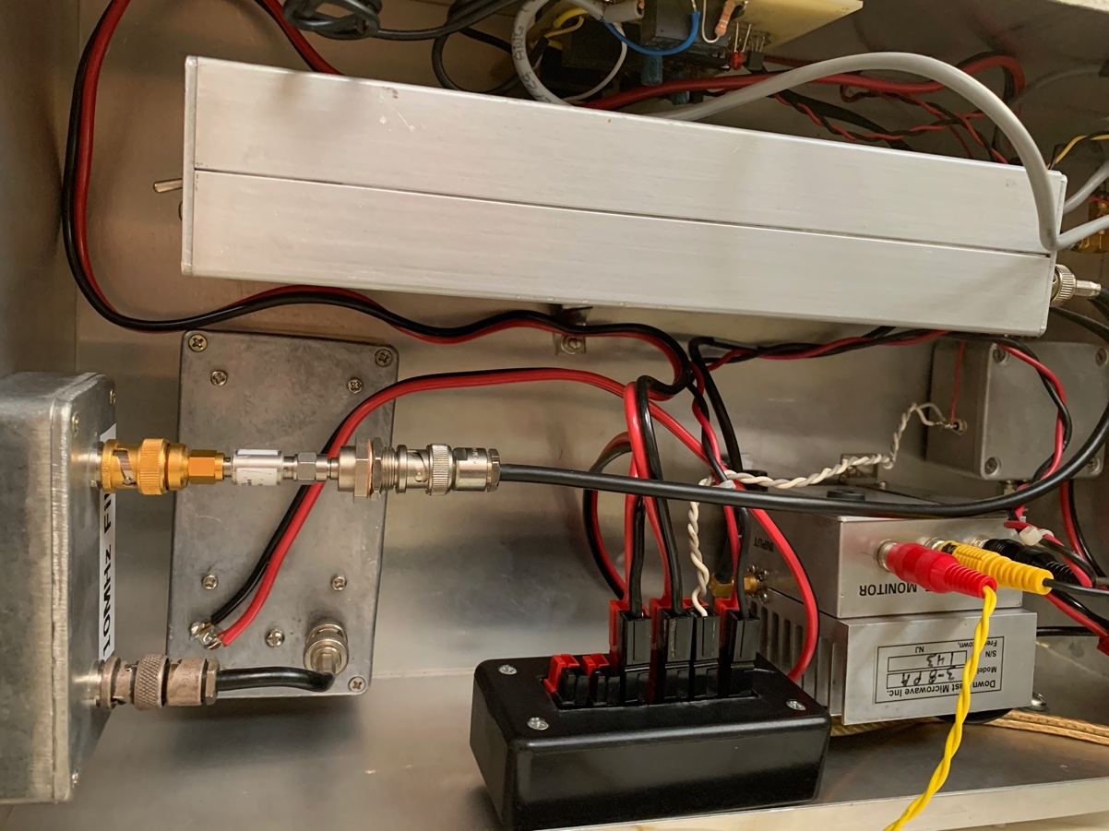
Rover Rig

Slide 6
No, not joking!
What do you need?
Where do you need to be?

Slide 7
No, not joking!
What do you need?
Where do you need to be?
  View from the hood.

Slide 8
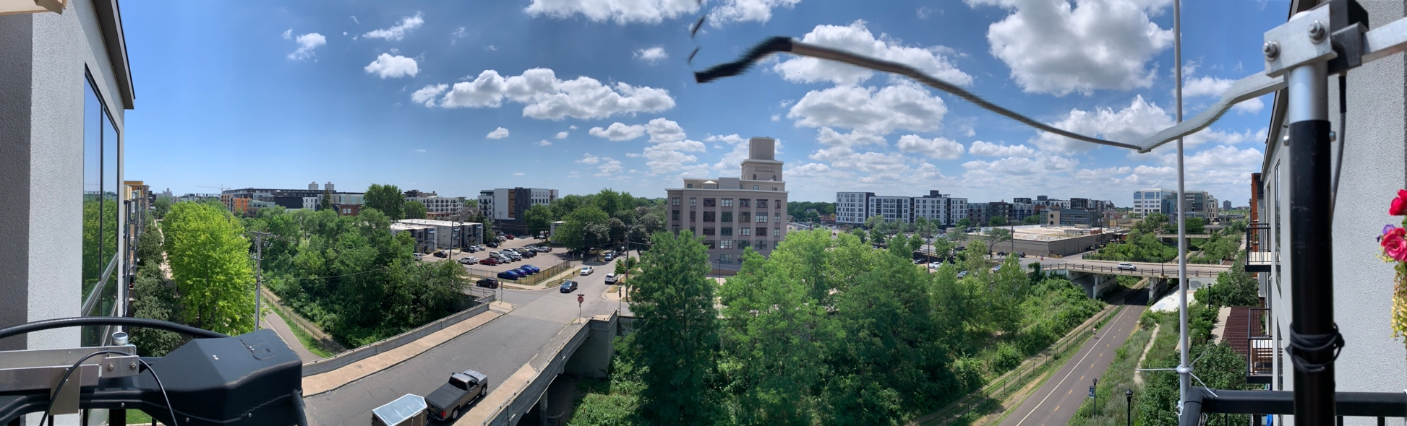
East to West Balcony Panoramic view

Slide 9
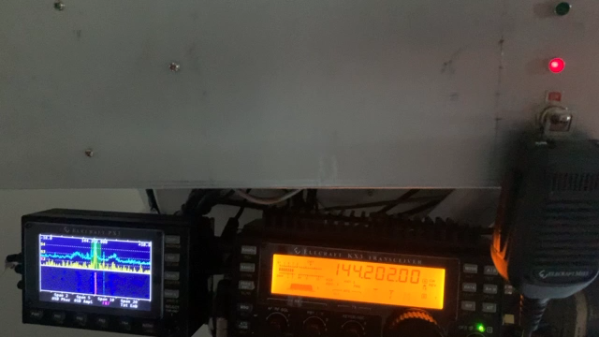
From inside the shack

Slide 10
No, not joking!
What do you need?
Where do you need to be?
What are realistic DX expectations?

Slide 11
Grids worked so far

Slide 12
Propagation modes
Line-of-sight
Troposcatter
Rainscatter/Snowscatter
Aircraft scatter

Slide 13
Propagation
The two chief mechanisms for working DX on 10GHz are:
Troposcatter (Tropo). Most of my grids have been worked via tropo. Most prevalent during the warm, Summer months and typically capable of supporting distances of two to three hundred kilometres although varies throughout the day.
Rainscatter. The wavelength at 10GHz is small and water droplets become a significant size relatively causing signals to get scattered at higher elevations and making those signals then readable over extended distances. Weather radar uses this medium to map weather systems.
Each of my longest contacts have been as a result of rainscatter propagation. Notables include:
N8PUM EN66dl 467km
K9JK/R EN51xr 554km
K2YAZ EN74av 578km
N0OY EM18ct 775km
And…

Slide 14

“I love it when a plan comes together” – Hannibal Smith
Partially obstructed view from Uptown Minneapolis looking south-east towards W8BYA in EN70jt at 802km.
The direct path is between the two tower blocks on the horizon at the left.

